Slide 1
Education Half Day CCG Update
Thursday, 20 September 2018

Slide 2
Dementia Update
Dr Sophie Norris

Slide 3
Advice and Guidance Update
The following table shows the specialties that are available at ASPH, RSCH or at other providers
The table also shows the response times for the specialties live at RSCH

Slide 4
Advice and Guidance Specialties | ASPH Status | RSCH Status | Other | Average response days at RSCH
Allergy | Not available | LIVE |  | 2
Audiology | LIVE | Not available
Cardiology | LIVE | LIVE |  | 2
Children’s & Adolescent Services (Paediatrics at ASPH) | LIVE | LIVE |  | 2
Dermatology | LIVE | Not available | SUSPENDED
Diabetic Medicine | LIVE | LIVE |  | 3
Dietetics | LIVE | Not available
Endocrinology & Metabolic Medicine | LIVE | LIVE |  | 3
ENT | LIVE | LIVE |  | 4
Geriatric Medicine | LIVE | LIVE |  | 3
GI and Liver (Medicine and Surgery)/Gastroenterology (Gastroenterology, Upper GI Surgery or Colorectal Surgery at ASPH or General Surgery at RSCH) | LIVE | LIVE |  | 3
Gynaecology | LIVE | LIVE |  | 3
Haematology (Clinical Haematology at ASPH) | SUSPENDED | LIVE |  | 1
Immunology | Not available | LIVE |  | Not yet used
Mental Health | Not available | Not available | Investigating
Neurology | LIVE | LIVE |  | 3
Ophthalmology | LIVE | LIVE |  | 3
Oral & Maxillofacial Surgery | LIVE | LIVE |  | 6
Orthopaedics (Trauma and Orthopaedics at ASPH) | LIVE | LIVE |  | 2
Pain Management | LIVE | LIVE |  | 4
Physiotherapy | Not available | LIVE |  | Not yet used
Respiratory Medicine | LIVE | LIVE |  | 4
Rheumatology | LIVE | LIVE |  | 2
Sleep Medicine | Not available | LIVE |  | Not yet used
Surgery – Breast | LIVE | LIVE |  | 3
Surgery – Not Otherwise Specified | LIVE | LIVE |  | 3
Urology | LIVE | LIVE |  | 3
Vascular Surgery | LIVE | Not available
Plastics | Not available | Not available
Renal/Nephrology | Not available | Not available | Investigating
Shaping healthcare for you … and your family

Slide 5
Cancer and End of Life Care Update
Shaping healthcare for you … and your family

Slide 6
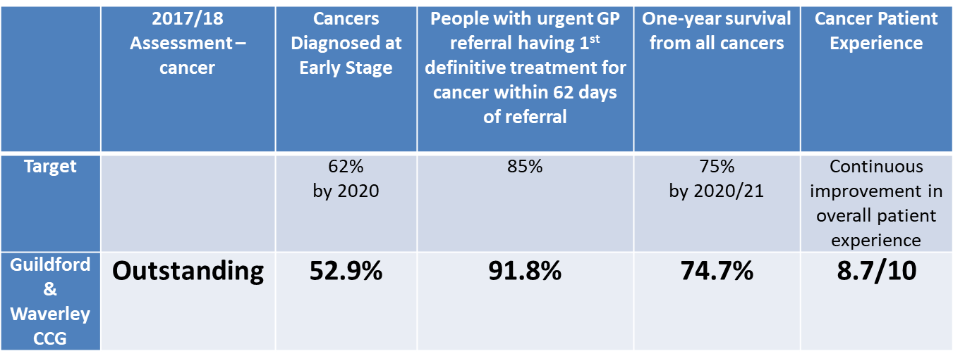
CCG Cancer Integrated Assessment Framework (IAF) Rating
CCG rating provides a snapshot of how performance on cancer compares with other CCGs, and whether the CCG is meeting national ambitions.
Thank you for all you do to achieve early diagnosis, and support people living with and beyond cancer in Guildford & Waverley.

Slide 7
Cancer – education opportunities & support
Royal Surrey’s Macmillan Practice Educators’ learning and development offer includes:
Training courses e.g. cancer awareness programme, sage and thyme
Oncology journal club: Twitter @OncJnlClub
Educational events e.g. breast cancer study day
Contact:
rsc-tr.macmillaneducation@nhs.net
Support and guidance – practice visits, etc
Contact:
Alessandra Dale, Macmillan GP
alessandra.dale@nhs.net
and/or
Debbie Bell, Cancer Research UK Facilitator
debbie.bell@cancer.org.uk

Slide 8
Falls Prevention
A Guildford & Waverley Falls Prevention Pack has been developed for people who have had a fall, are fearful of falling or would like advice on falls prevention
The pack includes information on eating well, Lets Get Steady falls prevention sessions and general advice on falls prevention
The pack will be widely distributed to be handed to to patients

