Slide 1
Diabetes Update and cardiovascular risk assessment

Slide 2
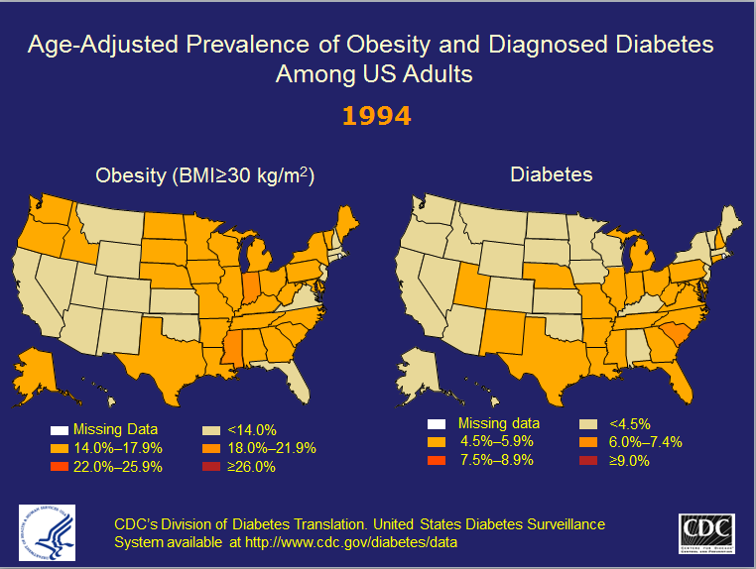

Slide 3
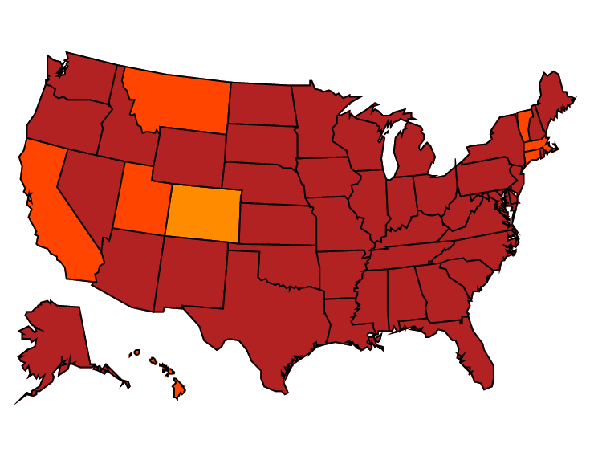
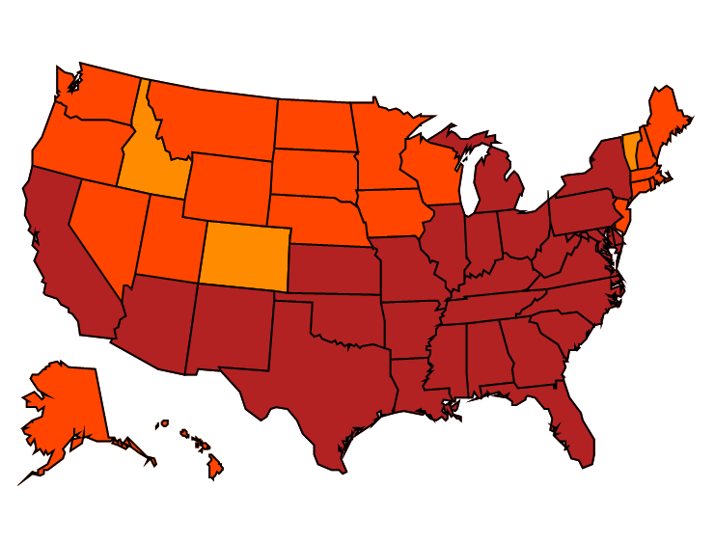


Age-adjusted Prevalence of Obesity and Diagnosed Diabetes Among US Adults
Obesity (BMI ≥30 kg/m²)
1994
2000
2014
No Data <14.0% 14.0%–17.9% 18.0%–21.9% 22.0%–25.9% > 26.0%
Diabetes
1994
2000
2014
No Data <4.5% 4.5%–5.9% 6.0%–7.4% 7.5%–8.9% >9.0%
CDC’s Division of Diabetes Translation. United States Surveillance System available at http://www.cdc.gov/diabetes/data

Slide 5
How do I Diagnose Diabetes?

Slide 6
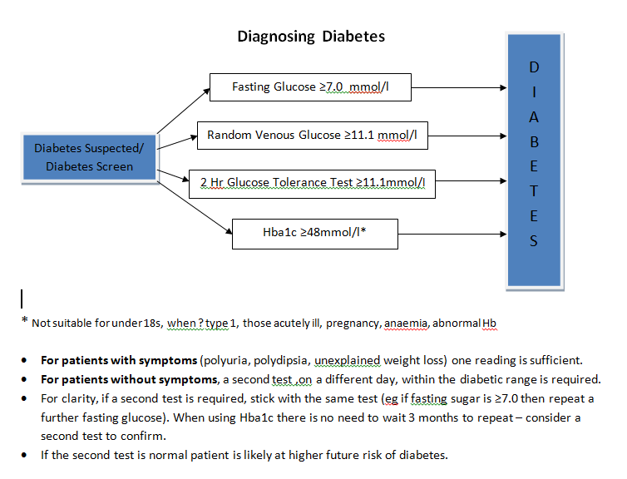

Slide 8
How do I keep perspective in looking after patients with diabetes?

Slide 9
Keeping Perspective
Variable | CHD (fatal and non-fatal MI and sudden death) | Stroke
Cholesterol down 1mmol NNT for 5 years to prevent one event | 59 | 178
BP down by 10/5 mm Hg NNT for 5 years to prevent one event | 62 | 74
Hba1c down by 10 mmol/mol NNT for 5 years to prevent one event | 140 | 768
Intensified glucose lowering in type 2 diabetes - time for a reappraisal J. S. Yudkin & B. Richter & E. A. M. Gale Diabetologia 2010
Age matters – while intensive glucose control may benefit the young, moderate control is sufficient for most patients with later onset diabetes.
“Always hesitate before giving lifestyle advice to someone who has already survived 80 years!”

Slide 10
Perspective Matters
65 year old woman Type 2 diabetes, HbA1c 64mmol/mol on maximal oral Rx.
What are the benefits of starting insulin?

Slide 11
Perspective Matters
65 year old woman Type 2 diabetes, HbA1c 64mmol/mol on maximal oral Rx.
What are the “benefits” of starting insulin?
    4773 daily injections (13 years of treatment) yields 0.4 of a quality adjusted life year.
    366,600 injections (1000 years of treatment) to prevent one (non-fatal) myocardial infarction
    The risk of serious hypoglycaemia would be increased with insulin by 5% per year.

Slide 12
Diabetes Treatments
Meet the Players….

Slide 13
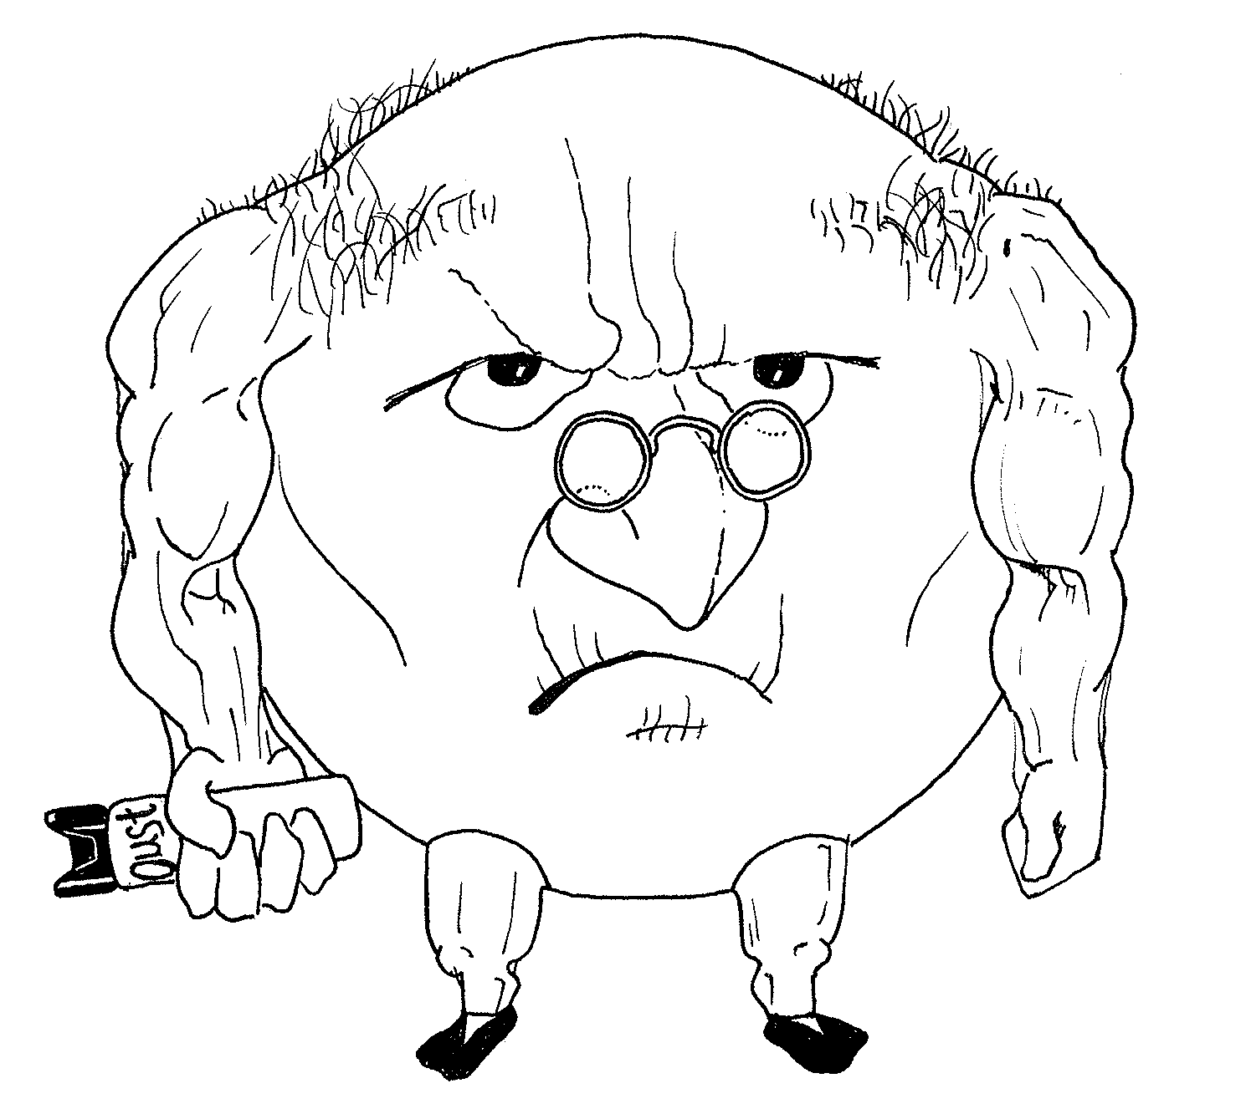

Metformin Biguanide
PPM £3.20
eGFR<30

Slide 14
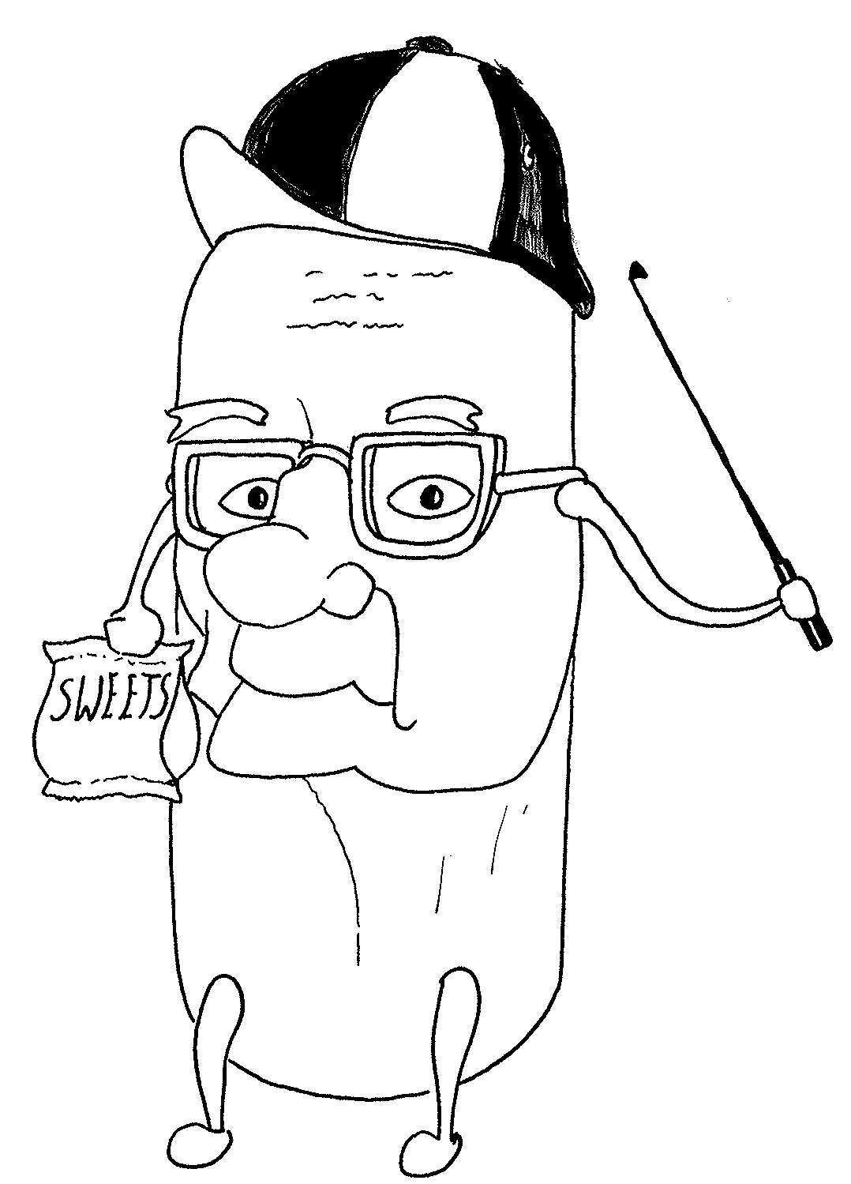
Gliclazide Sulfonylurea
PPM £3.20

Slide 15
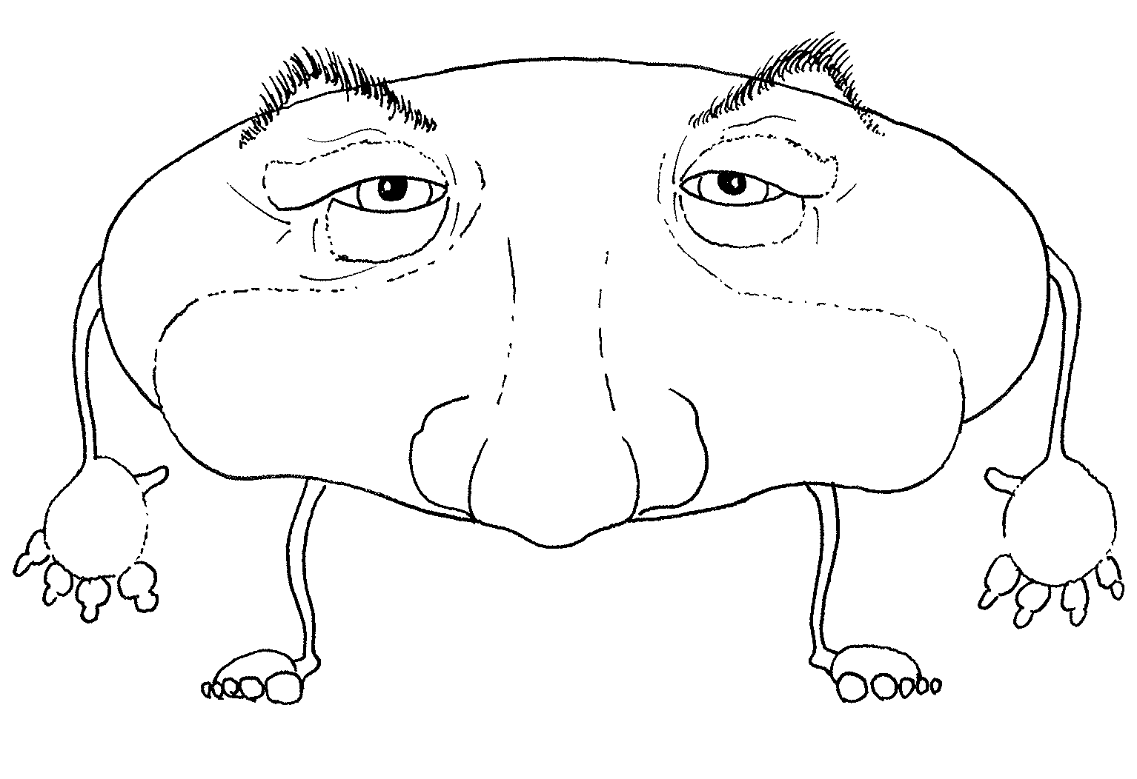


Pioglitazone/ Glitazones
(Rosiglitazone RIP)
PPM £17.29

Slide 17
Diabetes Treatments
* Just a little bit of post-prandial physiology…

Slide 18


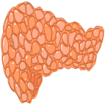
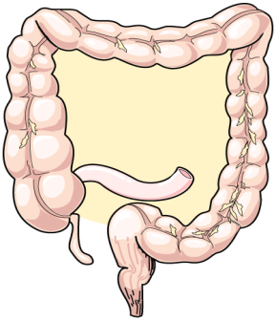
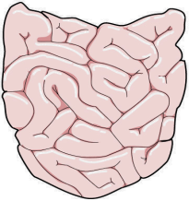
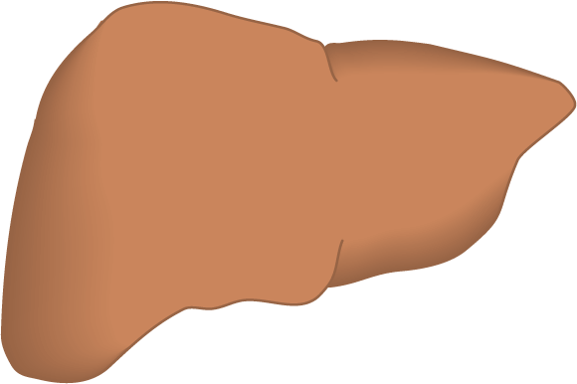
GLP-1
Mechanisms of Action
Increased
insulin secretion
Gosh, I’m full!
Decreased glucagon secretion
GLP-1
release
DPP-4 inhibitor
X
DPP-4 enzyme
Reduced hepatic glucose output
Inactive metabolites

Slide 19
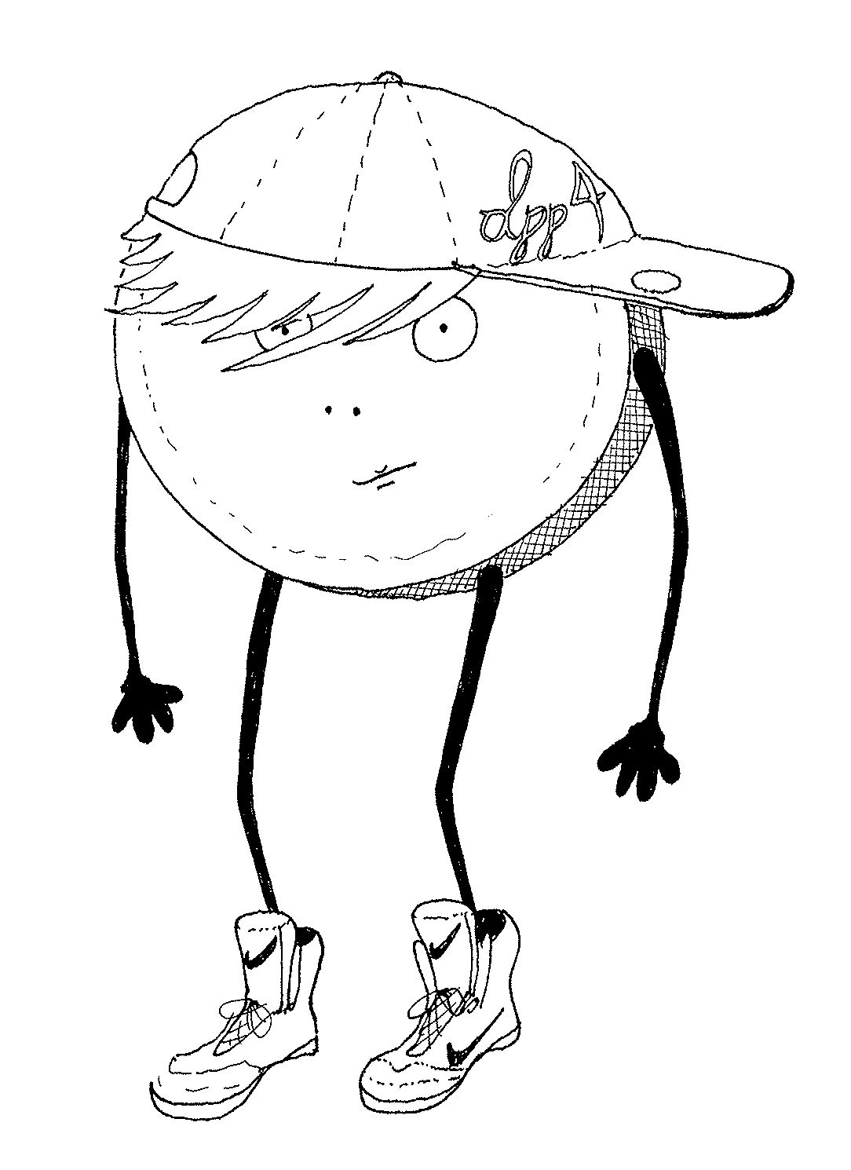
Alo/lina/saxa/sita/vilda
….gliptin
DPP4 inhibitors
Dipeptidyl peptidase-4 inhibitor
PPM £31.60

Slide 20
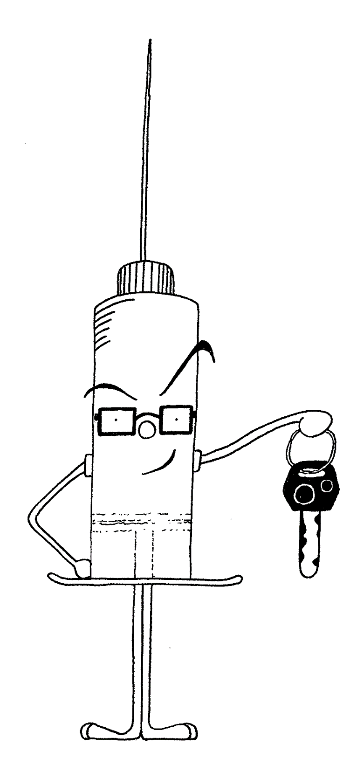
GLP Agonists
Glucagon like peptide 1 mimetic
Exenatide/liraglutide/
Lixisenatide
PPM £78.48

Slide 21
Diabetes Treatments
* Just a little bit of renal excretory physiology…

Slide 22
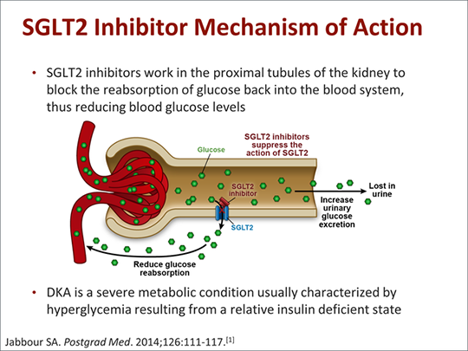

Slide 23
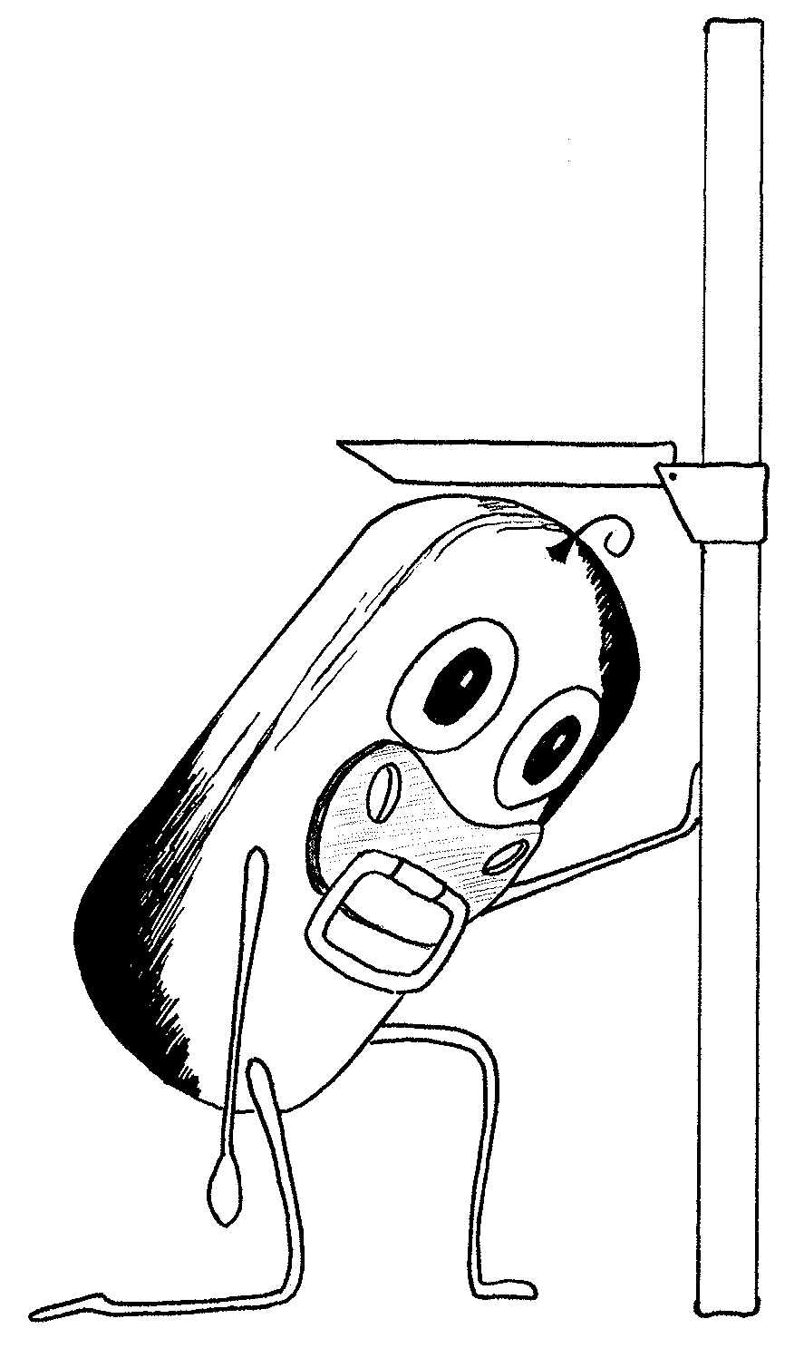

Dapa/Cana/Empa
…gliflozin
SGLT2 inhibitors
Sodium-glucose
co-transporter 2 inhibitors
PPM £36.59
75
Weird
DKA
UTI
Thrush
Best
Newcomer
eGFR<60
Age
>75

Slide 24
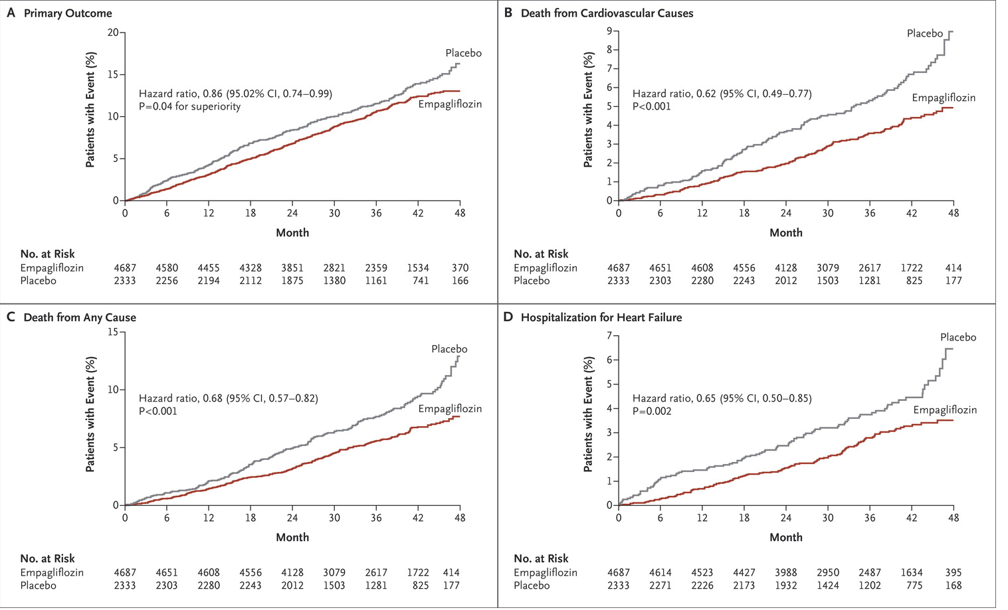
NEJM Nov 2015 Empagliflozin, Cardiovascular Outcomes, and Mortality in Type 2 Diabetes

Slide 25
Diabetes Treatments
Never forget who got us through the war…. (…respect to Gary Oldman)

Slide 26
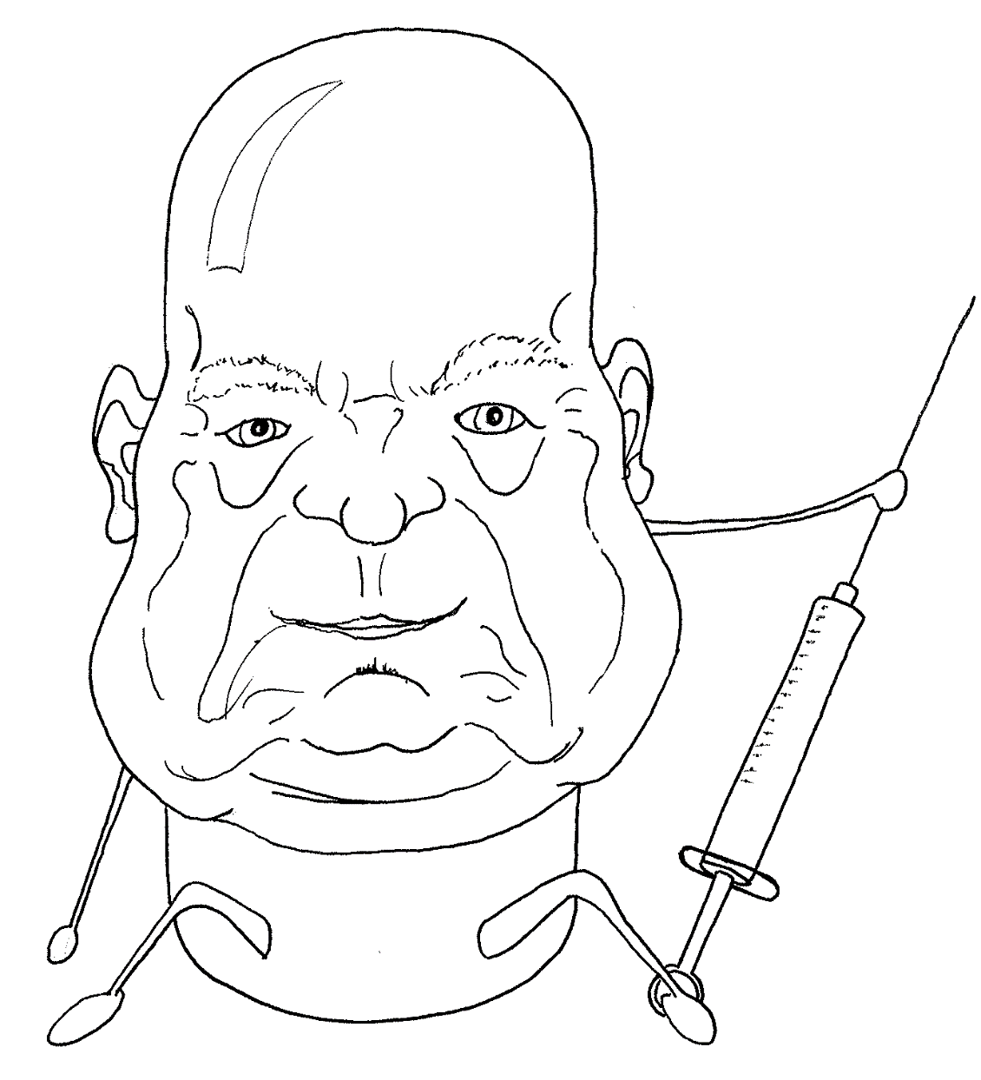
Insulin
NPH (isophane) PPM 21.70
Analogues (determir/ glargine) PPM 41.50

Slide 27







Diabetes Treatments
See how they work together…

Slide 29
Summary of Updated NICE guidance April 2016
Glycaemic control is only one aspect of care of type 2 diabetes
Involve patients in target setting of Hba1c
Metformin remains first line
Self monitoring – home BMs – only if
  On insulin/ oral meds causing hypos/ evidence of hypos/pregnant/ as part of education.
  Stick to the formulary meters!
Do not give aspirin or clopidogrel for primary prevention
Offer structured education to all (watch for update on DESMOND later)
Blood pressure targets remain at 140/80, but 130/80 if kidney, eye or cerebrovascular damage.
STATINS – use atorvastatin 20mgs
Type 1 primary prevention if >40yrs, Diabetes >10yrs, nephropathy or other CVD risk factors
Type 2 primary prevention – Either “All Patients” Joint British Societies
Or if CVD risk is >10% on Qrisk/JBS3

Slide 30
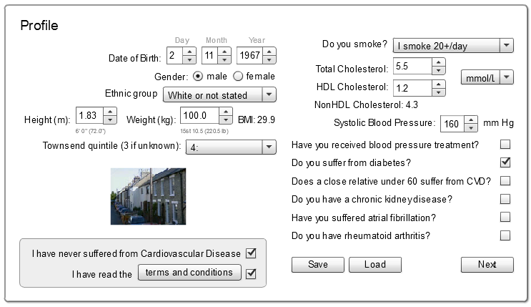
www.jbs3risk.com

Slide 31
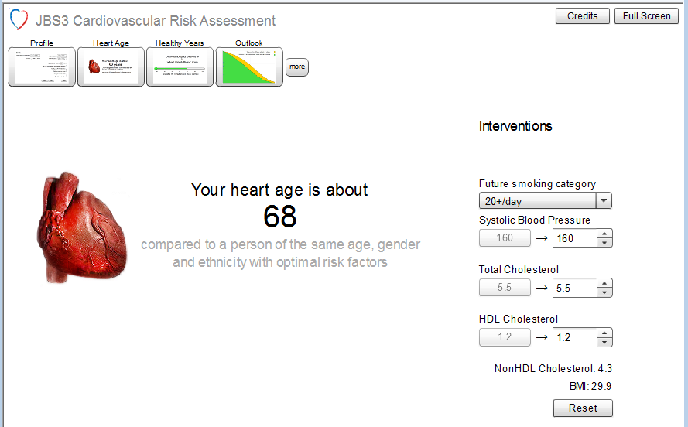
Heart Age

Slide 32
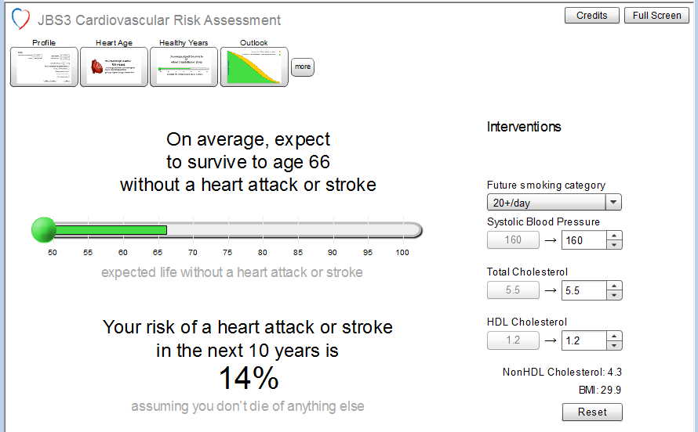
Healthy Years

Slide 33
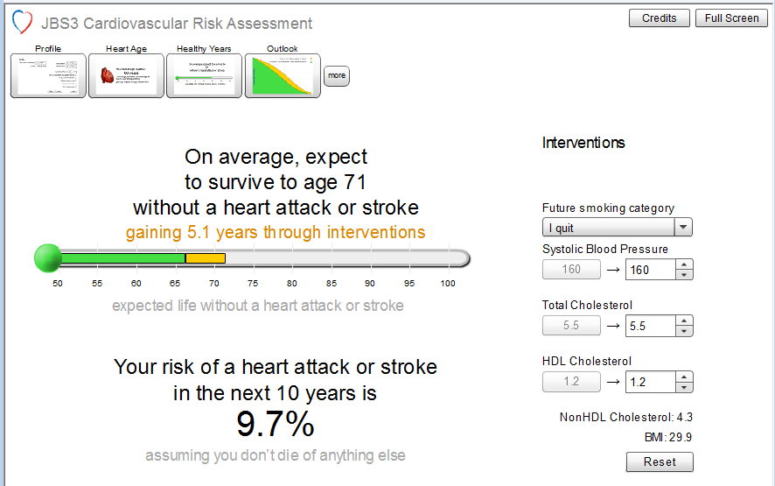
Stopping smoking…
Heart age 68 to 61yrs

Slide 34
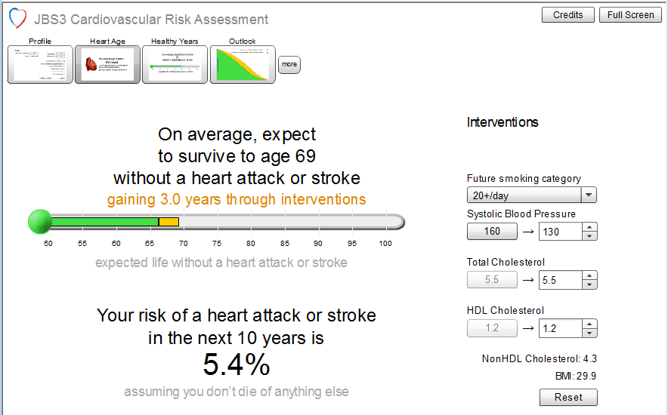
Controlling BP…
Heart age 68 to 54yrs

Slide 35
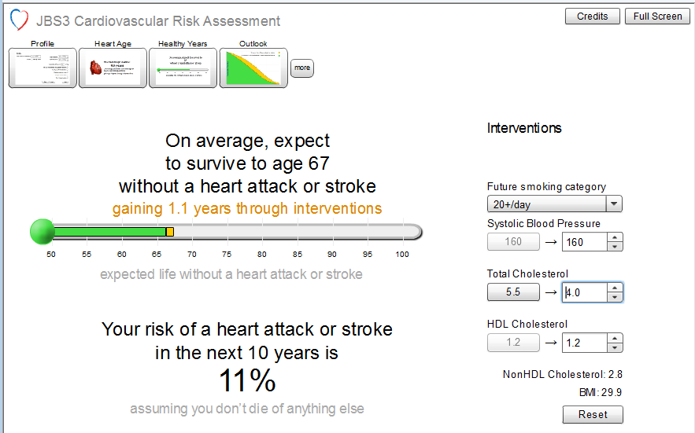
Reducing Cholesterol…
Heart age 68 to 62yrs

Slide 36
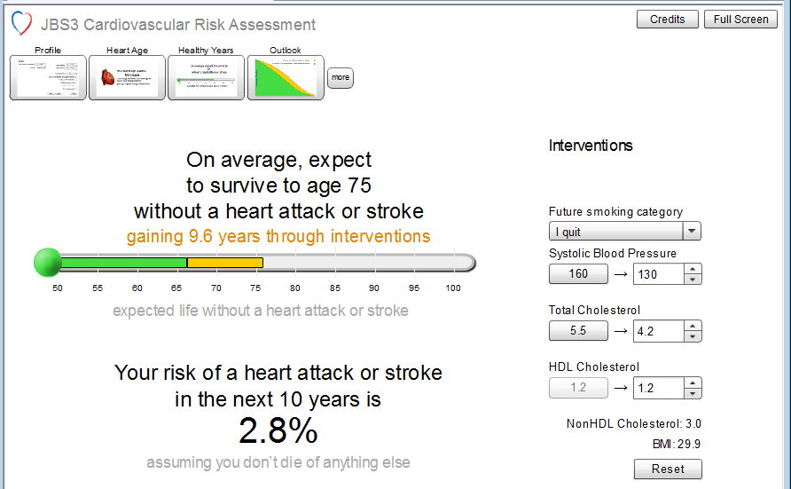
The full monty…..
Heart age 68 to 47yrs

Slide 37
Case Histories
1. Female 50yrs, Type 2, Smokes 20+, BMI 30
  Cholesterol of 5.1, HDL 2.2
  JBS3 Heart age of 61yrs, Healthy LE of 71, 10 yr risk 5.6%
  Stopping smoking
  JBS3 Heart age of 56yrs, Healthy LE of 77, 10 yr risk 3.6%
  Using a statin to reduce cholesterol to 3.5…
  Heart age of 59, Healthy LE improves by 4/12, 10 yr risk 4.5%

Slide 38
Case Histories
1. Female 60yrs, Type 2, Never smoked, BMI 22, Hypertensive
  Cholesterol of 6.9, HDL 3.0
  JBS3 Heart age of 68 yrs, Healthy LE of 80yrs, 10 yr risk of 8.5%
  Benefits of reduction of cholesterol to 5.0 would be a gain of 0.8 of a year of healthy life expectancy. Patient declined
  “At least I have lived longer than Mum”.
  Add in FHx of CVD under 60 in a close relative…
  JBS3 Heart age of 75, Healthy LE of 79, 10 year risk now 14%. Statin accepted

Slide 39
What about the grey zone?
Male aged 50 with a Cholesterol of 7.5 and no other risk factors
  JBS3 heart age of 60, Healthy LE 76 and 10 yr risk of 8.7%
  No FHx, no tendon xanthomata, doesn’t meet the Simon Broome Criteria for Familial Hyperchoesterolaemia…
  2 lab tests can help in weighing up the decision…
    hsCRP – need to know no other inflammation – if High suggestive of significant CV risk
    Lipoprotein (a) if over 300 suggests genetic risk factors are present

Slide 40
Diet, fats and turning the Supertanker
BMJ April 2016
We know swapping saturated fat for polyunsatures reduces cholesterol….BUT….
It does not seem to reduce mortality from heart disease…
In fact mortality was increased amongst older patients in the intervention group.
USA – have now removed dietary cholesterol and total fat as risk factors worth worrying about.
UK advice is still “consume less than 10% of calories from saturated fat”
Actually – the real problem is carbohydrates.
Eat less CHO – remember it turns to sugar and be relaxed about taking a greater proportion from fats and protein.

Slide 41
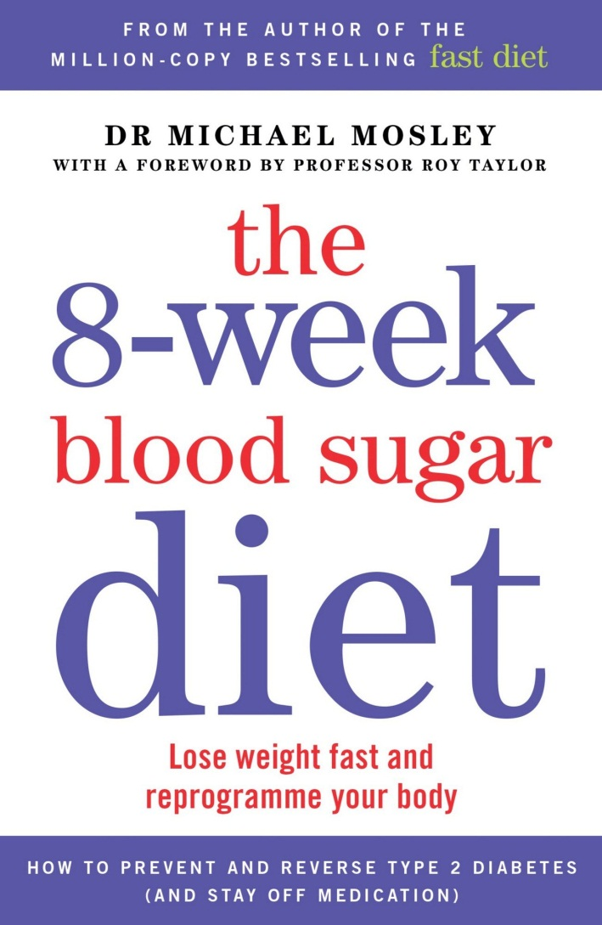
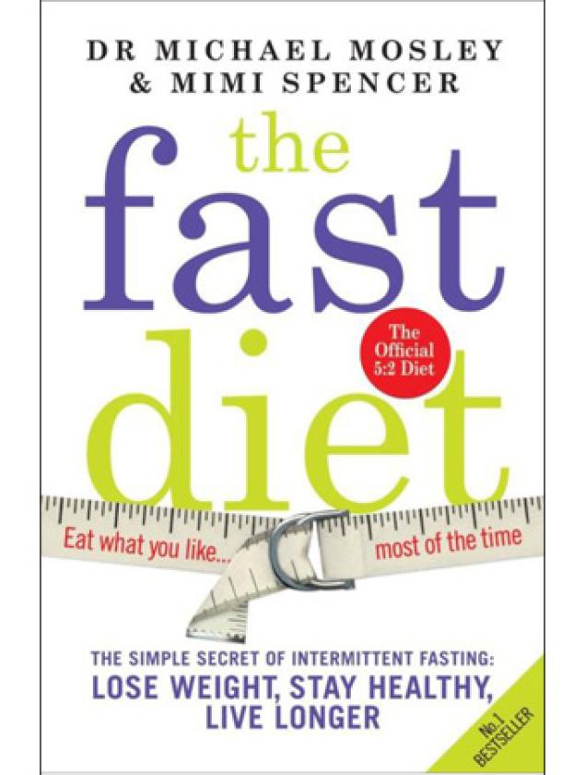
For the right patients…

Slide 42
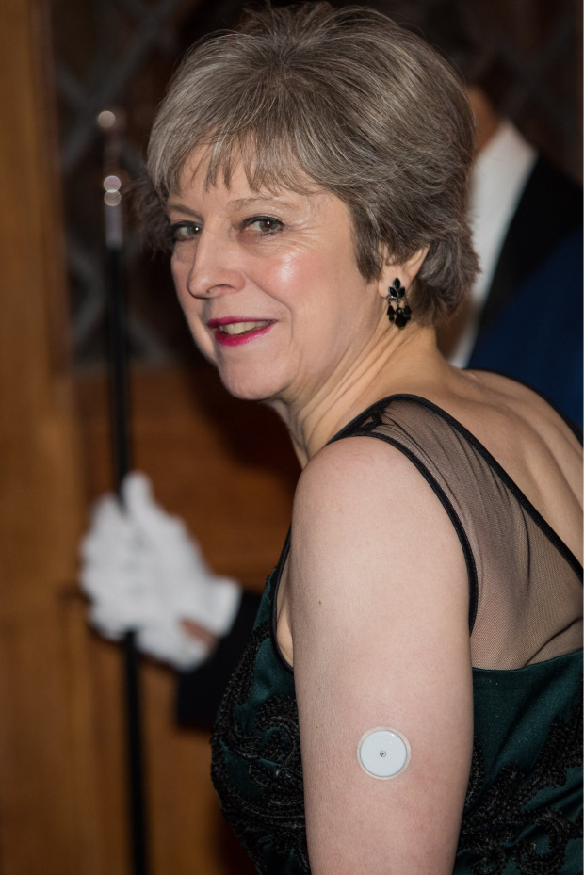
Local initiatives to watch for..
FreeStyle Libre

Slide 43
Local initiatives to watch for..
PREVENT – for patients at risk of diabetes
    Hba1c 42-48 mmol/mol
    See email dated 14th September 2017 “NDPP Healthier You (Diabetes)” for details.
DESMOND structured education
    See email dated 20th December 2017 “Additional funding – referring patients to DESMOND” with full details of how to refer including self referral and payment details.
The New LCS for diabetes
    Will follow the NDA in rewarding for the 8 care processes. Bonus for all 8 + % to 3 targets +insulin + GLP initiation

Slide 44
Ideas for Audit and QIA
Find your patients “At risk of diabetes” – do they even know? Refer to PREVENT.
What is happening to the mass of your diabetic population? Intervene and see if there is a difference.
Check out, shortcut and use JBS3.
Have all your patients with Type 2 been offered DESMOND?
Check you have no-one on metformin with an eGFR less than 30, reduce the dose in patients with eGFR less than 40.
Review your patients on pioglitazone – consider other options
Read up and consider actually recommending a diet plan.
Revise Simon Broome criteria for FH, and consider using hsCRP and LPa.

