Slide 1
Hot topics Safeguarding in Surrey.
Dr Sharon Kefford
Dr Tara Jones
NHS Guildford & Waverley CCG
Countywide Safeguarding Team
Notes:
Statutory, biannual . In relation to S11 children's Act
Primary care, health trusts and mental health providers.
Joint adult and Childrens tool.

Slide 2
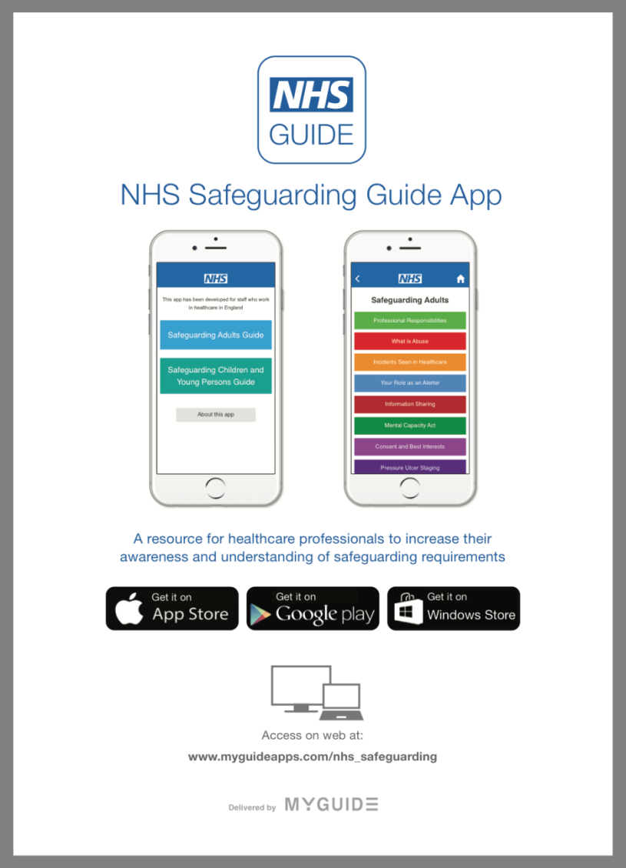
NHS Safeguarding App
Android NHS Safeguarding Guide
https://play.google.com/store/apps/details?id=com.antbits.nhsSafeguardingGuide&hl=en_GB
Apple NHS Safeguarding Guide
https://itunes.apple.com/gb/app/nhs-safeguarding-guide/id1112091419?mt=8
Guildford & Waverley CCG
Countywide Safeguarding Team

Slide 3
Section 11 Audit tool
9 questions
8 national safeguarding priorities
1 local issues
Self rated; not met, partially met, met
Used as evidence good practice for CQC
Guildford & Waverley CCG
Countywide Safeguarding Team

Slide 4
What is required | Evidence to show practice is complying with this | Red/Amber/Green rating children |  |  |  |  | Red/Amber/Green rating adults
 |  | Not Met | Partially Met |  |  | Met | Not met | Partially Met |  |  | Met
Senior management have commitment to safeguarding
The practice has a written safeguarding policy for children and adults | Safeguarding policy | ☐ |  | ☐ | ☐ |  | ☐ |  | ☐ | ☐
The policy has been reviewed in the last 3 years | Safeguarding policy which has been reviewed since the Care Act 2014 | ☐ |  | ☐ | ☐ |  | ☐ |  | ☐ | ☐
The practice has a named safeguarding lead and deputy for children and adults | Named in the safeguarding policy or in the practice structure | ☐ |  | ☐ | ☐ |  | ☐ |  | ☐ | ☐
Multiagency safeguarding professionals’ contact details are easily accessible throughout the practice | Evidence from intranet or posters in practice eg Social Care, Local Authority Designated Officer | ☐ |  | ☐ | ☐ |  | ☐ |  | ☐ | ☐
The practice have regular safeguarding meetings with other health professionals to discuss vulnerable children and adults at risk | Minutes of relevant practice meetings detailing cases and actions to take | ☐ |  | ☐ | ☐ |  | ☐ |  | ☐ | ☐
The practice uses recognised RCGP codes and practice alerts to record safeguarding concerns and for Looked after Children and foster parents. | Evidence from practice policy and patient records | ☐ |  | ☐ | ☐ |  | ☐ |  | ☐ | ☐
The practice is aware of the requirements with Female Genital Mutilation and complies with FGM reporting in line with recent legislation | Evidence of registration with enhanced data set, FGM protocol, referrals made, patient records | ☐ |  | ☐ | ☐ |  | ☐ |  | ☐ | ☐
Guildford & Waverley CCG
Countywide Safeguarding Team

Slide 5
Section 11 Pilot North West Surrey.
What's working well:
The section 11 response rate from the practices in North West Surrey CCG was 83%. This shows a commitment within primary care to safeguard vulnerable children and adults.
Guildford & Waverley CCG
Countywide Safeguarding Team

Slide 6
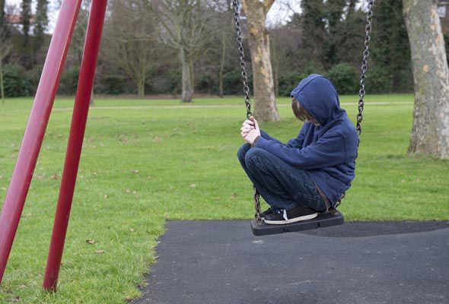
Child Sexual Exploitation
Guildford & Waverley CCG
Countywide Safeguarding Team
Notes:
Child under 18. Perform sexual acts or have sexual acts performed on them. In exchange for something. Child does not always realise abnormal relationship. Grooming, technology. Boys.

Slide 7
Models of CSE
Inappropriate relationships- usually one abuser with inappropriate power over a young person
Boyfriend. Abuser grooms victim, initially a ‘normal’ relationship. Relationship turns abusive.
Organized exploitation and trafficking/ Missing, exploited, trafficked (MET)
Clear MET protocol on the 4LSCB website
Guildford & Waverley CCG
Countywide Safeguarding Team
Notes:
Grooming
In all these models a form of grooming takes place. The word grooming is used to describe the process that is used to trick a child or young person into believing that they are trustworthy so that they can eventually sexually exploit them.
Increasing numbers of MET cases doubled in 2013.
Most common nationality Vietnam, UK, Albania
These children may be subject to physical ,emotion sexual abuse and neglect.
Inappropriate “Lado”, Teenage sexual health templates.
Boyfriends, consent 16 sex, 17-18 years most vulnerable waiting for them to turn 16 pre sex. Still abuse.
What does this mean for professionals?
“Children and young people who are sexually exploited are the victims of child sexual abuse, and their needs require careful assessment. They are likely to be in need of welfare services and – in many cases – protection under the Children Act 1989. This group may include children who have been sexually abused through the misuse of technology, coerced into sexual activity by criminal gangs or the victims of trafficking.”
In all cases those exploiting the child/young person have power over them by virtue of their age, gender, intellect, physical strength and/or economic or other resources. Violence, coercion and intimidation are common, involvement in exploitative relationships being characterised in the main by the child or young person’s limited availability of choice resulting from their social/economic and/or emotional vulnerability.
(Definition by NWG and cited in DCSF guidance)

Slide 8
Child sexual exploitation
How do we identify CSE in primary care?
Contraception or STI testing/treatment (including emergency contraception/pregnancy testing)
Pregnancy
Drug or alcohol problems or overdose
Self-harm
Disclosure of sexual assault or sexual activity that raises concern
Domestic violence in the home
For children aged 10-17 complete a risk assessment (CSERQ4)
Guildford & Waverley CCG
Countywide Safeguarding Team

Slide 9
Child Sexual Exploitation Research Question 4 (CSERQ4)
 | Questions | Yes | No
1 | Have you ever stayed out overnight or longer without permission from your parent(s) or guardian?
2 | How old is your boyfriend/ girlfriend or the person(s) you have sex with? Age of partner ______ Age of client/patient ______ Age difference ______ If age difference is 4 or more years then tick ‘YES’
3 | Does your boyfriend/ girlfriend or the person(s) you have sex with stop you from doing things you want to do?
4 | Thinking about where you go to hang out, or to have sex. Do you feel unsafe there or are your parent(s) or guardian worried about your safety?
OUTCOME
If the child has answered ‘yes’ to one or more of questions 1-4 then a referral should be made to Children Services as this indicates that the child is at risk of, or experiencing child sexual exploitation
Guildford & Waverley CCG
Countywide Safeguarding Team

Slide 10
Guildford & Waverley CCG
Countywide Safeguarding Team
Notes:
RMM

Slide 11
Tools For Frontline staff:
SSCB website www.surreyscb.org.uk
SSAB website www.surreycc.gov.uk
Resources for professionals
Level of needs document
Domestic abuse checklist
CSE screening tool
Neglect screening tool
Early help
Escalation
Managing allegations re adults who work with children
Safer Surrey
RCGP Toolkit
www.rcgp.org.uk/clinical-and-research/toolkits/the-rcgp-nspcc-safeguarding-children-toolkit-for-general-practice.aspx
Guildford & Waverley CCG
Countywide Safeguarding Team

Slide 12
Local Authority Designated Officer
LADO’s are the officers to call if you need to report a concern or allegation against a member of staff that might pose a threat to children. To report concerns of this nature please call the Local Authority Designated Officer (LADO): 0300 123 1650 (option 3). Further information provided through the link below.
http://www.surreyscb.org.uk/professionals/dealing-with-allegations-against-people-who-work-with-children/
Guildford & Waverley CCG
Countywide Safeguarding Team

Slide 13
Private Fostering
This occurs when a child under the age of 18 years has been staying with someone other than the person with parental responsibility for more than 28 days.
These arrangements should be discussed with Childrens services via the MASH. Further information is found on the link below.
http://www.surreyscb.org.uk/wp-content/uploads/2016/05/Private-Fostering-Feb-2017.pdf
Guildford & Waverley CCG
Countywide Safeguarding Team

Slide 14
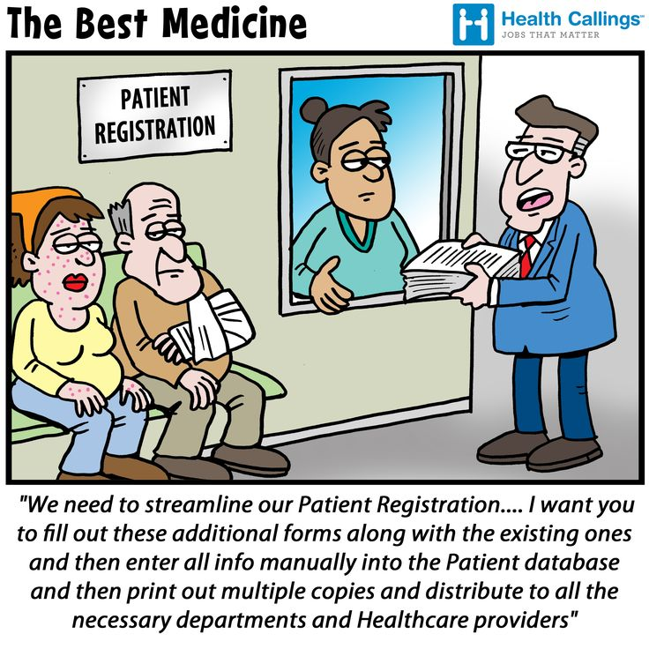
Guildford & Waverley CCG
Countywide Safeguarding Team

Slide 15
LMC Guidance Registration Under 18’s
Parent or carer registered at practice
Person of parenteral responsibility
Social care history
Looked after children status
School
Past GP
Past medical history , drug history ,family history allergies
Guildford & Waverley CCG
Countywide Safeguarding Team

Slide 16
Registration and safeguarding
Ethnic minority
Language / interpreter
Disability
Unidentified adults
Caring
Sharing
SCR
Online access
Permission for someone other than parent to take child to GP.
Guildford & Waverley CCG
Countywide Safeguarding Team

Slide 17
FGM enhanced dataset
NHS England registration of Surrey Practice on FGM enhanced data set.
Total Surrey wide is 14%
Surrey Heath 22%
Surrey Downs 5%
North West 16%
NEHF 40%
G&W 20%
ES 5%
Guildford & Waverley CCG
Countywide Safeguarding Team

Slide 18
FGM enhanced dataset
Registering for the enhanced dataset.
http://content.digital.nhs.uk/fgm
FGM enhanced dataset CAP user registration form
Step 1.
Create a single sign on with NHS Digital by registering online.
Step 2.
Electronically complete registration form for FGM enhanced dataset. Complete forms A and B, then send electronically to registered Caldicott guardian for completion.
Step 3.
Caldicott guardian to complete form C and e-mails completed form with their own e-mail address to
enquiries@nhsdigital.nhs.uk
Contact NHS Digital for Queries 0300 303 5678
Guildford & Waverley CCG
Countywide Safeguarding Team

Slide 19
Bruising in non-independently mobile children
Definition of NIM; includes all infants younger than 6 months
High predictive value for NAI in this age group
ALL infants with bruising who are NIM MUST be referred to MASH
When to go straight to paediatrician on-call?
Birth injury/birthmarks/self-inflicted injury/injury from another child
Practice complaint/leaflet for parents
http://www.surreyscb.org.uk
Guildford & Waverley CCG
Countywide Safeguarding Team
Notes:
SSCB website for this plus training/e-learning, policies and procedures, case reviews. Dedicated professionals page

Slide 20
Safeguarding training requirements
CQC expectations
All levels stated relate to minimum requirement
Training includes formal (see next slide) and informal e.g. case discussions, review of policies, general updates, audit.
Role of practice leads/practice managers
Guildford & Waverley CCG
Countywide Safeguarding Team
Notes:
CQC; induction, training log. Increasingly asking re adult training. Prevent topical
Awaiting intercollegiate document ? Combined competencies and training for children, adults and LAC

Slide 21
Safeguarding training requirements(2)
Level 1; all non-clinical staff
Accessed online or delivered in-house
https://www.nsahealth.org.uk/e-learning
https://www.e-lfh.org.uk/
Level 2; all clinical staff (non-doctor) and consider practice managers/safeguarding administrators
Level 3; ALL GPs and increasing expectation for practice nurses
Multiagency. Face to face gold-standard
Guildford & Waverley CCG
Countywide Safeguarding Team

Slide 22
Contact details
Our role; support, advice, case discussion, training information etc etc…
IF URGENT? Does this need to be discussed with the MASH?
tara.jones@nhs.net
sharon.kefford@nhs.net
Guildford & Waverley CCG
Countywide Safeguarding Team

Slide 23
NHS Guildford & Waverley CCG
Countywide Safeguarding Team

