Slide 1
Mental Health refresher for Primary Care
Dr Vimal Mannali MBBS MPH MRCPsych
Consultant Psychiatrist

Slide 2
Bit on my background
‘newbie’ Consultant Psychiatrist
Working Age Adult – Guildford CMHRS
Masters in Public Health, Univ of Pittsburgh, Pennsylvania
Core Training Psychiatry- Surrey
Higher Specialist Training (Dual) Adult and Old Age Psychiatry – West London
Special interests – MH in Univ Students, Physician Burnout & Human Factors in
Patient Safety

Slide 3
Lets talk about
Snapshot on Mental Health in Primary Care
Update/ refresher on
Valproate prescription safety
Treatment pathways in Depression
Novel Psychoactive Substances
Secondary Care Mental Health –The dreaded Referral Process to CMHRS
Future Directions

Slide 4
Mental Health in Primary Care

Slide 5
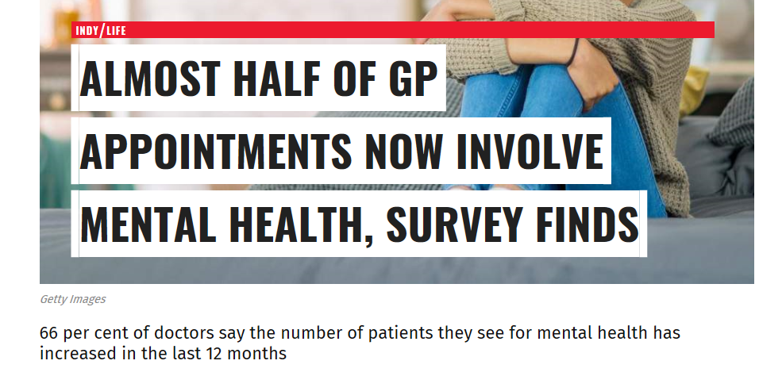

Slide 6
From the Primary Care viewfinder
MIND survey of >1,000 GPs - revealed rising demand for mental health support in primary care
2 in 5 (40%) of GP appointments now involve mental health
2 out of 3 GPs (66 %) say the proportion of patients needing help with their mental health has increased in the last 12 months
Mind is calling for better mental health training for GPs
( More training time +/- a wider range of relevant MH placement options)

Slide 7
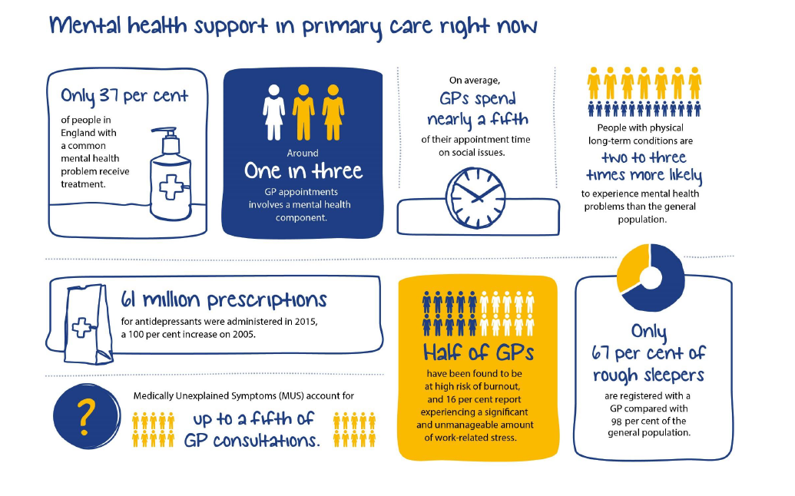
Source: MIND.org

Slide 8
What have we learnt
GP - Patient relationship can help to optimise the quality of an initial/ screening assessment and in establishing the characterisation of their problems.
Validated tools such as PHQ-9 and GAD-7 can help support diagnostic formulation + establish symptom severity BUT a comprehensive assessment not just relying on a symptom count alone is recommended.
Assessment of risk is vital.
A more rounded assessment can be achieved by exploring lifestyle factors like accommodation status or living conditions, social network, family challenges, cultural issues, financial problems etc
GPs do take into consideration protective factors, such as social support or a person’s spirituality.

Slide 9
Social Prescribing – GPs and MH Care
Social prescribing highlighted in white paper Our Health Our Care Our Say (2006) and NHS five year forward view (2014)
Encourages a focus on prevention and wellbeing, patient-centred care, and better integration of services
Highlights the role of the third sector in delivering services that promote wellbeing
General Practice Forward View (2016) emphasised the role of voluntary sector organisations contributing to broader government objectives (employment, volunteering and learning). Highlighted role of Practice staff in early referral and treatment
Guidance on social prescribing available for CCG + Social Prescribing Network ( local and national level).
In June 2016, NHS England appointed a National Clinical Champion for Social Prescribing

Slide 10
Physical health care Collaborative working between MH specialists and GPs
Improve access to follow up physical health interventions for people with SMI
Improve quality of both the physical health checks and interventions to ensure in line with NICE guidance
CQUIN 3a: Improving physical healthcare to reduce premature mortality in people with SMI: Cardio metabolic assessment and treatment for patients with psychoses
CQUIN 3b: Improving physical healthcare to reduce premature mortality in people with SMI: Collaborating with primary care clinicians

Slide 11
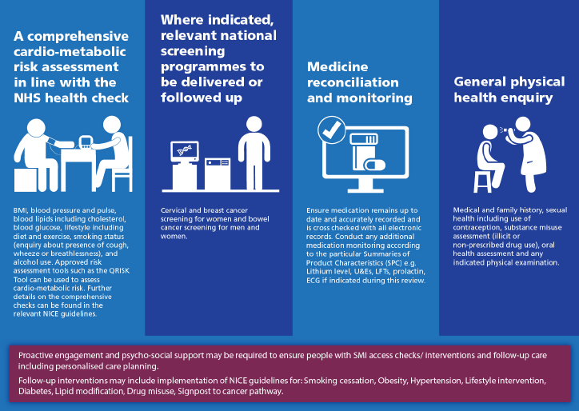
Recommended Physical Health Investigations for People on the SMI Register

Slide 12
Barriers to communication at GP appointments
https://youtu.be/Dqb-n_L5hIA

Slide 13
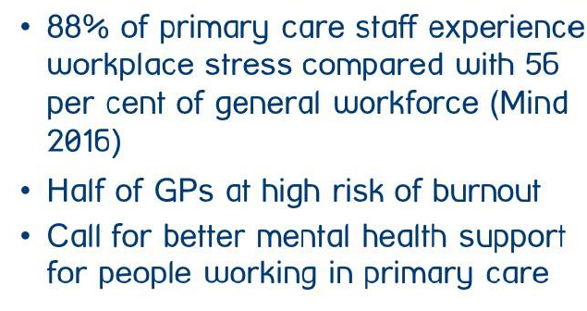
Stress among Clinicians – Lets support each other
CQUIN 2017-2019 1a
Improvement of health & wellbeing of NHS staff
Office for National Statistics data showed that between 2011 and 2015, 430 doctors died by suicide.

Slide 14
Any questions / comments?

Slide 15
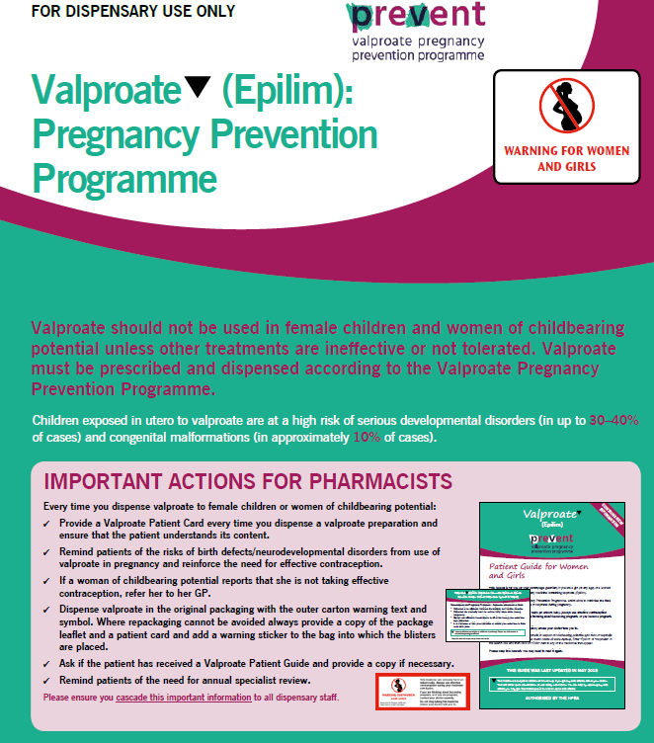
VALPROATE – a prescription safety update

Slide 16
Sodium valproate must no longer be prescribed to women or girls of childbearing potential unless they are on the pregnancy prevention programme (PPP)
24 April 2018 MHRA has changed the licence for valproate medicines in the UK

Slide 17
Licensed indications for Valproate use
Acute mania
Mixed affective states and rapid cycling Bipolar Affective disorder
Off-label uses
Bipolar depression
Adjunctive treatment for schizophrenia
Impulsivity, agitation and aggression: Brain injury/Dementia/ Personality disorder
Alcohol dependence

Slide 18
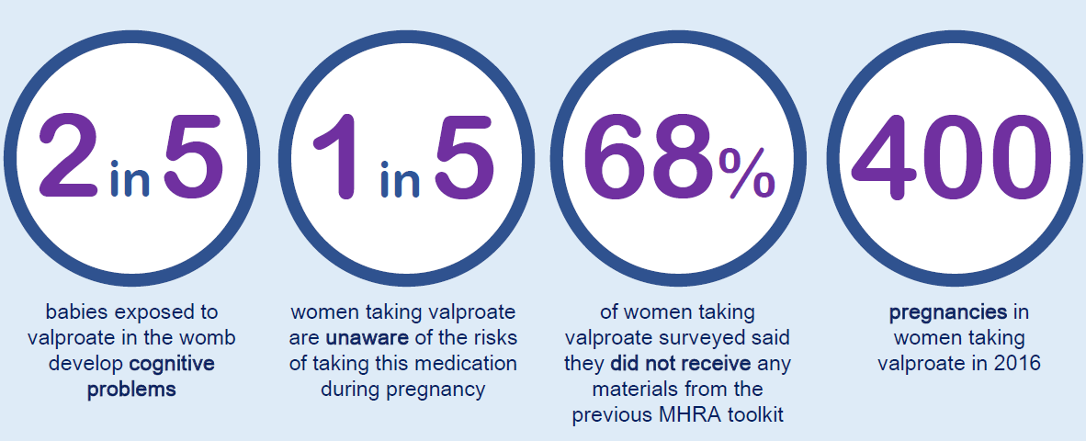

Slide 19
Prescriber’s responsibilities
As part of the PPP, the prescriber must make sure the woman or girl understands the risk if she became pregnant while taking the medicine.
They must also understand the need to take contraception while on the medicine, and be referred to contraception services if needed.
A risk acknowledgement form must also be completed and signed when the medicine is renewed, at least once a year.
The MHRA said that women and girls taking valproate at the moment should speak to their doctor to arrange a medicine review.
The agency stressed that they should not stop taking their medicine without medical advice.

Slide 20
Action plan for GPs and MH Specialists
GPs must identify and recall all women and girls who may be of childbearing potential, provide the Patient Guide and check they have been reviewed by a specialist in the last year and are on highly effective contraception
Specialists must book in review appointments at least annually with women and girls under the Pregnancy Prevention Programme and re-evaluate treatment as necessary; explain clearly the conditions as outlined in the supporting materials; and complete and sign the Risk Acknowledgement Form
(copies of the form must be given to the patient or patient/caregiver/responsible person and sent to their GP)

Slide 21
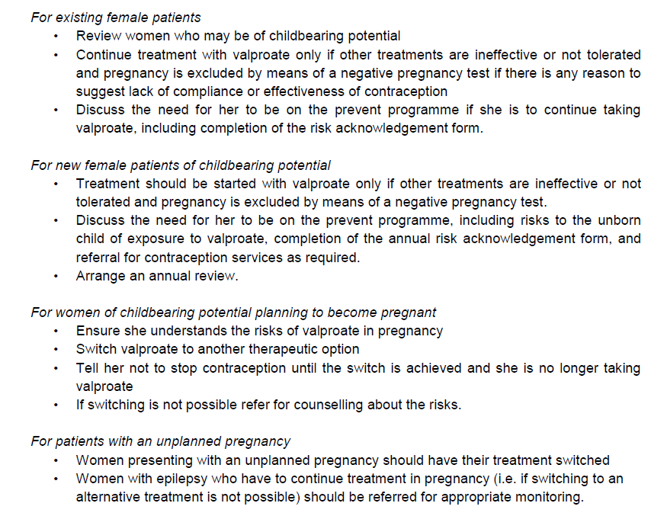

Slide 22
Action plan for GPs and MH Specialists
Off-label use: Valproate is not licensed for treatment of conditions other than epilepsy or bipolar disorder in the UK. But sometimes used off-label (for eg, in migraine prophylaxis).
All women and girls of childbearing potential should meet the conditions of a Pregnancy Prevention Programme, irrespective of indication.
All prescribers should be aware of their responsibilities when prescribing medicines off-label
Contraindication in pregnancy
Use of valproate in pregnancy is contraindicated for bipolar disorder and must only be considered for epilepsy if there is no suitable alternative treatment

Slide 23
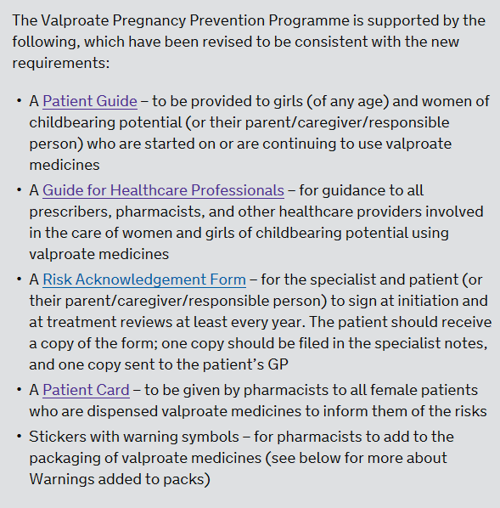
https://youtu.be/VuBq2M1Me04

Slide 24
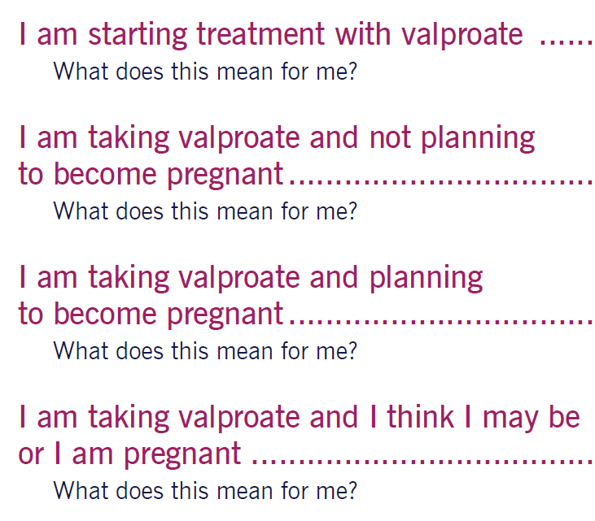
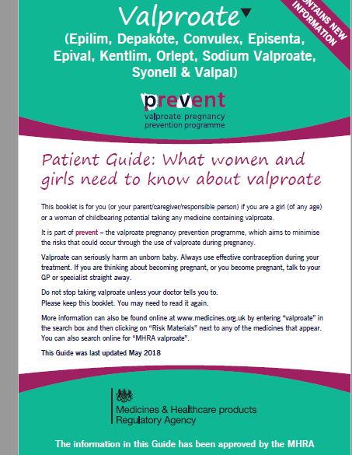
PATIENT GUIDE

Slide 25
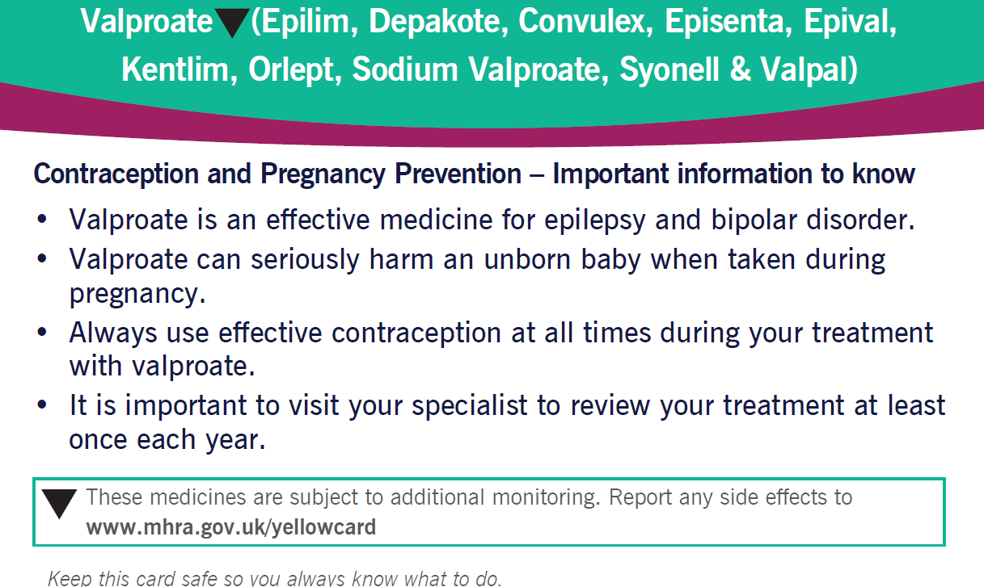
PATIENT SAFETY CARD

Slide 26
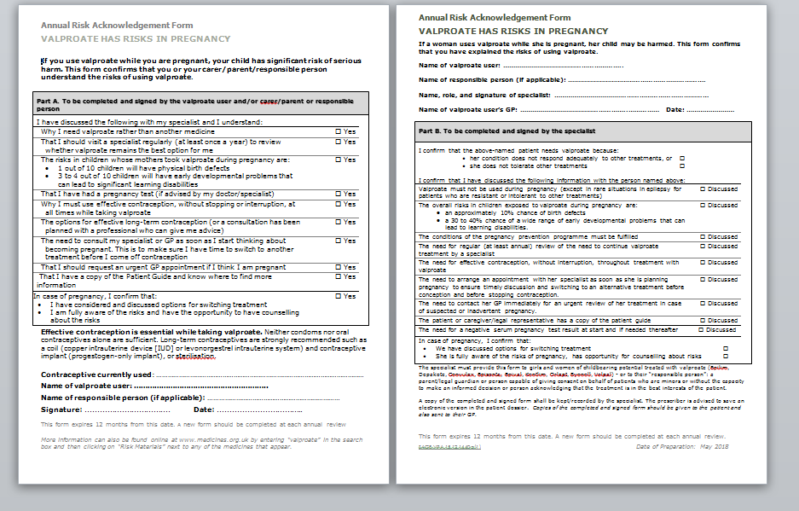
RISK ACKNOWLEDGEMENT FORM

Slide 27
Any questions?

Slide 28
Treatment Pathways in Depression A refresher

Slide 29
Key focus in Primary Care
Quality of assessment
Treatment for mild to moderate depression
Effective delivery of interventions for depression
Low-intensity psychosocial interventions
Drug treatment
Continuation of drug treatment and relapse prevention
Psychological interventions for relapse prevention

Slide 30
Assessment
Consider using a depression questionnaire (PHQ, HADS, or BDI-II)
Not required by QOF, should not be used on their own, but
Gives an indication of the severity of depression and helps assess improvement over time.
Perform a bio-psychosocial assessment.
Was required by QOF until March 2014.
Considers physical, psychological and social aspects of the condition.
Can be carried out over more than one consultation.
Need to make a record in the notes on the day depression is diagnosed.
Notes:
Based on the CKS topic Depression (August 2013), NICE guidance (2009); Depression: the treatment and management of depression in adults (CG90), and Quality and Outcomes Framework (QOF) guidance for the General Medical Services contract 2013/14.

Slide 31
Pointers to a clinical diagnosis of Depression
Duration > 2 weeks
Pervasive mood state : can also present with diurnal variation
Subjective distress by symptoms
Difficulty in normal functioning (Socio-Occupational-Personal)
Presence of psychotic symptoms
Self harm or suicidal Ideation

Slide 32
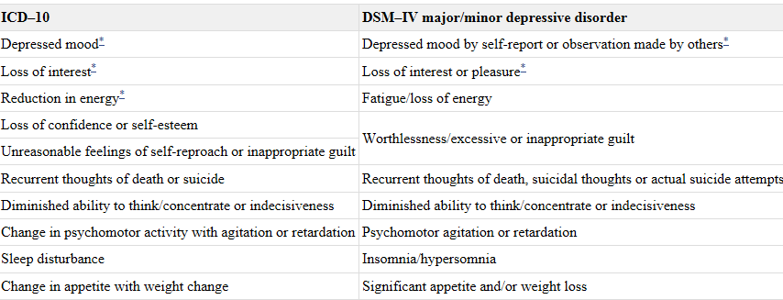
Depression symptomatology – a revision

Slide 33
PHQ9 Score Interpretation
No longer QOF but helps diagnosis & progress
Used in Psychological Therapies – Referral vs Discharge score
Interpretation of Total Score Depression Severity (Impact)
1-4 Minimal depression
5-9 Mild depression
10-14 Moderate depression
15-19 Moderately severe depression
20-27 Severe depression

Slide 34
Depression – Assessing severity
Sub-threshold symptoms: Fewer than 5 symptoms
Mild depression: Few (if any) symptoms over the 5 for diagnosis + minor functional impairment
Moderate depression: Symptoms or functional impairment between ‘mild’ and ‘severe’
Severe depression: Most symptoms + these markedly interfere with functioning
Can occur with or without psychotic symptoms

Slide 35
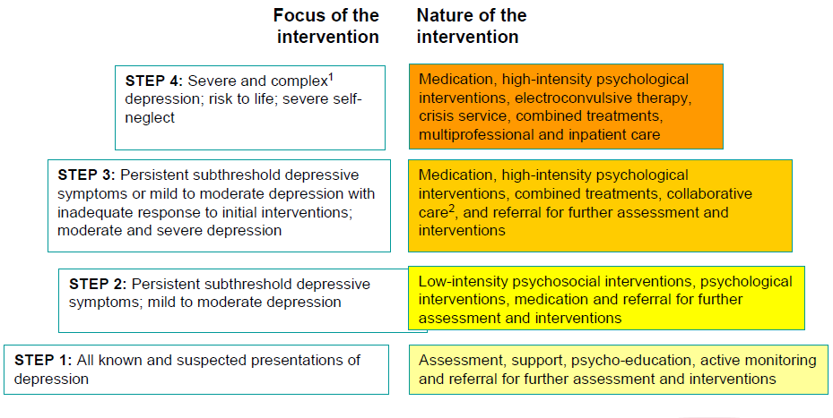
Stepped Care Model

Slide 36
Managing subthreshold depressive symptoms
Consider a period of active monitoring, and:
Provide information about the nature and course of depression.
Arrange follow up, within 2 weeks (consider contacting the person if they do not attend follow-up appointments).
If still unwell after 2 weeks
Consider referral for a low-intensity psychological intervention.
Notes:
Based on the CKS topic Depression (August 2013), NICE guidance (2009); Depression: the treatment and management of depression in adults (CG90), and Depression in adults with a chronic physical health problem (CG91).

Slide 38
Mx of persistent subthreshold Depressive sx or mild-to-moderate Depression
Consider referral for one or more low-intensity psychological interventions.
If chronic physical health problem – group-based peer support programme may be considered.
Notes:
Based on the CKS topic Depression (August 2013), NICE guidance (2009); Depression: the treatment and management of depression in adults (CG90), and Depression in adults with a chronic physical health problem (CG91).

Slide 39
Drug treatment
Do not use antidepressants routinely to treat subthreshold depressive symptoms or mild depression because the risk–benefit ratio is poor
Consider antidepressants for people with:
a past history of moderate or severe depression, or
subthreshold depressive symptoms present for a long time, or
subthreshold depressive symptoms or mild depression that persist(s) after other interventions.
Mild depression that is complicating the care of a chronic physical health problem
Notes:
NOTES FOR PRESENTERS:
Recommendation in full:
Do not use antidepressants routinely to treat persistent subthreshold depressive symptoms or mild depression because the risk–benefit ratio is poor, but consider them for people with:
•a past history of moderate or severe depression or
•initial presentation of subthreshold depressive symptoms that have been present for a long period (typically at least 2 years) or
•subthreshold depressive symptoms or mild depression that persist(s) after other interventions. (1.4.4.1)
Related recommendation:
Although there is evidence that St John’s wort may be of benefit in mild or moderate depression, practitioners should:
•not prescribe or advise its use by people with depression because of uncertainty about appropriate doses, persistence of effect, variation in the nature of preparations and potential serious interactions with other drugs (including oral contraceptives, anticoagulants and anticonvulsants)
•advise people with depression of the different potencies of the preparations available and of the potential serious interactions of St John’s wort with other drugs. (1.4.4.2)

Slide 40
Low-intensity psychosocial interventions
For people with persistent subthreshold depressive symptoms or mild to moderate depression, consider offering one or more of the following interventions, guided by the person’s preference:
Individual guided self-help based on the principles of Cognitive Behavioural therapy (CBT)
Computerised Cognitive Behavioural Therapy (CCBT)
Structured group physical activity programme.
Notes:
NOTES FOR PRESENTERS:
Key points to raise:
This recommendation (and recommendation 1.4.2.1 in CG91) updates the recommendations on depression only in ‘Computerised cognitive behavioural therapy for depression and anxiety (review)’ (NICE technology appraisal 97)
Recommendation in full: shown on slide (1.4.2.1)
Related recommendations: see 1.4.2.2 to 1.4.2.4 in the NICE guideline.
The related recommendations contain specifications for:
Individual guided self-help programmes based on the principles of CBT (and including behavioural activation and problem-solving techniques)
CCBT
physical activity programmes.

Slide 41
Improving Access to Psychological Therapies (IAPT)
For people over 18 years experiencing mild to moderate mental ill-health. This can include stress, low mood, anxiety, panic attacks, depression (including pre and post natal), obsessive compulsive disorder, phobias, post traumatic stress and eating difficulties (not severe).
Interventions
Workshops/courses
Group therapy
Computerised Cognitive Behaviour Therapy
Guided self help material
Individual Therapy – eg CBT

Slide 42
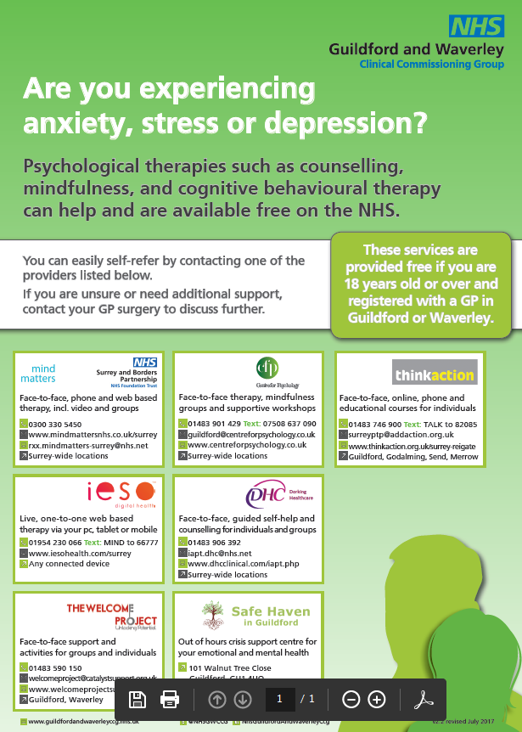
IAPT providers

Slide 44
Treatment for moderate or severe depression
Provide a combination of
antidepressant medication, and
a high-intensity psychological intervention (cognitive behavioural therapy CBT or interpersonal therapy IPT)
Notes:
Recommendation in full: CBT: is based on the idea that the way we feel is affected by our thoughts and beliefs and by how we behave. People with depression tend to have negative thoughts which can lead to negative behaviour. CBT encourages people to engage in activities and to write down their thoughts and problems. It helps them to identify and counteract negative thoughts.
IPT: A treatment which helps people with depression to identify and address problems in their relationships with family, partners and friends.
Related recommendations:
For people with persistent subthreshold depressive symptoms or mild to moderate depression who have not benefited from a low-intensity psychosocial intervention, discuss the relative merits of different interventions with the person and provide:
an antidepressant (normally a selective serotonin reuptake inhibitor [SSRI]) or
a high-intensity psychological intervention, normally one of the following options:
- CBT
- interpersonal therapy (IPT)
- behavioural activation (but note that the evidence is less robust than for CBT or IPT)
- [behavioural ]couples therapy for people who have a regular partner and where the relationship may contribute to the development or maintenance of depression, or where involving the partner is considered to be of potential therapeutic benefit. (1.5.1.1)
The choice of intervention should be influenced by the:
duration of the episode of depression and the trajectory of symptoms
previous course of depression and response to treatment
likelihood of adherence to treatment and any potential adverse effects
person’s treatment preference and priorities .
For people with depression who decline an antidepressant, CBT, IPT, behavioural activation and behavioural couples therapy, consider:
•counselling for people with persistent subthreshold depressive symptoms or mild to moderate depression
•short-term psychodynamic psychotherapy for people with mild to moderate depression.
Discuss with the person the uncertainty of the effectiveness of counselling and psychodynamic psychotherapy in treating depression. (1.5.1.4)

Slide 45
Which antidepressant?
The efficacy of antidepressants is largely equivalent.
The choice is based on:
The person's preference.
Adverse effect profile (e.g. sedation, sexual adverse effects, weight gain).
Safety in overdose - avoid TCAs or venlafaxine.
Previous response to therapy.
Presence of a chronic physical health problem.
Notes:
Based on the CKS topic Depression (August 2013), NICE guidance (2009); Depression: the treatment and management of depression in adults (CG90), and Depression in adults with a chronic physical health problem (CG91

Slide 46
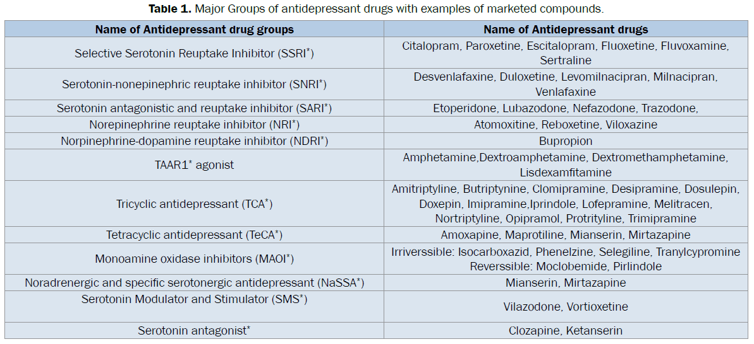
Types of antidepressants

Slide 47
Which antidepressant?
First episode:
Generic SSRIs preferred – better tolerated, safer in overdose.
Citalopram, fluoxetine, paroxetine, or sertraline.
Recurrent episode of depression
Consider an antidepressant the person has responded well to in the past.
Chronic physical health problem
Sertraline preferred (lower risk of drug interactions).
Dosulepin should only be started by a specialist
Increased cardiac risk and toxicity in overdose.
Notes:
Based on the CKS topic Depression (August 2013), NICE guidance (2009); Depression: the treatment and management of depression in adults (CG90), and Depression in adults with a chronic physical health problem (CG91).

Slide 48
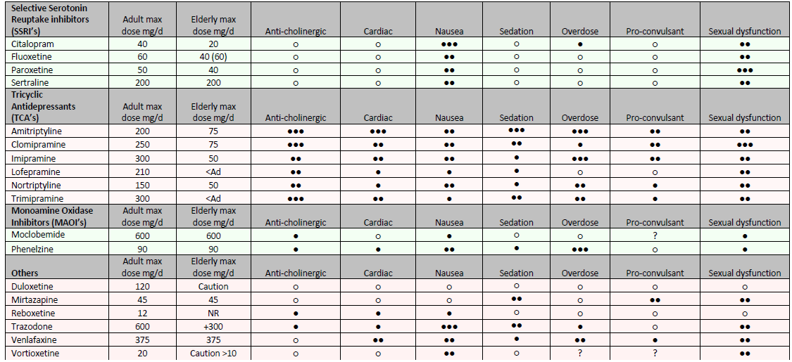
Relative side effects of antidepressants

Slide 49
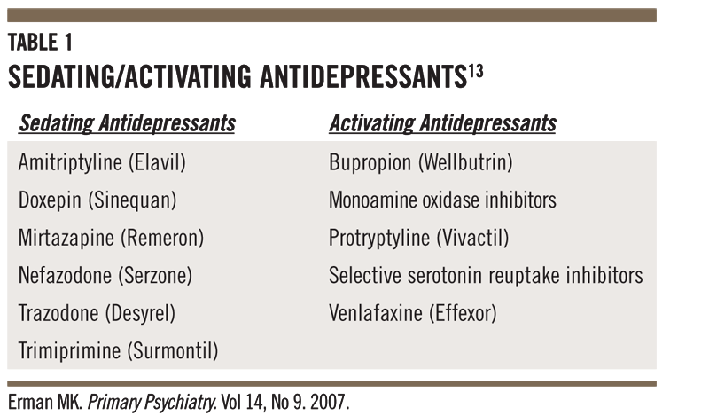

Slide 50
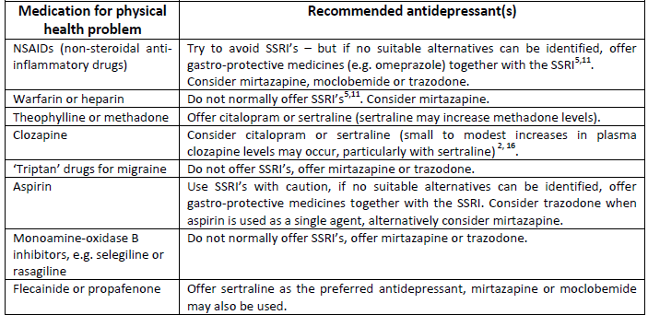

Slide 51
Follow up
Arrange frequent, regular review to assess:
Suicide risk
Any safeguarding concerns
Response to treatment
Adherence to treatment and adverse effects
Antidepressant effect is usually seen within 2 weeks.
Consider changing antidepressant after 4 weeks if poor response.
Augmentation of antidepressant– Ideally by an MH Specialist

Slide 52
Continuation and relapse prevention
Continue antidepressant for at least 6 months following remission – greatly reduces the risk of relapse.
Longer duration (up to 2 years or longer) may be needed (e.g. if the risk of relapse is high).
Discuss with the patient that:
this is to significantly reduce the risk of relapse
antidepressants are not associated with addiction.
Notes:
NOTES FOR PRESENTERS:

Slide 53
Psychological interventions for relapse prevention
Patients considered to be at significant risk of relapse or who have residual symptoms, should be offered one of the following psychological interventions:
Individual CBT:
for people who have relapsed despite antidepressant medication
for people with a significant history of depression and residual symptoms despite treatment.
Mindfulness-based cognitive therapy:
for people who are currently well but have experienced three or more previous episodes of depression.
Notes:
NOTES FOR PRESENTERS:
Key points to raise:
Mindfulness-based cognitive therapy: A psychological treatment that helps people with depression to become aware of negative thoughts and reduces the tendency to react to them. The aim is to encourage people to feel differently about their negative thoughts rather than to change the content of their thoughts. It usually takes place in groups consisting of 8 weekly sessions lasting 2 hours each. A further four sessions may be offered in the 12 months after the end of treatment.
Recommendation in full:
People with depression who are considered to be at significant risk of relapse (including those who have relapsed despite antidepressant treatment or who are unable or choose not to continue antidepressant treatment) or who have residual symptoms, should be offered one of the following psychological interventions:
•individual CBT for people who have relapsed despite antidepressant medication and for people with a significant history of depression and residual symptoms despite treatment
•mindfulness-based cognitive therapy for people who are currently well but have experienced three or more previous episodes of depression.
Related recommendations:
Delivering psychological interventions for relapse prevention:
For all people with depression who are having individual CBT for relapse prevention, the duration of treatment should typically be in the range of 16 to 20 sessions over 3 to 4 months. If the duration of treatment needs to be extended to achieve remission it should:
•consist of two sessions per week for the first 2 to 3 weeks of treatment
•include additional follow-up sessions, typically consisting of four to six sessions over the following 6 months.
Mindfulness-based cognitive therapy should normally be delivered in groups of 8 to 15 participants and consist of weekly 2-hour meetings over 8 weeks and four follow-up sessions in the 12 months after the end of treatment.
individual CBT for people who have relapsed despite antidepressants and for people with a significant history of depression and residual symptoms despite treatment. 16–20 sessions over 3–4 months. Offer follow up therapy
Provide mindfulness-based cognitive therapy for people who are currently well but have had 3 or more episodes of depression. Deliver in groups of 8–15 people in weekly 2-hour meetings over 8 weeks. Also offer 4 follow-up sessions in the next 12 months.

Slide 55
Refer to Secondary Care
if the patient is suffering from psychotic symptoms
if the patient has a history of bipolar effective disorder
if there is a risk of suicide
Also it is appropriate for consultation with, or referral to, a Psychiatrist
If the practitioner does not feel sufficiently experienced to manage a patient's condition
If two or more attempts to treat the patients depressive disorder have failed or only resulted in a partial response
If there is diagnostic uncertainty
Notes:
NICE suggest that (2) "..When a patient's depression has failed to respond to various strategies for augmentation and combination treatments, referral to a clinician with a specialist interest in treating depression should be considered.."

Slide 56
Ideal to avoid combining antidepressants in primary care
Refer to Specialist mental health services for oversight
High-intensity psychological interventions
Increased intensity & duration of the interventions
Need to develop a multidisciplinary care plan with the patient
Include a crisis plan
Identify crisis triggers & strategies to manage these
Shared with the patient & others

Slide 57
Step 4 interventions
Use intense CMHRS support & home treatment teams for crises
Consider advance decisions & advance statements if appropriate
Consider inpatient treatment if significant risk of suicide, self-harm or neglect, severity of associated psychotic symptoms etc
Consider ECT for severe, life-threatening depression, when a rapid response is required, or other treatments have failed

Slide 58
Secondary Care Mental Health The dreaded Referral Process to CMHRS

Slide 59
Who are we?

Slide 60
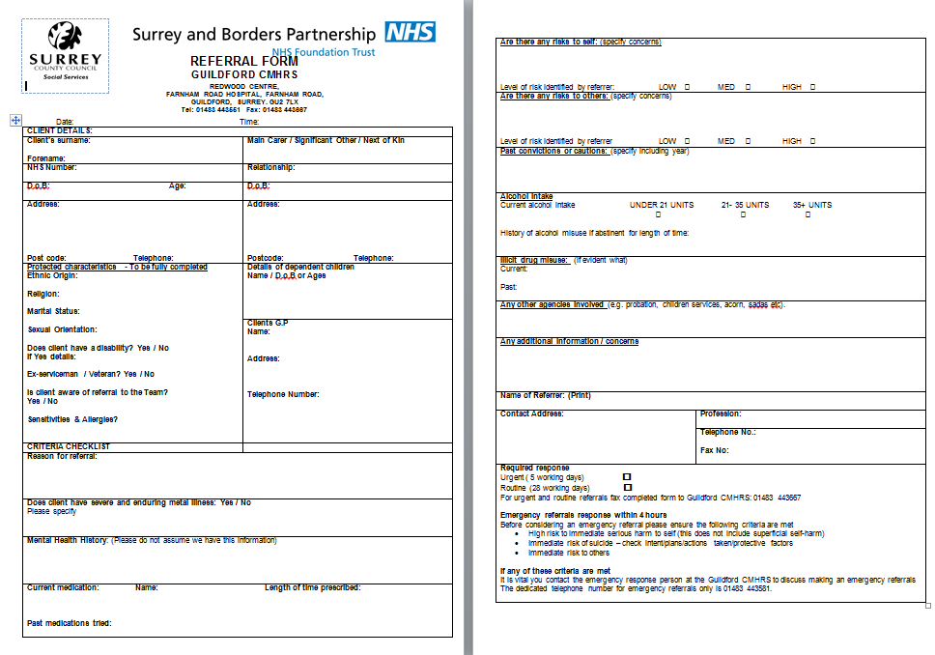
Current referral form

Slide 61
We would love to hear from you!
Positives – We don’t hear that very often
Negatives – Certainly want to hear more (if any)
Ideas for improvement?

Slide 62
Future Direction
eRS Advice and Guidance – Pilot project. Email based discussions between GPs and Consultant Psychiatrist. 72 hour response timeframe. Streamline referral process and facilitate better communication with GPs for patients not on CMHRS caseload. Future plan to link to SystemOne care notes.
Planned QI project -Personalised care plans from consultant(s) for patients who do not meet the mental health referral criteria. (learning from NHS Basildon and Brentwood CCG and Essex Partnership University NHS Foundation Trust)
Case for shared IT systems (between GPs and MH teams): Prompt access to patient notes + Physical health issues and investigations + Risk assessments.
Primary Mental Health Care Models- Many boroughs in London. Increasing awareness of the importance of mental health care provision to be housed in familiar, non stigmatised settings, closer to sources of family and community support

Slide 64
Any questions?

Slide 65
Novel Psychoactive Substances (NPS)

Slide 66
NPS – What are they?
Designer drugs, research chemicals, plant food, bath crystals, pond cleaner, synthetic drugs, analogues, legal highs.
Psychoactive drugs that are relatively new to recreational markets.
Mimic the effects of illegal drugs of abuse but are not (at present) covered by the Misuse of Drugs Act 1971.
Substances not controlled by international legislation, but which may pose a public health threat.
Illegal if sold for human consumption.
Chemical structure related to heroin, cocaine, cannabis, amphetamines, ecstasy, benzodiazepines, LSD.

Slide 67
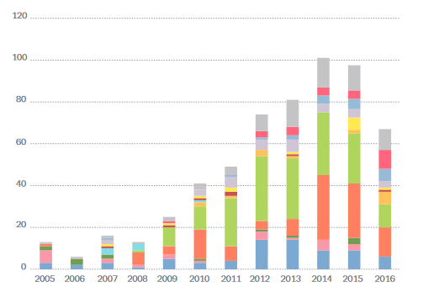
NPS reported each year by category
Source: EMCDDA, 2017. EMCDDA - Europol 2016 Annual Report on the implementation of Council Decision 20054/387/JHA.

Slide 68
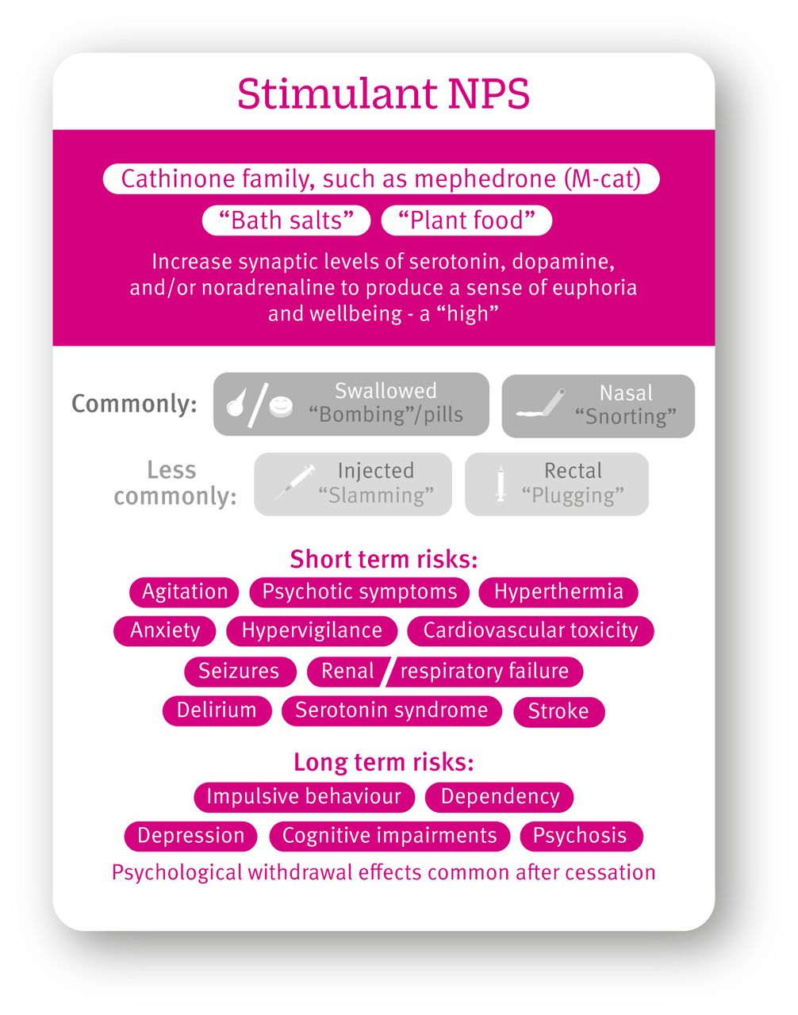
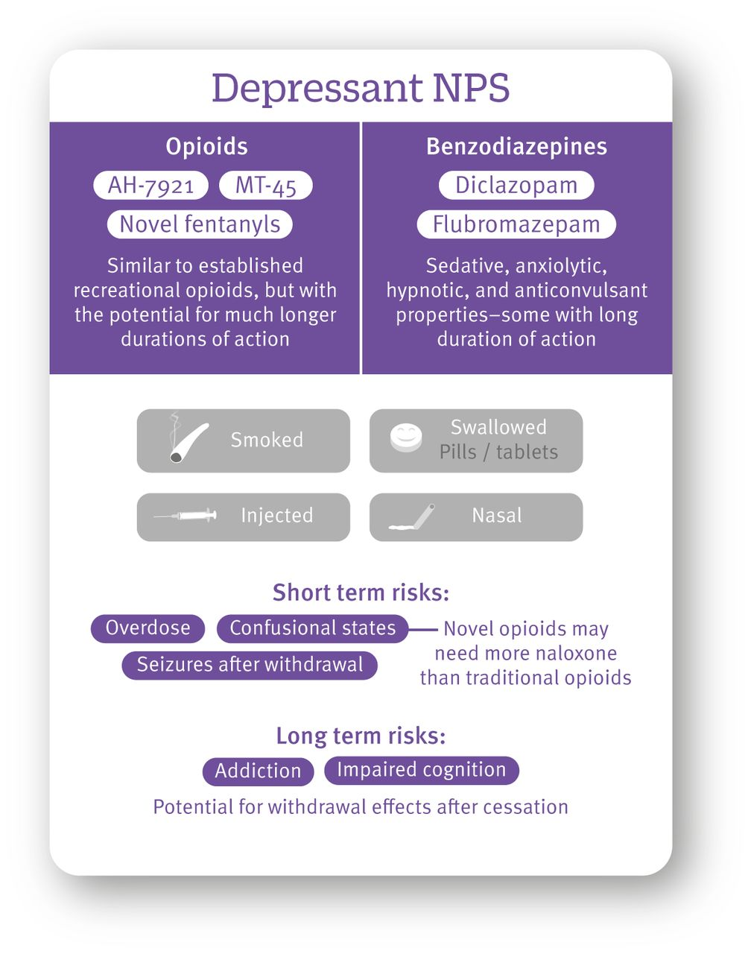

Slide 69
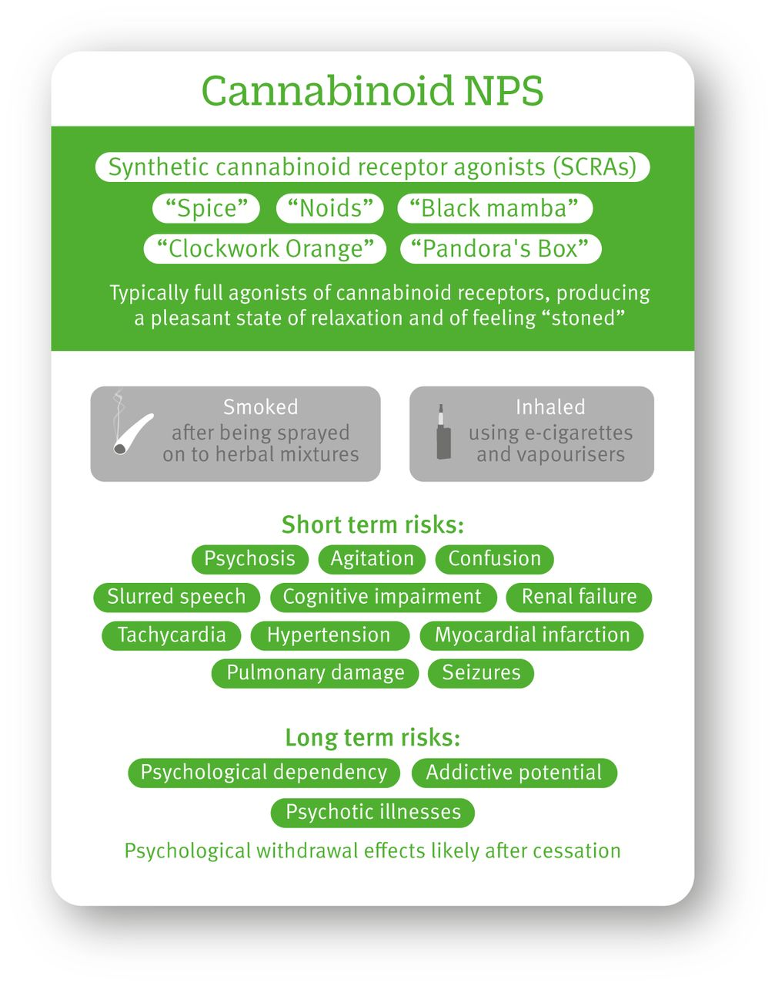
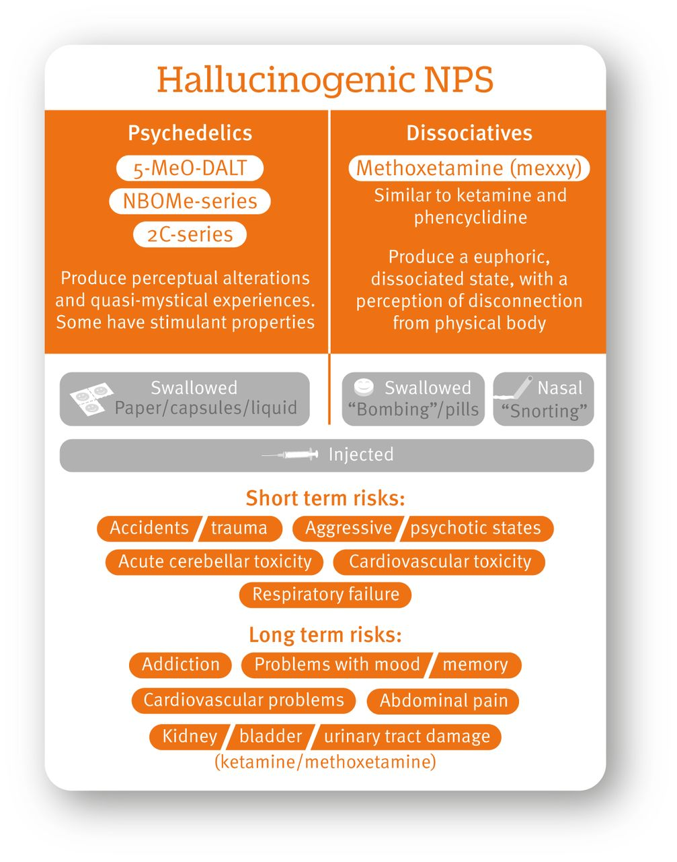

Slide 71
Where can I find out more?
SABP NHS foundation Trust website. But also do call us!
Guildford and Waverley CCG
NICE Guidance
RCPsych website

