Slide 1
Surrey Stop Smoking Service Liz fellows liz.fellows@quit51.co.uk 07971 807 844

Slide 2
Where we are now....
Current Stats
UK Prevalence down to 16.9%
Surrey prevalence 14%
132,000 smokers in Surrey
Smoking is the leading preventable cause of premature death in the UK,
Over 80,000 people die each year as a result of smoking – that’s 219 people every day
Notes:
In Surrey alone, the nicotine habit of more than 130,000 people is estimated to cost society more than £214 million a year, including:
• More than £42m for the NHS • More than £45m for work breaks • Nearly £39m for sick days • Almost £8m from fires • More than £5m to clean up litter

Slide 3
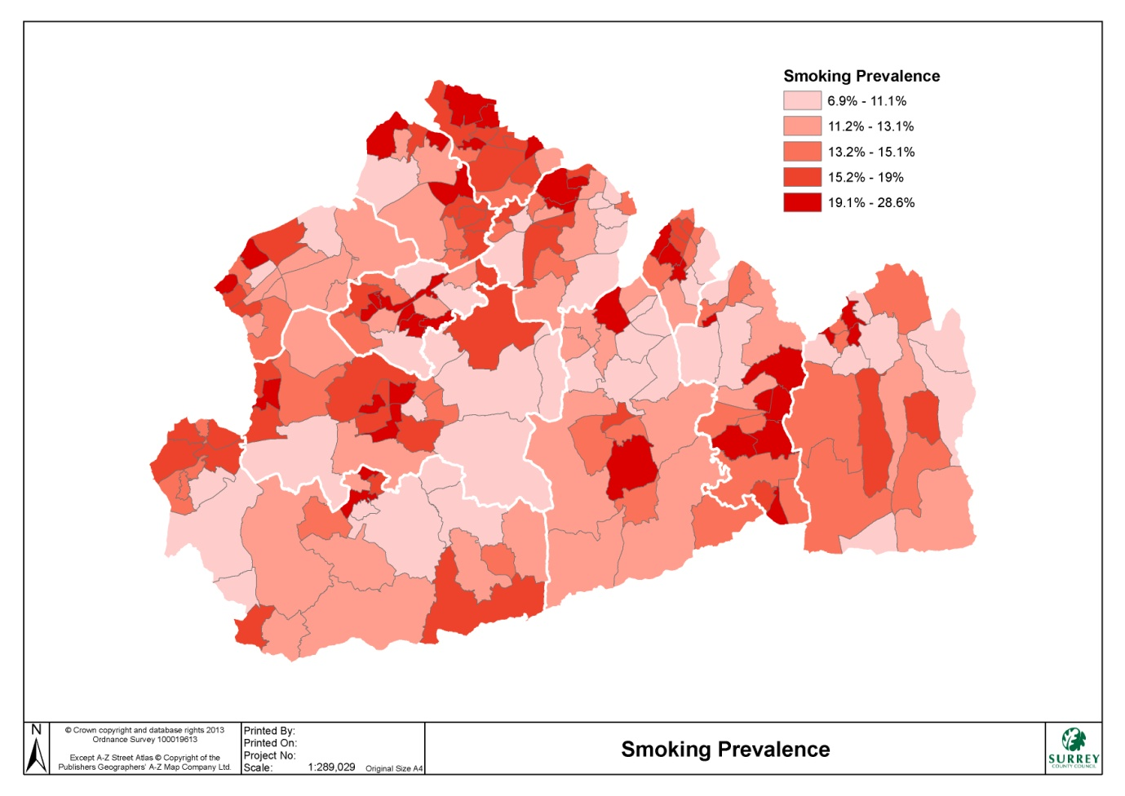
Notes:
Wards such as Preston in Reigate & Banstead, Westborough in Guildford, Old Dean in Surrey Heath, Maybury & Sheerwater Ward in Woking
Highest Ward Prevalence Preston - 28.6%

Slide 4
Smokinow....
Smoking is the main avoidable risk factor for Lung Cancer
In UK, 86% of lung cancer deaths are attributed to smoking
3%, from second hand smoke
Current smokers are 15 times more likely to die from lung cancer than life-long non smokers
After 10 years of quitting smoking, the risk of lung cancer reduces to half that of a smoker
Notes:
In Surrey alone, the nicotine habit of more than 130,000 people is estimated to cost society more than £214 million a year, including:
• More than £42m for the NHS • More than £45m for work breaks • Nearly £39m for sick days • Almost £8m from fires • More than £5m to clean up litter

Slide 5
The
The Good News
After 20 mins – blood pressure and pulse go back to normal
After 24 hours – carbon monoxide has left the body
After 1 year - the risk of heart attack fall to about half that of a smoker
Within 5 years -the risk of stroke is the same as a non smoker
Within 15 years - the risk of heart attack is the same as someone who has never smoked

Slide 6
Why raise the Issue
Only 1-3% of smokers quit without help
An offer of VBA from triggers a quit attempt in 40% of smokers
People are 4x more likely to quit smoking with a combination of medication and support by a trained practitioner.
We are a free service
Notes:
In Surrey alone, the nicotine habit of more than 130,000 people is estimated to cost society more than £214 million a year, including:
• More than £42m for the NHS • More than £45m for work breaks • Nearly £39m for sick days • Almost £8m from fires • More than £5m to clean up litter

Slide 7
VBA- Ask, Advise, Act
Ask (and record)
‘Are you a smoker’, ‘Do you currently smoke’
Record status- smoker, ex-smoker, non-smokers
Advise
‘You a 4 times more likely to quit with a combination of specialist support and stop smoking medication’
Act
‘Would you like me to make a referral to the local stop smoking service’
Notes:
In Surrey alone, the nicotine habit of more than 130,000 people is estimated to cost society more than £214 million a year, including:
• More than £42m for the NHS • More than £45m for work breaks • Nearly £39m for sick days • Almost £8m from fires • More than £5m to clean up litter

Slide 8
What Can a Client Expect
They will:
Receive a call within 48 hours from a trained stop smoking practitioner
Be advised that Quit51 have received a referral requesting stop smoking support
Check that the client is ready to quit and wants support to do so
Be advised about local support options and booked onto a suitable treatment programme

Slide 9
How we Help Smokers to Quit
We Offer:
Structured 12 week treatment programme –
Evidence based behavioural support programme
Delivered by a trained and experienced stop smoking practitioner
Weekly carbon monoxide readings
A variety of licensed treatment aid
Direct Supply NRT
Or prescribed medication – Champix or Zyban
This will increase chances of stopping X4 (DOH2003)

Slide 10
How to contact Quit51
Direct referral via emis template
Call Quit 51 – 0800 622 6968 (Mon-Fri 9am-6pm)
Text ‘smokefree’ to 66777
www.quit51.co.uk
Q51 offer a free 12 week support program to smokers over the age of 12 years, who live or work in Surrey.
Clinics take place across the community, and take the form of one-to-one or group sessions. We currently operate in GP, Pharmacies, libraries, supermarkets, sports centres. We offer telephone support for those unable to attend face to face clinics
Notes:
In Surrey alone, the nicotine habit of more than 130,000 people is estimated to cost society more than £214 million a year, including:
• More than £42m for the NHS • More than £45m for work breaks • Nearly £39m for sick days • Almost £8m from fires • More than £5m to clean up litter

