Slide 1
GP Education Afternoon 19th October 2017 Mild Cognitive Impairment Dementia in Care Homes
Dr Sophie Norris
Mental Health and Dementia Clinical CCG Lead and GP

Slide 2
Mild Cognitive Impairment (MCI) ‘Key Facts and Recommendations for Management’ –South East Clinical Networks
Notes:
Introduction.

Slide 3
Key Facts about MCI
Different from normal ageing, there is objective evidence of memory difficulty, may drop one or two points on GPCOG.
Differs from dementia because dementia affects a person’s everyday activities and is more than just memory loss.
Important to recognise because it occupies a position between normal ageing and dementia, similar to an abnormal glucose tolerance for diabetes.
Affects up to 20% of people over 65.
About a third may get better (showing symptoms were due to a transient physical or emotional illness). One third stay the same and one third go on to develop dementia (15 times more likely than the general population).
Notes:
Aims of presentation.

Slide 4
Following people up is the only way at present to distinguish those people who are getting worse.
This is also a great opportunity to talk about dementia risk reduction/prevention ‘What’s good for your heart’s good for your head’.
Advise about the importance of healthy lifestyle (exercise, alcohol within recommended limits, no smoking), nutrition, keeping your brain active (puzzles, cross words, suduko).
Notes:
Aims of presentation.

Slide 5
MCI Recommendations
Code on primary care systems: Read Code Eu057 or CTv3 code X00RS.
Include on the problem page so it is apparent whenever the patient attends an appointment.
Review at least annually in primary care, and ask two simple questions about their memory and/or how they are managing. Examples of questions:
Do you remember being referred to a specialist clinic last year to investigate how well you remember things? How are things now – better, the same or are you concerned?
How are you coping with every day things e.g. bills, remembering family events, driving?

Slide 6
Outcome of MCI review
Concerns about deterioration in memory or functioning
Re-evaluate using usual dementia screening process before rereferral to memory clinic:
Bloods
Screen for depression
Exclude physical illness and side effects from medication
History from patient and carer/family
Dementia screening tool eg GP-cog
No concerns about deterioration in memory or functioning
Review again in 12 months

Slide 7
Why Diagnose Dementia In Care Homes?

Slide 8
Diagnosing Dementia in Care Homes
Around three-quarters of people living in residential and nursing homes have dementia.
Some residents will have been assessed in the past and have a recorded diagnosis of dementia. However, many will have bypassed pathways to formal diagnosis if they were admitted from direct from hospital, placed as an emergency because of severe risks or a breakdown in home support or were admitted from outside the locality with limited background information coming with them.

Slide 9
It might be argued that there is limited benefit in diagnosing people with significant physical illness and high care needs as having dementia, as it will have little impact on their care. However, diagnosis, even in the presence of established disease, can have important practical benefits:
Some care home residents have mild or moderate dementia and symptoms which may be helped by cholinesterase inhibitor drugs or memantine. These diagnoses may be “missed” as they may appear to care home staff as relatively cognitively intact compared with other residents with more severe dementia and present no challenges to care – labels such as “pleasantly confused” are often attributed to them.
A diagnosis of dementia may trigger a general review of a resident’s medication – and the stopping of drugs which may affect cognition adversely.
The diagnosis can be recorded in the care home records which are useful for health and social care professionals who may be assessing the resident, prompts staff to consider MCA and DOLs issues where appropriate.

Slide 10
A diagnosis can help care home staff understand behaviours which may emerge – people with dementia are at significantly increased risk of developing a confused state in the presence of an intercurrent physical illness – and can alert clinicians to the risks of prescribing neuroleptic drugs.
Care staff may need to alter their care plans if a resident has cognitive impairment, for example to manage distress due to disorientation.
A diagnosis of dementia in a care home resident can act as a trigger for a discussion about advance care planning, addressing such important areas like how to manage physical illness and when and when not to admit to hospital.
Relatives and friends may find a formal diagnosis of dementia helpful as it helps them to understand some of the changes they have seen in their loved one and helps them to contribute in an informed way to their relatives care.

Slide 11
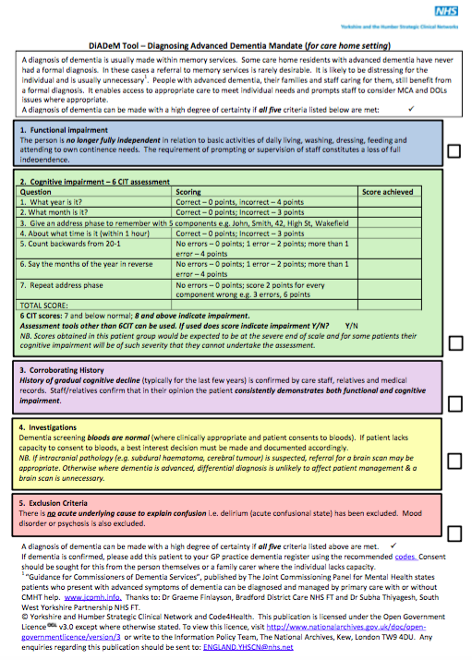
DiADeM (Diagnosis of Advanced Dementia Mandate in Care Homes)
DiADeM aims to support GPs to diagnose dementia for people living with advanced dementia in a care home setting.
Designed to be used with those patients for whom a trip to memory services is unlikely to be feasible, would be distressing and/or would not make a difference to ongoing management.
A diagnosis of dementia can be made with a high degree of certainty if all five criteria listed in the protocol are met.

Slide 12
Thank You

