Slide 1
Education Half Day CCG Update
Thursday, 19 July 2018

Slide 2
Primary Care Update
Shaping healthcare for you … and your family

Slide 3
Surrey Heartlands: Primary Care Home

Slide 4
The quadruple aim
Improving the health of populations
Improving the individual experience of care
Reducing the per capita cost of care
Improving the experience of providing care
- Increasing joy and meaning for the workforce
Sikka et al (2015)BMJ Quality and Safety - http://qualitysafety.bmj.com/content/early/2015/06/02/bmjqs-2015-004160.full
4

Slide 5
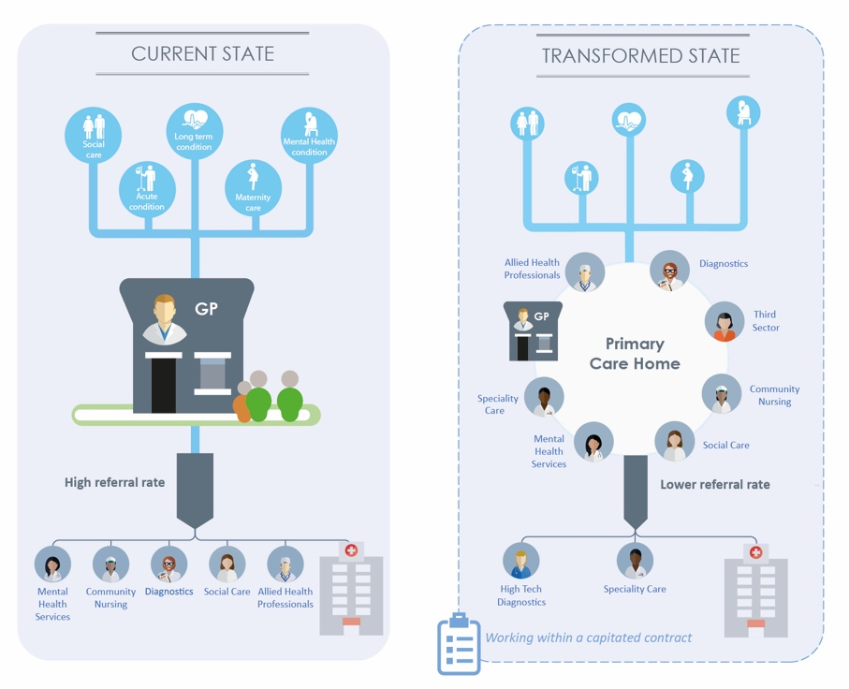
PCH has four key characteristics
provision of care to a defined, registered population of between 30,000 and 50,000.
a combined focus on improvements in population health outcomes and personalization of care
aligned clinical and financial drivers
an integrated workforce, with a strong focus on partnerships spanning primary, secondary and social care;
1
2
3
4
5
© 2017 National Association of Primary Care

Slide 6
Typical Journey – and support available
1
Engagement
2
Understand Population Health Data and Needs
6
Evidence and evaluation
Development Cycle
3
Care Model Development
5
Alignment of resources and financial drivers
4
Workforce, training, education, culture and planning
Building the energy, commitment and capability
National Network
Care Model Examples
National and international Lessons
6

Slide 7
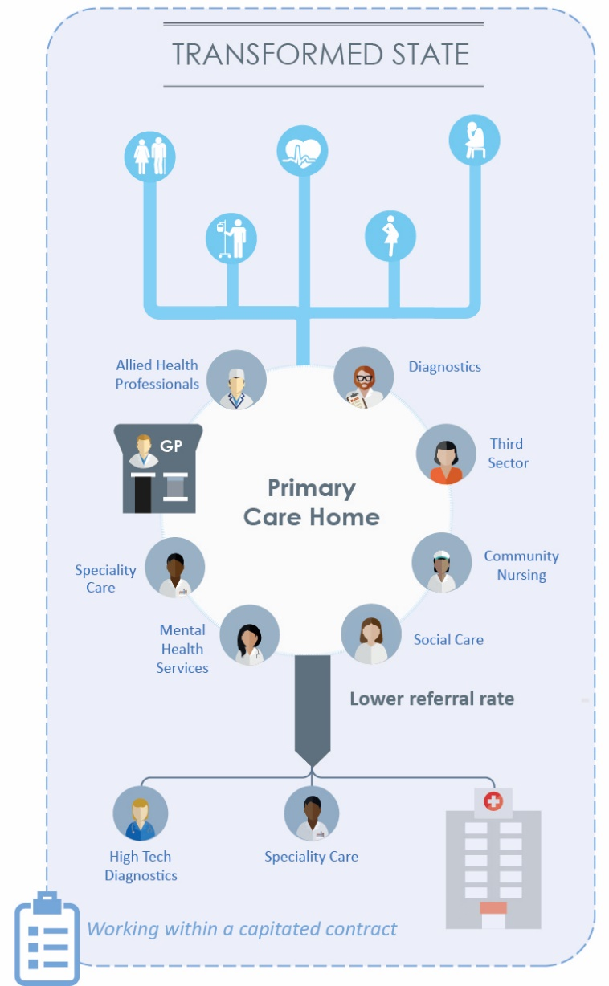
Stabilising general practice
The PCH, as well as being the right size to care, provides a ‘sweet spot’ for professional collaboration:
1. Encourages practices to morph and seek economies of scale
2. Easier for whole ‘system’ to engage
3. Freedom to act encourages innovation and improve recruitment and retention
4. Multidisciplinary Teams release more time for GPs
5. Allows real delivery of benefits faster and a development escalator

Slide 9
Unplanned Care Update
Shaping healthcare for you … and your family

Slide 10
Frailty and Integrated Care Programme
Purpose - to build and deliver an appropriate model for care, centered on individuals and provided closer to home by integrating mental health, physical health and social care.
Output - a joint transformation plan with RSCH to deliver system efficiencies and improve the care and support provided to local residents.
A Frailty and Integrated Care Programme Steering Group will deliver;
• strong clinical leadership; asking clinicians to lead improvement – the mantra is ‘physician-led, data driven, evidence-based’
• wide communication of strategic vision to make sure we bring colleagues and patients on a journey with us
• regular measurement and feedback reporting
• sustained focus on engagement with patients and families
• a culture strongly supportive of change and learning.

Slide 12
Let’s Get Steady FREE Falls Prevention Advice Sessions Prevention Advice Session
A reminder to refer in to ‘Let’s Get Steady’. A 2.5hr free falls prevention advice session which aims to provide practical advice to identify and reduce the risk of falls. The sessions are for people who have had a recent fall, are vulnerable to falls due to a long term condition or are fearful of falling. The session will provide:
advice on strength and balance from a physiotherapist
advice on hydration and nutrition
advice on safety within the home environment from an occupational therapist
advice on medication, sensory issues and foot care
advice on the latest alarms and sensors available
free falls and resource booklet packed with lots useful local information
Individuals can now self-refer via the borough council 01483 444 476 / 01483 444 347 or via a GP or Practice Nurse.

Slide 13
ReSPECT
What is ReSPECT?
ReSPECT is a process that creates personalised recommendations for a person’s clinical care in a future emergency in which they are unable to make or express choices.
Who is ReSPECT for?
ReSPECT can be for anyone, but will have increasing relevance for people who have complex health needs, people who are likely to be nearing the end of their lives, and people who are at risk of sudden deterioration or cardiac arrest. Some people will want to record their care and treatment preferences for other reasons.
Where has ReSPECT been implemented locally?
The ReSPECT process was implemented at the Royal Surrey County Hospital on 1st April 2018, and will be implemented at Ashford and St. Peter’s Hospitals in August 2018. All 3 CCGs in the Surrey Heartlands region have now agreed to implement ReSPECT, so it will be introduced in primary care later in the year.
How will practices know if a patient has a ReSPECT form?
Following introduction at Royal Surrey County Hospital, patients may be discharged into GP care with a ReSPECT form. Currently, this will be evident from the discharge summary. However, the ReSPECT Implementation Team is working on production of a copy of forms, to be sent to GPs upon patient discharge.
Who will hold ReSPECT forms?
The ReSPECT form is given to the patient when discharged, and must follow the patient for their ongoing care and any subsequent readmissions as relevant. The ReSPECT form, which stands out as it is purple, should be held with a patient’s care planning documentation.
How will ReSPECT forms be shared?
The ReSPECT Implementation Team is urgently trying to solve the digital challenge to document sharing. There is work underway for a national approach, but until then a local solution is being sought.
What happens to DNACPR forms?
For patients with a new ReSPECT form - The agreed clinical recommendations that are recorded on a ReSPECT form include a recommendation on whether or not CPR should be attempted. There is no need for a supplementary DNACPR form to be completed (if applicable), as ReSPECT is valid as an emergency decision making guide.
For patients with existing DNACPR forms - Any current DNACPR forms will not be rewritten, and will continue to be valid until no longer relevant.
For patients in the community where a DNACPR discussion is appropriate - Until the ReSPECT process is fully introduced across the whole system, DNACPR forms should continue to be produced by primary care, where appropriate.
What happens to PACe and advance care planning forms?
ReSPECT can be complementary to a wider process of advance/anticipatory care planning. Therefore, patients may also have a PACe form or other advance care plan. ReSPECT will not replace such plans.
Contact:
Janni Hodgson, ReSPECT Implementation Lead - jannihodgson@nhs.net , 07976 581579

Slide 14
Planned Care Update
Shaping healthcare for you … and your family

Slide 15
e-RS Paper Switch Off
The Standard Contract for 2018/19 requires the full use of the NHS e-Referral Service (e-RS) for all consultant-led first outpatient appointments.
From 1st October 2018, providers will only be paid for activity resulting from referrals made through e-RS. Locally, Royal Surrey County, Frimley Park and Ashford and St. Peter’s trusts are working towards an earlier date.
Moving from a paper-based referral system to an electronic referral system has some big advantages including:
· Improving patient experience by making referrals easier to track
· Removing the need for paper referrals and faxes
· Faster and more accurate systems with correct clinic booking first time
What will it involve and what will it mean?
From 2nd July the Royal Surrey County, Frimley Park and Ashford and St. Peter’s trusts will only accept bookings through e-RS for all consultant-led first outpatient appointments.
From 1st October trusts will only be paid for activity resulting from referrals sent electronically. Over the next three months the Royal Surrey County are planning a phased introduction of e-RS by specialty. Implementation will also involve phased removal of fax machines and fax lines in the trust and e-RS email referral options. GP referrals received after these dates, which are not sent by e-RS, will be returned to practices and GPs will be asked to resubmit them electronically.

Slide 16
X-Pert Course
X-PERT Diabetes
An effective self-management intervention
This is a highly effective programme for people with Type 2 diabetes, or those at risk of developing diabetes. It aims to develop the knowledge, skills and confidence of participants, enabling them to make informed decisions about their lifestyles and management of their condition.
For: People with diabetes or those at risk
Course Type: 6 week course – 2.5 hours per week – up to 20 participants
Benefits to patients;
Increased carbohydrate awareness
Healthier eating
Increased energy levels
Improved fitness
Improved wellbeing and quality of life
Improved blood glucose levels
Fewer hypos
Lower blood pressure
GP’s can send patient referrals directly to iowselfmanagementuk@nhs.net, or ‘bulk’ refer patients via the guidance on the next slide

