Slide 1
Lung cancer: An update
Consultant Respiratory Physician
jonathan.dakin@nhs.net

Slide 2
Programme
Epidemiology
Clinical presentation
Investigation
Staging
Survival
Therapy
Nodules
Screening
The future

Slide 3
Local epidemiology / performance Incidence Rate and One Year Survival

Slide 4
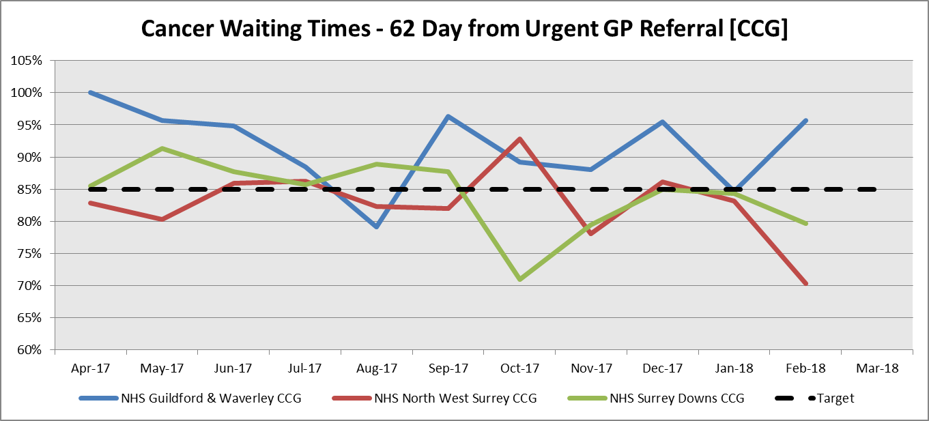
Cancer Waiting Times – 62 Day from Urgent GP Referral
Shaping healthcare … for you and your family

Slide 5
Clinical presentation
Cough 55%
Haemoptysis 28% (<30% have Ca)
Dyspnoea 45% (← effusion)
Chest pain 38%
↓ Weight 36%
Mean age 64, M > F
Hyde L Chest 1974; 65:299 and Chute CG Cancer 1985; 56:2107

Slide 6
Clinical presentation: smoking
Always say “never” (smoker).
16 years post cessation to reset risk.
Always suspect in a current or former smoker with new onset cough or haemoptysis.

Slide 7
Investigation
CXR (23% -ve*)
CT
Bronchoscopy
Endobronchial ultrasound
PET
CT biopsy
Pleural aspiration
Thoracoscopy
*Stapley, S. Br J Gen Prac 2006

Slide 8
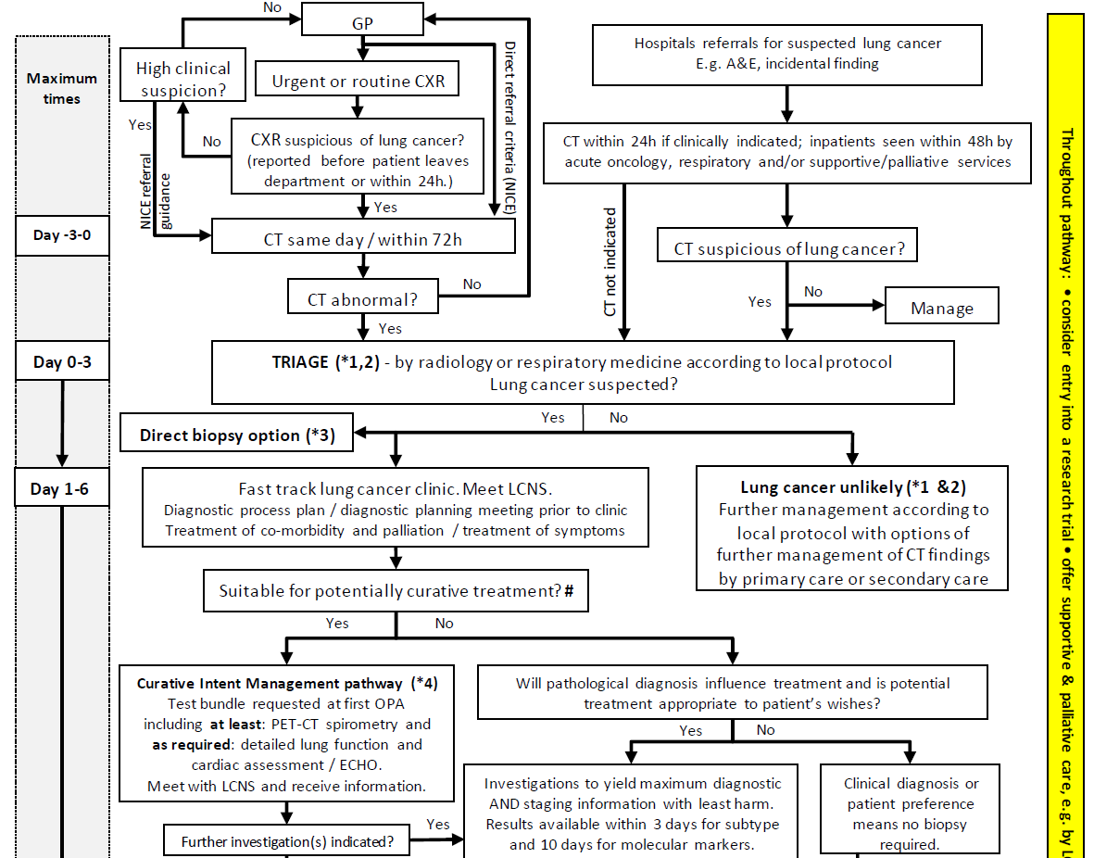
National Optimal Lung Cancer Pathway (49/7)
Notes:
Pathway Detail 3
Direct to biopsy variation
This pathway allows for early diagnostic biopsy where other tests are not required for staging and treatment. Such patients include those that have obvious advanced disease that is not suitable for treatment with curative intent. Patients potentially suitable for curative intent generally require a PET-CT to clarify diagnosis (for small pulmonary nodules) staging and the most appropriate first diagnostic and staging investigation. Direct biopsy investigations include neck ultrasound guided biopsy, percutaneous lung biopsy, endobronchial ultrasound needle biopsy, pleural aspiration and pleural biopsy. The direct biopsy pathway has the potential to provide a rapid diagnosis for some patients where detailed staging and fitness investigations are not needed to guide management.

Slide 9
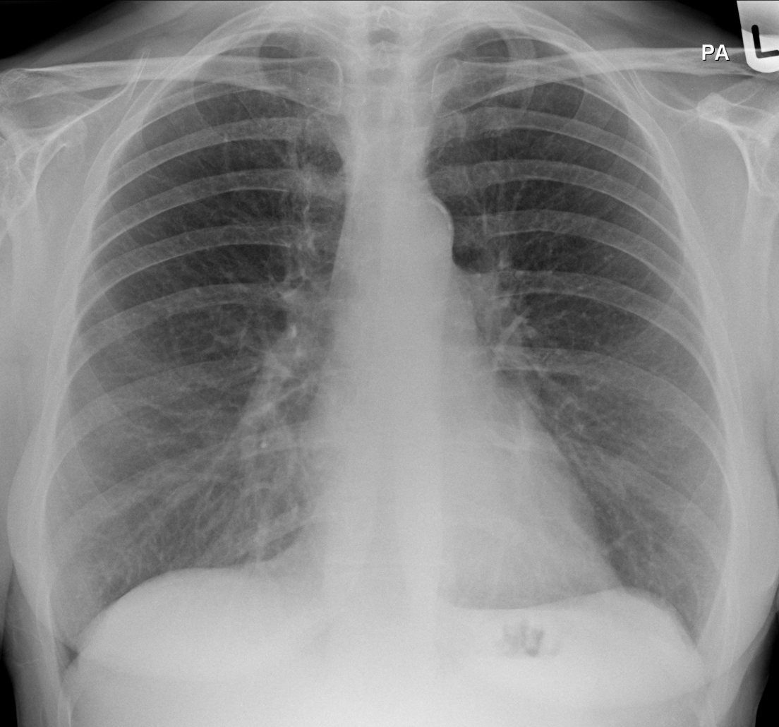
Investigation: CXR
CXR
CT

Slide 10
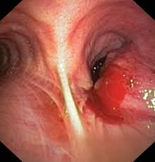
Bronchoscopy

Slide 11
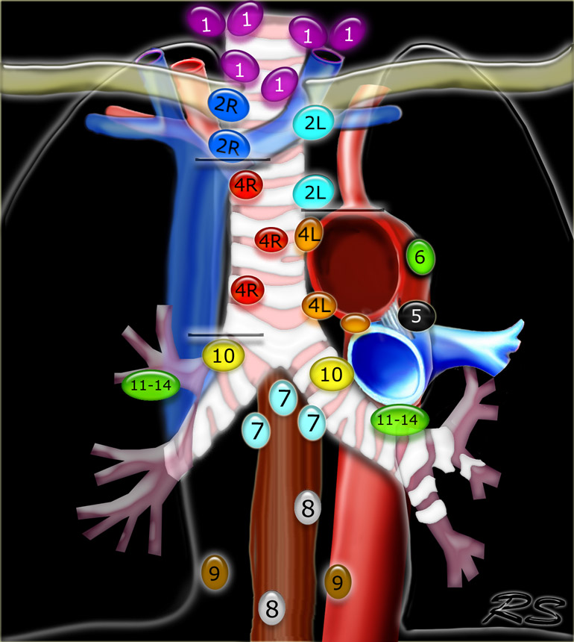
Investigation: PET for staging
PET

Slide 12
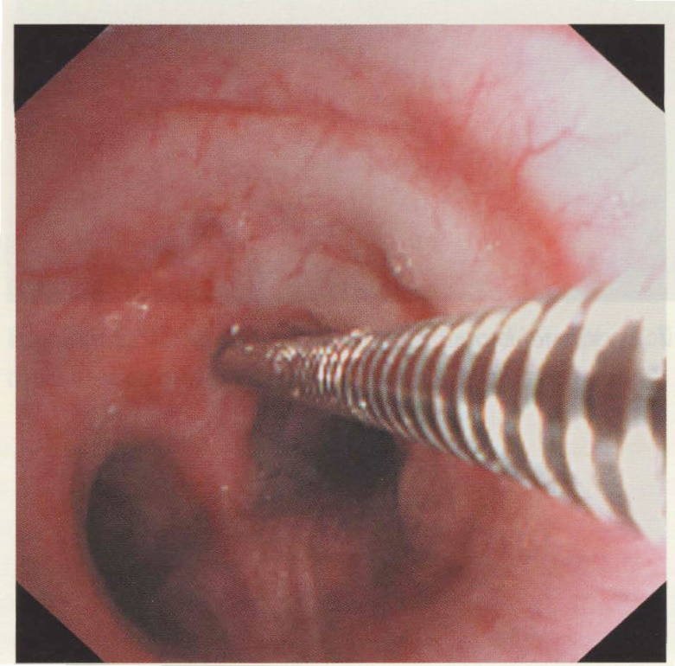
Investigation: Endobronchial US

Slide 13
Survival by clinical stage
IA1
IA2
IA3
IB
IIA
IIB
IIIA
IIIB
IVA
IVB
Months
Goldstraw P. J Thorac Oncol 2016; 1:39.
Notes:
Goldstraw P. The IASLC lung cancer staging project: proposals for revision of the TNM state grouping in the forthcoming (Eighth) edition of the TNM classification for lung cancer. J Thorac Oncol 2016; 1:39.

Slide 14
Types
Squamous
Adeno
Small cell
Adeno with Lepidic growth
(brocheolo-alveolar cell, BAC)

Slide 15
Adeno with lepidic growth
2014
2018

Slide 16
CT biopsy

Slide 17
Treatment

Slide 18
Therapy: Surgery
Treatment of choice
Stage I and II disease resectable
16% of patients in UK¹
Heavily determined by stage at diagnosis
Many diagnosed on acute presentation
30% recurrence rate at 5 years²
1 National Cancer Registration & Analysis Service and Cancer Research UK: Chemotherapy, Radiotherapy and Tumour Resections in England: 2013-2014. London: NCRAS; 2017
2 Landreneau RJ. J Clin Oncol 2014

Slide 19
Therapy: Radiotherapy
With curative intent
Stereotactic ablative radiotherapy (SABR)
3 year survival 50%
Adjunctive
+ve margins, N2 disease
Chemo / rad for stage 3
Palliative for pain, SOB, haem, spinal column, bones, brain.

Slide 20
Treatment: Cytotoxic therapy WHO performance scale
Performance status | Definition
0 | Fully active; no performance restriction.
1 | Strenuous physical activity restricted; fully ambulatory and able to carry out light work.
2 | Capable of all self-care but unable to carry out any work activities. Up and about >50% of waking hours.
3 | Capable of only limited self-care; confined to bed or chair >50% of waking hours.
4 | Completely disabled; cannot carry out any self-care; totally confined to bed or chair.
Notes:
2 may be ok for single agent

Slide 21
Targeted therapies
Molecular targets involved in genesis / progression of cancer
“Driver mutations”
Proliferation switch in the on position
Notes:
https://en.wikipedia.org/wiki/Epidermal_growth_factor_receptor
DRIVER MUTATIONS AS BIOMARKERS — The most useful biomarkers for predicting the efficacy of targeted therapy in advanced NSCLC are somatic genome alterations known as "driver mutations." These mutations occur in cancer cells within genes encoding for proteins critical to cell growth and survival. Many other recurrent molecular alterations have been identified in NSCLC that are much less essential to maintain the oncogenic phenotype, and are often referred to as "passenger mutations." Driver mutations are typically not found in the germline (noncancer) genome of the host and are usually mutually exclusive (ie, a cancer is unlikely to have more than one driver mutation) (figure 1).
Driver mutations are typically transformative, which means that they initiate the evolution of a noncancerous cell to malignancy. In addition, driver mutations often impart an oncogene-addicted biology to the transformed cell, meaning that the mutated protein engenders reliance within the cancer cell to receive a signal from the driver in order to survive.
Oncogene addiction tends to make driver mutations good biomarkers for selecting patients for targeted therapies. The extreme reliance of crucial downstream growth and survival pathways in the cell upon a single upstream signal that is "stuck in the on position" serves as an Achilles’ heel, making the cancer uniquely susceptible to down-regulation of signal originating from the driver (ie, unable to survive if a targeted drug essentially turns the switch to the off position because other mechanisms to keep downstream signals flowing are nonexistent).
EGFR mutation — Mutations in the epidermal growth factor receptor (EGFR) tyrosine kinase are observed in approximately 15 percent of NSCLC adenocarcinoma in the United States and occur more frequently in nonsmokers [13]. In Asian populations, the incidence of EGFR mutations is substantially higher, up to 62 percent [14]. In advanced NSCLC, the presence of an EGFR mutation confers a more favorable prognosis and strongly predicts for sensitivity to EGFR tyrosine kinase inhibitors (TKIs) such as erlotinib, gefitinib, afatinib, and osimertinib. A detailed discussion of the treatment of EGFR-mutant NSCLC is presented separately. (See "Systemic therapy for advanced non-small cell lung cancer with an activating mutation in the epidermal growth factor receptor".)
The use of EGFR TKIs is based upon the detection of these mutations, which may be detected either in solid tissue biopsies or in liquid biopsies [15]. The US Food and Drug Administration (FDA)-approved tests are the Cobas EGFR mutation test for common activating mutations or Cobas EGFR mutation test v2 for the T790M mutation; however, any Clinical Laboratory Improvement Amendments (CLIA) certified-laboratory EGFRmutation result is generally acceptable for clinical decision-making [16]. Clinical standards are rapidly evolving, but based on available evidence, we offer liquid biopsy to EGFR mutation-positive patients who have progressed on erlotinib, gefitinib, or afatinib to look for the T790M mutation. If positive, such patients can be treated with osimertinib. However, the emerging use of first-line osimertinib may largely prevent the development of T790M resistance [17]. For those who are T790M-negative on a plasma assay, we proceed with tumor biopsy given an observed false-negative rate of 30 percent associated with plasma genotyping [10,15]. (See 'Liquid biopsies' above and "Systemic therapy for advanced non-small cell lung cancer with an activating mutation in the epidermal growth factor receptor".)
Systemic therapy for advanced non-small cell lung cancer with an activating mutation in the epidermal growth factor receptor
RATIONALE
Molecular pathogenesis — Tumor growth and progression depend upon the activity of cell surface membrane receptors that control intracellular signal transduction pathways regulating cell proliferation, apoptosis, angiogenesis, adhesion, and motility.
These cell surface receptors include the epidermal growth factor receptor (EGFR, also called HER1 or erbB-1) tyrosine kinases (TKs). EGFR exists as a monomer on the cell surface, and it must dimerize to activate the TK. While the TK activity of EGFR is tightly controlled in normal cells, the genes encoding these receptors may have escaped from their usual intracellular inhibitory mechanisms in malignant cells (figure 1).

Slide 22
Targeted therapies
Epidermal growth factor receptor (EGFR)
15% of cancers in non-smokers
Up to 60% of Asians
Anaplastic lymphoma kinase (ALK)
2-5%
ROS1
1-2%
Notes:
https://en.wikipedia.org/wiki/Epidermal_growth_factor_receptor
DRIVER MUTATIONS AS BIOMARKERS — The most useful biomarkers for predicting the efficacy of targeted therapy in advanced NSCLC are somatic genome alterations known as "driver mutations." These mutations occur in cancer cells within genes encoding for proteins critical to cell growth and survival. Many other recurrent molecular alterations have been identified in NSCLC that are much less essential to maintain the oncogenic phenotype, and are often referred to as "passenger mutations." Driver mutations are typically not found in the germline (noncancer) genome of the host and are usually mutually exclusive (ie, a cancer is unlikely to have more than one driver mutation) (figure 1).
Driver mutations are typically transformative, which means that they initiate the evolution of a noncancerous cell to malignancy. In addition, driver mutations often impart an oncogene-addicted biology to the transformed cell, meaning that the mutated protein engenders reliance within the cancer cell to receive a signal from the driver in order to survive.
Oncogene addiction tends to make driver mutations good biomarkers for selecting patients for targeted therapies. The extreme reliance of crucial downstream growth and survival pathways in the cell upon a single upstream signal that is "stuck in the on position" serves as an Achilles’ heel, making the cancer uniquely susceptible to down-regulation of signal originating from the driver (ie, unable to survive if a targeted drug essentially turns the switch to the off position because other mechanisms to keep downstream signals flowing are nonexistent).
EGFR mutation — Mutations in the epidermal growth factor receptor (EGFR) tyrosine kinase are observed in approximately 15 percent of NSCLC adenocarcinoma in the United States and occur more frequently in nonsmokers [13]. In Asian populations, the incidence of EGFR mutations is substantially higher, up to 62 percent [14]. In advanced NSCLC, the presence of an EGFR mutation confers a more favorable prognosis and strongly predicts for sensitivity to EGFR tyrosine kinase inhibitors (TKIs) such as erlotinib, gefitinib, afatinib, and osimertinib. A detailed discussion of the treatment of EGFR-mutant NSCLC is presented separately. (See "Systemic therapy for advanced non-small cell lung cancer with an activating mutation in the epidermal growth factor receptor".)
The use of EGFR TKIs is based upon the detection of these mutations, which may be detected either in solid tissue biopsies or in liquid biopsies [15]. The US Food and Drug Administration (FDA)-approved tests are the Cobas EGFR mutation test for common activating mutations or Cobas EGFR mutation test v2 for the T790M mutation; however, any Clinical Laboratory Improvement Amendments (CLIA) certified-laboratory EGFRmutation result is generally acceptable for clinical decision-making [16]. Clinical standards are rapidly evolving, but based on available evidence, we offer liquid biopsy to EGFR mutation-positive patients who have progressed on erlotinib, gefitinib, or afatinib to look for the T790M mutation. If positive, such patients can be treated with osimertinib. However, the emerging use of first-line osimertinib may largely prevent the development of T790M resistance [17]. For those who are T790M-negative on a plasma assay, we proceed with tumor biopsy given an observed false-negative rate of 30 percent associated with plasma genotyping [10,15]. (See 'Liquid biopsies' above and "Systemic therapy for advanced non-small cell lung cancer with an activating mutation in the epidermal growth factor receptor".)
Systemic therapy for advanced non-small cell lung cancer with an activating mutation in the epidermal growth factor receptor
RATIONALE
Molecular pathogenesis — Tumor growth and progression depend upon the activity of cell surface membrane receptors that control intracellular signal transduction pathways regulating cell proliferation, apoptosis, angiogenesis, adhesion, and motility.
These cell surface receptors include the epidermal growth factor receptor (EGFR, also called HER1 or erbB-1) tyrosine kinases (TKs). EGFR exists as a monomer on the cell surface, and it must dimerize to activate the TK. While the TK activity of EGFR is tightly controlled in normal cells, the genes encoding these receptors may have escaped from their usual intracellular inhibitory mechanisms in malignant cells (figure 1).

Slide 23
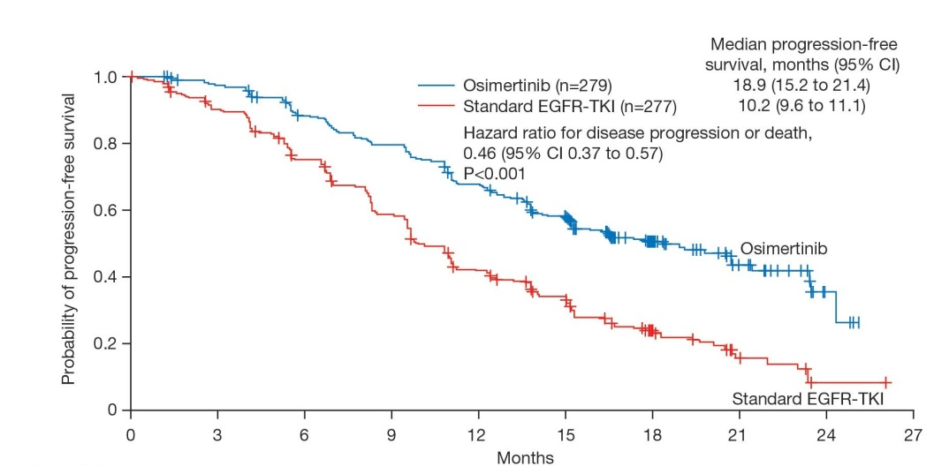
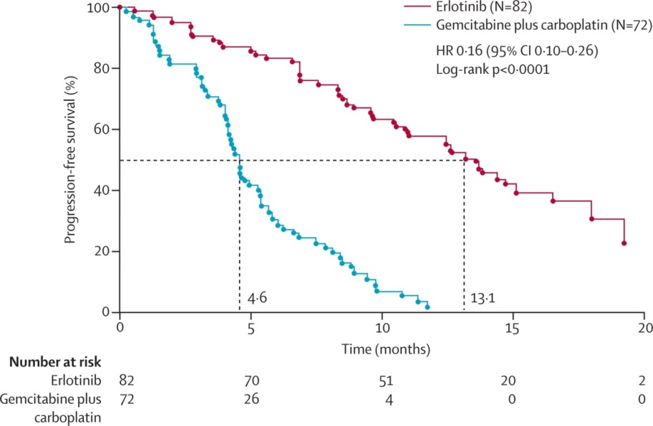
EGFR
10.2
18.9
Erlotinib (Tarceva) vs Gemcitabine + carboplatin
Osimertinib (Tagrisso) vs std EGFR TKI
Caicun Zhou. Lancet Onc 2011
Soria, JC. NEJM. 2017

Slide 24
Nodules
< 3cm
Types: solid, ground glass opacification
25% of CT scans in > 50 yo subjects
Brock model predicts malignancy likelihood
Surveillance needed for 3/12 to 4 years

Slide 25
Nodule CT

Slide 26
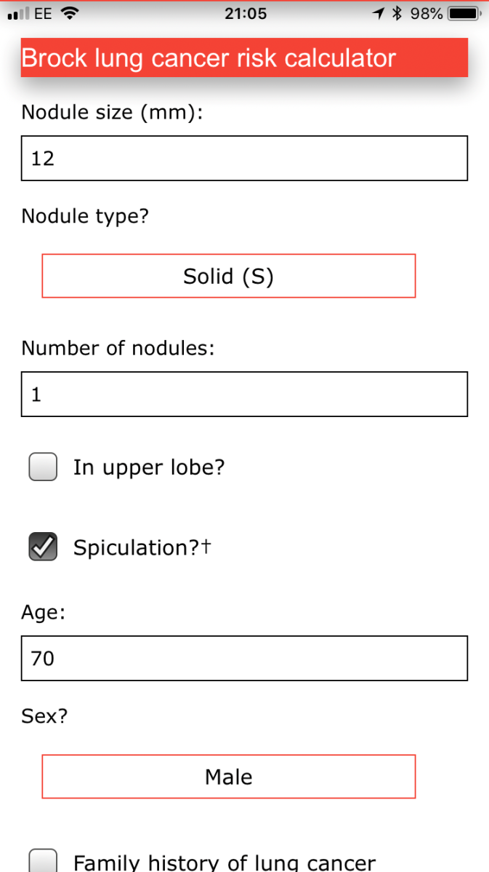
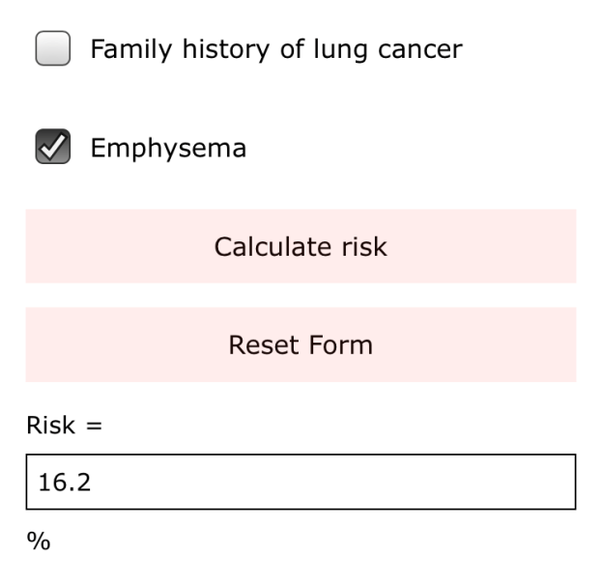
Brock calculator

Slide 27
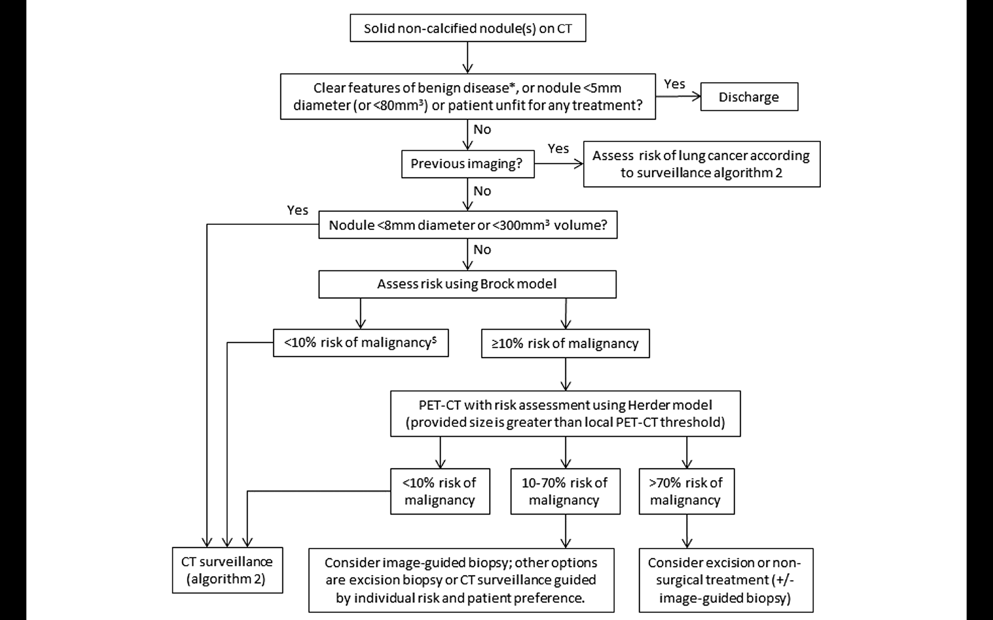
Solid nodules

Slide 28
GGO’s – adenocarcinoma spectrum
Atypical adenomatous hyperplasia | < 5mm
Adenocarcinoma in situ | < 30mm
Minimally invasive adenocarcinoma | < 30mm GGO with solid area < 5mm Adenocarcinoma with lepidic growth
Invasive adenocarcinoma
Notes:
Atypical adenomatous hyperplasia (AAH) is a premalignant lesion that typically measures <5 mm in diameter and may appear as a pure ground-glass nodule (pGGN) or may not be apparent on CT.
Adenocarcinoma in situ (AIS) is a preinvasive lesion that may measure up to 30 mm in diameter and typically appears as a pGGN on CT. AAH is a relatively common incidental finding, present in the lung tissue adjacent to resected adenocarcinomas in up to 23% of cases. A small but unknown proportion of AAH lesions may evolve (often slowly) into AIS, and AIS may progress to become invasive adenocarcinoma.
The first stage of AIS becoming invasive adenocarcinoma is termed minimally invasive adenocarcinoma (MIA). MIA is defined as a lesion of AIS within which there is an area of invasive adenocarcinoma that measures ≤5 mm in diameter. MIA may correlate with an appearance on CT as a ground-glass opacity within which there is a solid area measuring <5 mm (see table 2).

Slide 29
Screening
National US lung screening trial*
20% ↓ † in trial group – stopped early
Recommended (funded) for:
65-75 yo
30 py
active smoker or < 15 years post quitting
*Reduced Lung-Cancer Mortality with Low-Dose CT Screening. N Engl J Med 2011

Slide 30
European data
**
**Eurocare 5

Slide 31
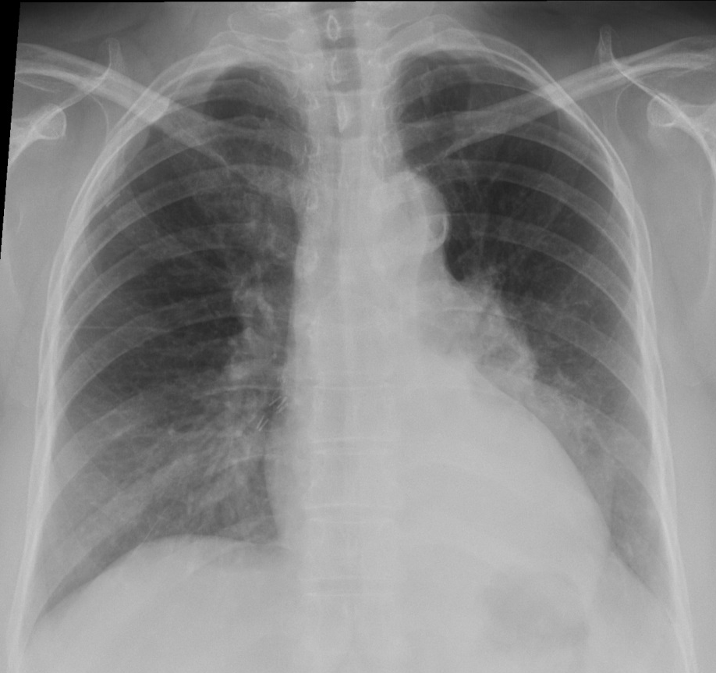
Late diagnosis
59 F. S American. Cough 17/12
Notes:
59 Latin American lady
Presented Aug 17 with 18/12 cough
Lifelong non-smoker
PH CA breast 2011 treated modified right radical mastectomy, 3/7 axillary nodes positive
Abnormal CXR July
PET showed mets liver, adrenal, bone, mediastinum
Excellent response to treatment on PET Feb 18

Slide 32
National Optimal Lung Cancer Pathway (49/7)
Notes:
Pathway Detail 3
Direct to biopsy variation
This pathway allows for early diagnostic biopsy where other tests are not required for staging and treatment. Such patients include those that have obvious advanced disease that is not suitable for treatment with curative intent. Patients potentially suitable for curative intent generally require a PET-CT to clarify diagnosis (for small pulmonary nodules) staging and the most appropriate first diagnostic and staging investigation. Direct biopsy investigations include neck ultrasound guided biopsy, percutaneous lung biopsy, endobronchial ultrasound needle biopsy, pleural aspiration and pleural biopsy. The direct biopsy pathway has the potential to provide a rapid diagnosis for some patients where detailed staging and fitness investigations are not needed to guide management.

Slide 33
The future
Refinement of pathway
CT 1st
One-stop service
Screening (?)
Biologicals – personalised medicine

