Slide 1
Neurodevelopmental Service
Sarah Hepburn
Service Manager

Slide 2
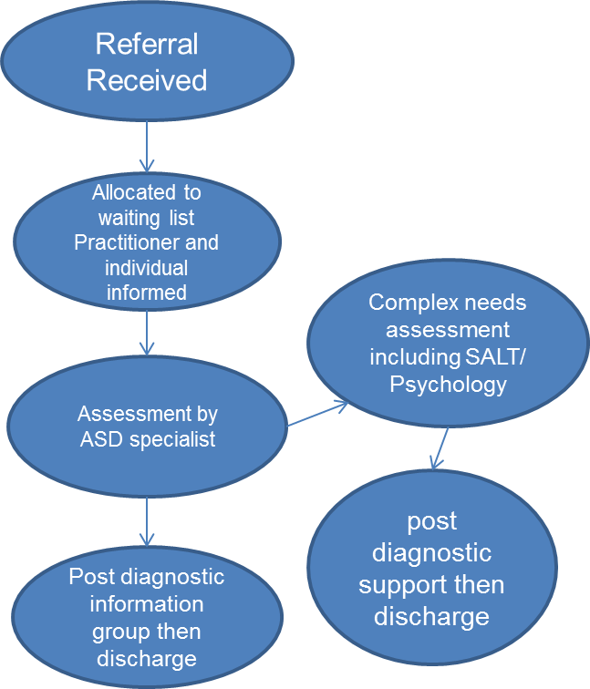
Surrey and Borders Partnership NHS Trust.
The ASD Diagnostic service is based in several locations across Surrey and Hampshire
Currently has 3 ASD Practitioners, SaLT and psychology, both part-time, consultant psychiatrist

Slide 3
ASD: the problem
ASD Referrals/ demand
Appointments
Discharges
?
ASD Clinic capacity

Slide 4
Problem Summary ASD : Health related issues
Very few drugs have ASD licence
Treat underlying symptoms and conditions
GP currently holding
Interface ASD/ CMHRS/ GP
Support needed for GP’s- liaison, advice and consultation

Slide 5
The new ASD management Service
Recently commissioned by Surrey CCG for people with a Surrey GP
To support people with a diagnosis of ASD who have a complex presentation
For people who’s ASD is impacting negatively throughout all areas of their daily lives
For people who have are experiencing a period of mental ill-health and need further support in relation to their ASD needs.

Slide 6
ASD Complex Management Service- staffing
1 ASD practitioner
1 Clinical Psychologist
1 Health Facilitator
Part-time Consultant Psychiatrist
For the whole of Surrey, so please be patient ☺

Slide 7
Care pathways for ASD services in Surrey
CMHRS/Ward
Gen MH issues
GP/ Primary care
Ward Liaison
Primary care
Medication/ Liaison
ASD Forum
Diagnosis
Complex assessment and medical management
Case
Management

Slide 8
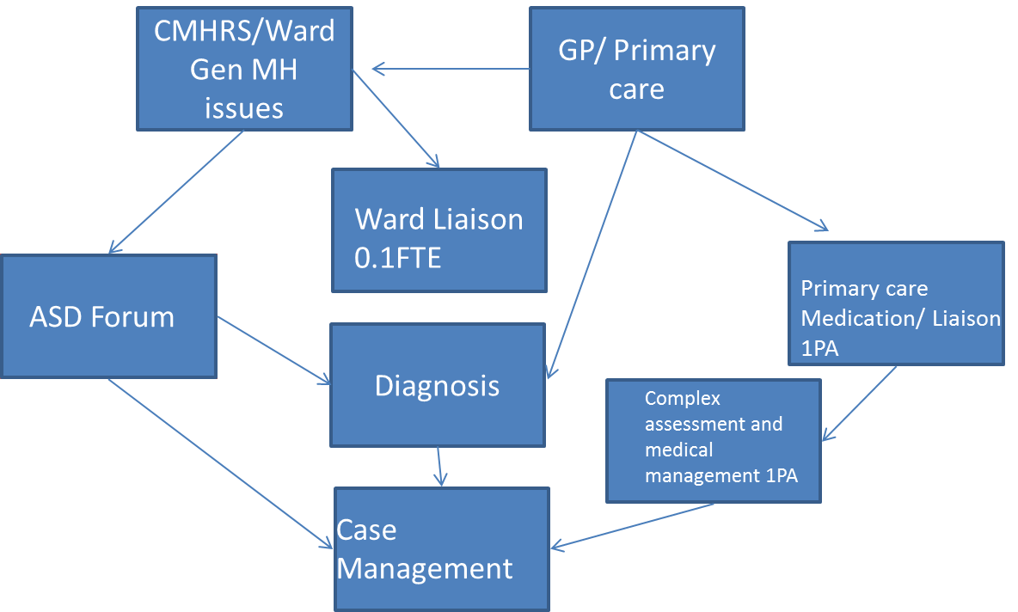
Primary care Medication Liaison
Criteria
Cases in primary care known to have a diagnosis of ASD who require consultation about ongoing psychiatric management including but not exclusively medication advice
Process
GP either by referral letter can book into a 20 minute slot as part of a 2 hr clinic twice per week to obtain advice about medication management of cases that have transitioned to primary care from CAMHS or who wish to discuss medicine management. This will be with Dr Mukherjee.
Max cases per week is 6
The Cases will not be open to SABP and will continue to he held in primary care including risks.
Where greater complexity is identified it will be signposted to complex assessment service [face to face with Dr Mukherjee].

Slide 9
Complex assessment and Management Advisory Clinic
Criteria
People with ASD who have been discussed in other parts of the ASD pathway and identified to have complex needs that need clarification or management guidance
Cannot be referred without having been discussed in another forum prior to acceptance.
Process
Discussion held in another forum which identifies that referral would be needed
Referrer would then be requested to send formal written request unless one already exists to allow case to be formally opened to team.
Pre consultation documentation will be sent to individual with requests for informant information if appropriate
Consultation will identify a management plan to either gate keep to wider ASD service for case management/ psychological therapy or discharge back to referrer with specific recommendations.

Slide 10
Case Management
Criteria
Can only be accepted when referred via a gatekeeping assessment
No direct referrals
Patients with complex care needs linked to ASD but not able to be managed in other fora
Cases will be managed when they have the ability to engage in the treatment and support process involved [40 per year]..
Process
Will support either therapeutically or through case support individual for a time limited period
Offer specific psychotherapeutic interventions as deemed appropriate where too complex for IAPT and inappropriate for CMHRS
CMHRS should remain involved until assessed and a decision as to ongoing need made jointly. If agreed that ongoing CMHRS involvement is not required it should be a standard discharge plan criteria for immediate acceptance back to CMHRS where mental state deterioration leads to increased risk.
Where CMHRS remain involved risks are shared with emergency management by CMHRS
Where only open to ASD team if risks increase due to deterioration in behavioural and psychiatric presentation an urgent referral for CMHRS/ HTT involvement will be made

Slide 11
Questions?

