Slide 1
Advance Care Planning, DNACPR & ReSPECT
Dr Jacqui Phillips, Consultant in Palliative Care
Phyllis Tuckwell Hospice care
January 2018

Slide 2
Aims
Advance care planning - evidence base
Spotlight on DNACPR decision-making
ReSPECT – process; feedback so far; progress

Slide 3
Advance Care Planning: the evidence
Methods/tools and outcome measures used in existing studies variable.
Need for well designed RCTs with standardised outcomes that examine the economic impact of ACP, its effect on quality of care and experiences of patients/families.
Improves EOLC, pt family satisfaction and bereavement process.
Reduced hospital admission.
ACP over time > effective than written documents alone.
60–90% of public supportive of ACP but uptake only 8%.
Most HCPs positive towards ACP but reservations about the applicability/validity of ACP documents.
Brinkman-Stoppelenburg et al (2014)
Weathers et al (2016)
Detering et al (2010)
RCP Concise Guidance to Good Practice (2009)
Notes:
Advance care planning is the process of discussing and recording patient preferences concerning goals of care for patients
1. The impact of advance care planning on end of life care in elderly patients: Karen M Detering, Andrew D Hancock, Michael C Reade, William Silvester,
BMJ 2010;340:c1345, Australian single centre Prospective RCT
Advance care planning improves end of life care and patient and family satisfaction and reduces stress, anxiety, and depression in surviving relatives.
2. The effects of advance care planning on end-of-life care: A systematic review
Arianne Brinkman-Stoppelenburg, Judith AC Rietjens and Agnes van der Heide
Palliative Medicine
2014, Vol. 28(8) 1000–1025
Dutch Systematic Review
What is already known about the topic?
who may lose capacity or communication ability in the future.
• Advance care planning could potentially improve end-of-life care but the methods/tools used are varied and of uncertain benefit.
• Outcome measures used in existing studies are highly variable
What this paper adds?
• Do-not-resuscitate orders were found to reduce the use of cardiopulmonary support measures, to reduce hospitalisations
and to increase the use of hospice care.
• Do-not-hospitalise orders have almost invariably been shown to be related to a reduced number of hospitalizations and
an increased use of hospice care.
• The effects of advance directives seem more diverse but they tend to be related to an increased frequency of out-ofhospital
care that is aimed at increasing the patient’s comfort instead of prolongation of life.
• Extensive advance care planning interventions may be more effective than written documents alone. They were found to
result in an increased frequency of out-of-hospital and out-of-ICU care, and in increased compliance with patient wishes
and satisfaction with care
Implications for practice, theory or policy?
• More studies on the effects of advance care planning are needed with an experimental design, in different settings including
the community.
• Outcome measures for such studies should preferably be standardized, focusing on the experiences of patients and their families.
3. Advance care planning: A systematic review of randomised controlled
trials conducted with older adults
Elizabeth Weathersa,c, Rónán O’Caoimha,c,d,∗, Nicola Cornallya,b, Carol Fitzgeralda,
Tara Kearnsa, Alice Coffeyb, Edel Dalya, Ronan O’Sullivana, Ciara McGladea,
D.William Molloya (2016)
ADVANCED CARE PLANNING: improves satisfaction and end-of-life care while respecting patient autonomy. Most studies did not implement a
standardised ACD, or measure the
impact on quality of end-of-life care or on the death and dying experience. While ACP interventions are well received by
older adults and generally have positive effects on outcomes, this review highlights the need for welldesigned
RCTs that examine the economic impact of ACP and its effect on quality of care in nursing homes
and other sectors.

Slide 4
Spotlight on DNACPR
DNACPR decisions: historically have been separate from advance care plans.
Fixation on CPR often at the expense of loss of focus on overall priorities of care for an individual.
Discussions/decisions associated with misunderstandings, negative clinicians‘ perceptions, complaints and litigation, negative media reports.

Slide 5
Spotlight on DNACPR
‘Time to intervene’ – NCEPOD, Nov 2012.
Case law: Tracey (2014) and Winspear (2015) - conversations that need to take place before decisions are taken not happening.
Waters (2015)- determinations as to when CPR may be appropriate made on the basis of unjustified assumptions as to disability.
House of Commons Health Committee report: EOLC – March 2015.
Revised 3rd edition of BMA/RC(UK)/RCN guidance – June 2016.
Notes:
NCEPOD – review of care of patients who underwent CPR after an in-hospital cardiac arrest, published Nov 2012
526 sets of notes of patients who had an in-hospital cardiac arrest in a 2/52 period in nov 2011. DNACPR Decision could have been made before the cardiac arrest in 85% cases, 52 cases of CPR being started despite presence of a DNACPR order in place. 2/3 had an underlying fatal disease
This may be the most important report that NCEPOD has produced in the last 10 years. This report should be a wake-up call to the NHS - Mr Bertie leigh, Chair of NCEPOD
Overall care was good in 29% cases
Tracey case – by failing to discuss DNACPR decision with a patient who has capacity and had expressed a wish to be involved in discussions about her treatment the defendant was in breach or Patients human rights under article 8 of European convention (everyone has right to respect for private life,
Tracey vs CUH Trust – June 2014. ‘…. there should be a presumption in favour of patient involvement… there need to be convincing reasons not to involve the patient’
Winspear v Sunderland Trust– need to consult with those important to patient without capacity before completing DNACPR form
House of commons – gov must review DNACPR decision making and documentation
12/15 AHSNs are focusing on cardiac / stroke.
Treatment Escalation plans, patient safety initiatives

Slide 6
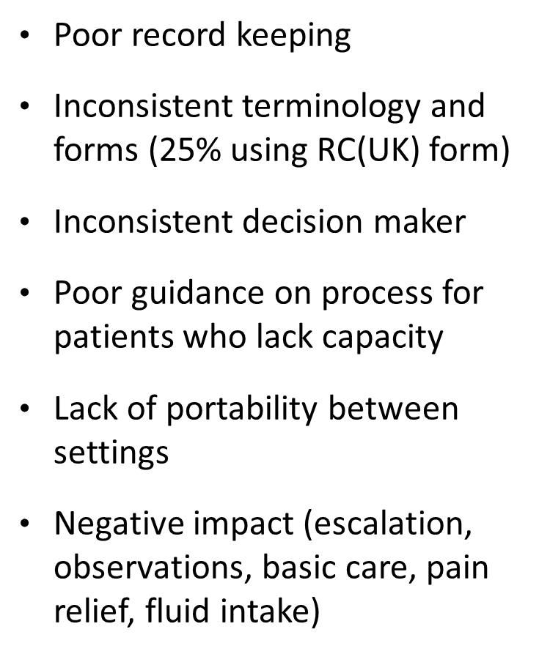
DNACPR: an evidence synthesis complaints & incidents
4500 incidents related to DNACPR (<0.5% of total number), ~1/3 causing harm.
Perkins et al, 2016
Fritz et al, 2013
Failure to anticipate need for DNACPR decision
Disagreement with DNACPR decision
Confusion over process for decision-making
Poor communication
Poor handover between settings, need for review following change in patient status
Notes:
84 in total 37 studies, 9 in UK, 20 in US
2 strong, 12 moderate, 23 weak evidence
Review of
interventions that improve process or recording of DNACPR decisions
incidents and complaints related to DNACPR decisions
DNACPR policies
Thematic analysis of focus groups to explore service-provider perspectives of DNACPR decision making in the NHS.
Huge variability in practice, poor quality studies, no robust evidence
Considering decisions
Timing: acute admission, specialist teams, long term planning
Prompts:
Patient factors - age, comorbidities, QOL
Likelihood that CPR would be successful
Potential for harm as a result of CPR
Discussions
As part of overall treatment plan,
Focus on what will be provided
Presenting options about resuscitation as routine discussions about treatment
Implementation
Consistent recording system
Consequences
Negative impact (escalation, observations, basic care, pain relief, fluid intake) results in impeded willingness to place DNACPR order
National Reporting and Learning System - January 2010 and December 2012
(>3500 in acute hospitals)
Parliamentary and health service ombudsman – 33 complaints between 2008 and 13 – poor communication, non-consultation with family members, discussing with patient against family wishes, ignoring verbal request from the patient to enforce a DNACPR decision

Slide 7
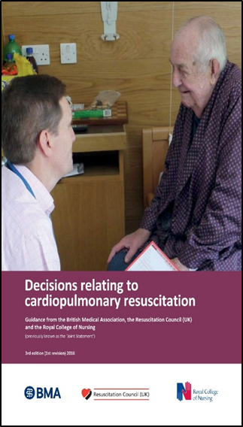
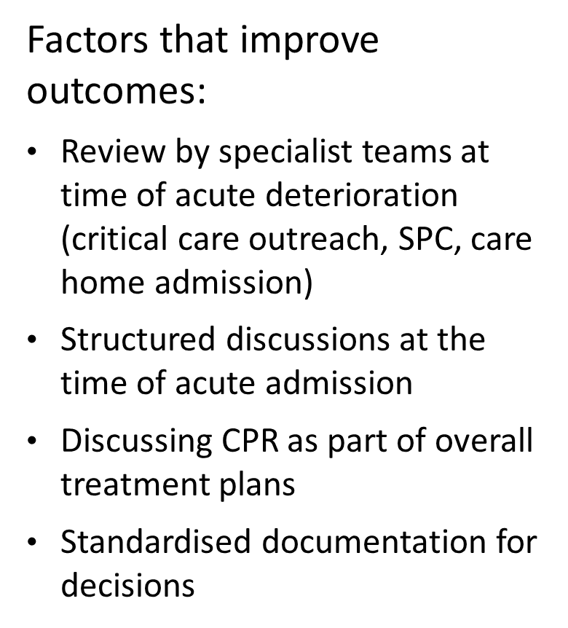

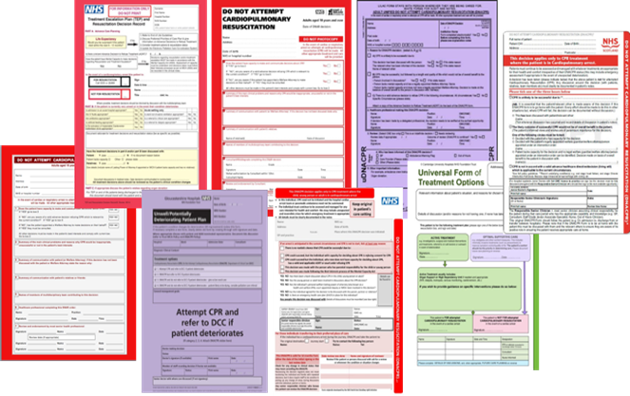
DNACPR: an evidence synthesis

Slide 8


Integration of DNACPR decisions with ACP.
Steering group co-chaired by RC(UK) and RCN, initiated Spring 2015. Wide representation – GMC, BMA, CQC, RCs, patient / public, academic institutions, clinical specialties, ambulance service etc.
Sets out recommendations for clinical care in emergency situations where obtaining consent not possible.
Starts not from ID of specific interventions, but preference of pt re whether their priority is to sustain life or prioritise comfort.
ReSPECT can be complementary to a wider process of advance/anticipatory care planning.

Slide 9

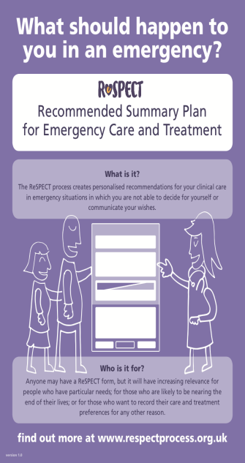
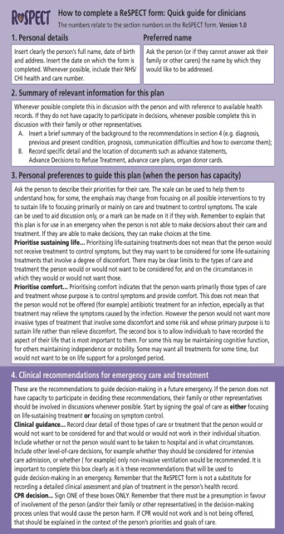
Tools to enhance / support clinician decision making and raise public awareness
http://www.respectprocess.org.uk/
Web APP: very good and raises the understanding of the process and the use in all different settings and backgrounds.
http://www.respectprocess.org.uk/learning
Terms of use
Clinician’s guide
Leaflet and poster
Implementation plans
Patient, parent, young persons info
Teaching slides
FAQs

Slide 10
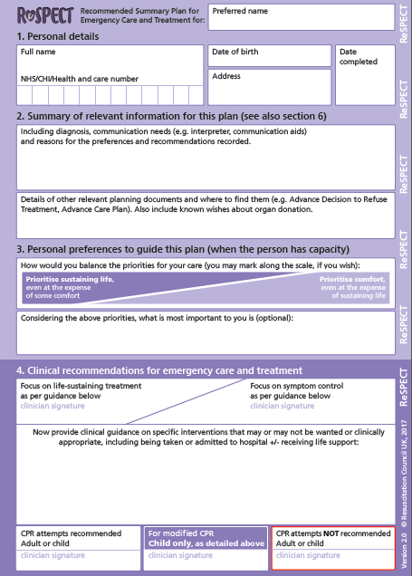
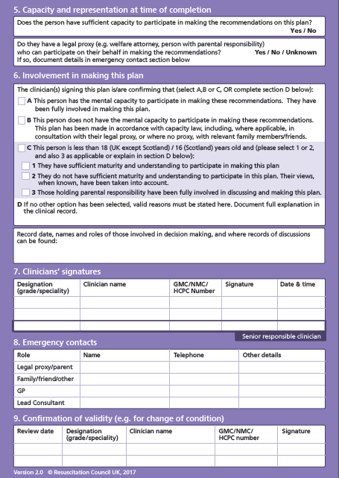

Slide 11

Aim was to adopt nationally from February 2017
NIHR funded study (Warwick University) – assess effects of ReSPECT in acute settings (n=6) over 3 years (2016-2019)
Alongside this it is now moving into the next phase in which health and care communities wishing to adopt ReSPECT can be offered access to the materials that they will need to start planning implementation. Interested organisations should join the Implementation Network.
Notes:
Warwick Study: Evaluation of the Recommended Summary Plan for Emergency Care and Treatment (ReSPECT) process.
The aim of the study is to evaluate the new national ReSPECT process for adults being admitted to acute hospitals to determine how, when and why they are used and what effects they have on patient care. The study will use a mixed methods approach to evaluate the impact of ReSPECT. We will use national audit data to compare patient outcomes in hospitals that adopt ReSPECT compared with those that use other systems. We will look in more detail at how the ReSPECT process is used in routine clinical practice and it’s impacts on patient care in six acute NHS hospitals. We will also investigate it’s impact on general practitioners working in the areas surrounding these hospitals.
3 years
November 2016 - 2019

Slide 12
Positive
Negative
Embedding DNACPR in wider discussions re priorities of care.
Places pt at centre of care.
Lay opinion that beneficial to pt care.
Standardised document.
Potential for improved communication between healthcare professional and patients and across boundaries; community and acute trust and between trusts.
Ultimately changing the culture so these conversations become the norm and aren't left to a point of crisis.
Dislike of the form
Many places are already using ACPs and DNACPR forms that are integrated and working well - this form may not in its current form, replace those items in use without risk.
Multiple stakeholders.
Version control.
No electronic version available.
Information sharing.
Suitability across all settings- ED, paeds.
Training in competencies.
Patchy implementation.
Several different forms - AMBER care bundle, DNACPR and now ReSPECT - clarity needs to be provided of when each is used.
Notes:
There is without a doubt some dislike of the actual form but that is just the documentation it’s the process that is important. From my contacts with the national ReSPECT group I understand how difficult it was to develop a form that fits across all healthcare settings and have the patient at the centre of it all. If it becomes a tick box form with lists of treatment options we move away from the whole reason for the change to have a more open and patient centred approach to decisions around treatment options.

Slide 13

How to move forward?
Feedback from Warwick:
Engaging all local providers.
Patient voice.
Local IT solution.
Funding.
Establishing a Working Group which includes representatives from the Trusts and Community.
Education.
Identifying champions of ReSPECT in all of these areas.
Support and a desire to want to implement this process – all healthcare sectors.
National mandate.
Electronic system.

Slide 14

:G&W
Guildford & Waverley
Lead: Janni Hodgson, Resuscitation Services Manager RSCH
jannihodgson@nhs.net
Tel: 01483 571122 ext 4938
RSCH introducing ReSPECT 1/4/2018. For new patients - old red forms will still be recognised.
In-house training to start this month and oncology plan to use in outpatients.
A proposal submitted to the STP for funding for a project lead to drive and support the implementation across Surrey Heartlands has been approved; lead being recruited.
SECAMB in support of the process : it will assist in making timely decisions according to the patients expressed wishes.
GP’s / community nurses / palliative teams / paramedics G@W CCG to receive early training to support this.
Patient information campaign.
Notes:
There is without a doubt some dislike of the actual form but that is just the documentation it’s the process that is important. From my contacts with the national ReSPECT group I understand how difficult it was to develop a form that fits across all healthcare settings and have the patient at the centre of it all. If it becomes a tick box form with lists of treatment options we move away from the whole reason for the change to have a more open and patient centred approach to decisions around treatment options
Sarah Taylor-Smith views:
We have had 2 Frailty meetings with GP’s, paramedics and community matrons where we discussed some of the problems with PACE . Paramedics are often the front line and many have no or little palliative care training.
However they will ring for advice if it is clear that there is a palliative care team involved.
The out of hours GP’s are very restrained as they are time poor and without EOL drugs in the home access to these OOH is a problem- Abi is reviewing this.
I know that I have often written the PACE long before and usually fail to update it thinking it is obvious if there are EOL meds in the Home. (It is administratively quite a burden to update a PACE as we have to update on IBIS too and get the new PACE on pink paper back to the home)
Patients and their relatives are not always forthcoming in an emergency-and even in A@E resus this is not known or mentioned! Last week was someone who had just had his ICD deactivated and he came into resus. The acute team took much persuasion to consider that he might already have palliative involved and on day 2- after many arterial blood samples it was discovered that he had EOL drugs in the home and a very involved palliative team.
This causes much frustration as PACE planning can be very time consuming for the GP and when this happens my colleague question their use.
On the positive side our PHE data shows that 86% of our patients that die in G@W are on a palliative care or EOL register. We think that this is PACE and GSF as it is drawn from QOF data but Abi was looking into it.
Janni:
The ReSPECT process will only work if all stakeholders are open to the process and see this as an opportunity to ensure we have a document that is easily recognisable across the region. I think other ACP documents are brilliant, but in the emergency situation for a paramedic or an out of hours doctor who needs the information in a format they will easily recognise and is readily available with a quick summary the ReSPECT document offers additional benefits.
For implantation here we are we will use the document for patients admitted for emergency care to plan and decide treatment escalation. A ward patient will have a ReSPECT document if their condition warrants a discussion around treatment options and preferences around escalation. In Out Patients settings if a patient receives a diagnosis that will warrant a discussion around treatment escalation we will provide a patient information leaflet and the ReSPECT form. On subsequent appointment the consultant will complete the form together with the patient, we will encourage the patient to bring a friend or relative with them for that process.
We will have a patient information campaign with information on our website and on posters and leaflets available in the trust.
The patients will be discharged from the Trust with the form -if relevant- for use in the wider community.

Slide 15
How will ReSPECT fit in with PACe?
G&W: > Proportion of patients dying in the community than neighbouring CCGs - this trend needs to continue. Still some cases of inappropriate escalation of care: PACe not always updated; OOH GPs time restrained; EOL drugs not available in home.
In the emergency situation, paramedic or OOH GP needs readily available information in an easily recognisable format. In this way, ReSPECT document offers additional benefits.
Important to establish which pts have just a RESPECT and which also have PACe, and how these interact.
PACe time-consuming, but its remit wider, > holistic. For some patients, likely to be a place for both.

Slide 16
            QUESTIONS?

Slide 17
References
The effects of advance care planning on end-of-life care: A systematic review. Arianne Brinkman-Stoppelenburg, Judith AC Rietjens and Agnes van der Heide. Palliative Medicine (2014) Vol. 28(8) 1000–1025
Advance care planning: A systematic review of randomised controlled trials conducted with older adults. Elizabeth Weathers, Rónán O’Caoimha, Nicola Cornally Carol Fitzgerald, Tara Kearns, Alice Coffey, Edel Daly, Ronan O’Sullivan, Ciara McGlade, D.William Molloy (2016), https://doi.org/10.1016/j.maturitas.2016.06.016
The impact of advance care planning on end of life care in elderly patients: Karen M Detering, Andrew D Hancock, Michael C Reade, William Silvester,
BMJ 2010;340:c1345. Single centre Prospective RCT
R (David Tracey) v (1) Cambridge University Hospitals NHS Foundation Trust (2) Secretary of State for Health (2014)
Winspear v City Hospitals Sunderland NHS Foundation Trust [2015] EWHC 3250 (QB); [2015] WLR (D) 468
Time to Intervene.A review of patients who underwent cardiopulmonary resuscitation as a result
of an in-hospital cardiorespiratory arrest. A report by the National Confidential Enquiry into Patient Outcome and Death (2012)
House of Commons Health Committee. End of Life Care. Fifth Report of Session 2014–15
Decisions relating to cardiopulmonary resuscitation. Guidance from the British Medical Association, the Resuscitation Council (UK) and the Royal College of Nursing. 3rd edition (1st revision) 2016
Perkins GD, Griffiths F, Slowther A-M, George R, Fritz Z, Satherley P, et al. Do-not-attempt- cardiopulmonary-resuscitation decisions: an evidence synthesis. Health Serv Deliv Res 2016;4(11).

