Slide 1
Alzheimer’s Society
Surrey Services

Slide 2
Dementia Information and Support
Triage service to support initial enquiries
Referral to a Dementia Navigator
Work closely with people with dementia, their families and carers to identify your individual needs
Provide practical support to help cope with the day to day challenges of living with dementia
Signposting or referring to local services and organisations
Provide information and guidance on legal rights, welfare benefits and health and social care
Surrey@alzheimers.org.uk
01932 855582

Slide 3
Supporting People to Live Well
Service Feedback
Thank you for the excellent advice and tips about day-to-day living, such as simplifying the wardrobe, organising bathroom routine etc. These are the areas that I'm finding most difficult at present.
Today's meeting with you was probably the best thing that has happened in the three or four years that these problems have been developing. Especially in the sense that it has enabled me to talk to G. about her dementia, and how we manage it - previously she had been mostly in denial, or hostile, whenever I tried to sit down and talk about it.
Surrey@alzheimers.org.uk
01932 855582

Slide 4
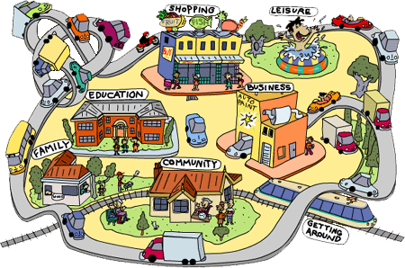
Dementia Friendly Towns
Town, village or area
Where local residents and businesses understand what dementia is and how people may be affected by the condition
Helps people living with dementia to feel included and safe in their local community
Commit to at least 3 actions to become dementia friendly.
dementiafriendlysurrey@alzheimers.org.uk
01932 855582

Slide 5
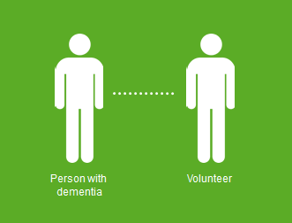
Side by Side
Enabling people living with dementia to be more involved and included in their community through support of a volunteer.
Supporting people living with dementia to continue with, or reignite a hobby or interest.
A person centred service that supports the person with dementia to chose their own volunteer, and the activities they wish to do.
Sidebysidesurrey@alzheimers.org.uk
01932 855582

Slide 6
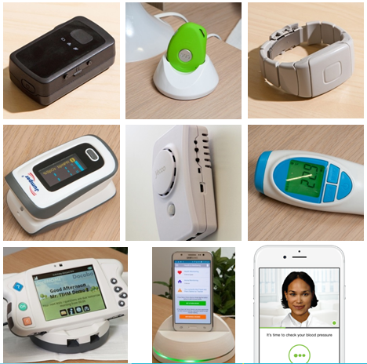
TIHM for dementia
Improving lives of people with dementia and their carers
Reducing hospital stays and care home admissions
Technological devices such as sensors, apps and trackers installed in people’s homes
Testing remote monitoring of health and wellbeing using data combinations gathered via Internet of Things
Evaluation of results and share health technology learning to support other long term conditions
http://www.sabp.nhs.uk/tihm
0300 55 55 222
Technology of Integrated Health Management

Slide 7
Time for Dementia Programme
Aims to improve student knowledge, attitudes and empathy towards people affected by dementia
Provides students with on-going contact with a family affected by dementia over a two-year period, visiting 4 times a year. Giving a balanced view of living with dementia from the perspective of both the person with dementia and their family.
The programme has been embedded into the curricula for nursing and paramedic students at the University of Surrey and for medical students at the Brighton and Sussex Medical School.
So far 570 families have been involved to help around 1330 students in their learning.
Timefordementia@alzheimers.org.uk
07713 779582

Slide 8
Lets take on dementia together
Volunteer. Donate. Campaign for change.
Whatever you do, unite with us against dementia.
Visit the Alzheimer’s Society website
Follow us on social media
Campaign to help raise awareness
Volunteer at one of our services
Volunteer at events like Memory Walk
Support national events like Dementia Awareness Week and Cupcake day
Fundraise on your own or part of a local group
facebook.com/AlzheimersSocietySouthEastEngland
twitter.com/AlzSocSEEngland
We need your help
#UniteAgainstDementia

Slide 9
Further information and support
Contact us in Surrey on 01932 855 582
surrey@alzheimers.org.uk
You can visit our website
www.alzheimers.org.uk
Become a dementia friend
www.dementiafriends.org.uk
National dementia helpline on 0300 222 1122
Online support and discussion forum, Talking Point, www.alzheimers.org.uk/talkingpoint

