Slide 1

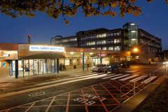
Oncology
Dr Katie Wood
Consultant Clinical Oncologist
St Luke’s Cancer Centre

Slide 2
Introduction
1 in 3 develop cancer
More than 2500 new patients are seen at St Luke’s each year
600 seen in St Luke's each day
Large catchment area, population of 1.2 million
Outskirts of London to west sussex, North and mid-Hampshire
  RSCH
  Frimley Park Hospital
  East Surrey, Crawley
  Ashford and St Peter’s Hospital

Slide 3
Introduction
Role of the Multidisciplinary team
Treatment options
  Radiotherapy +/- chemotherapy
New Drugs
  Biological agents
  Immunotherapy
Survivorship

Slide 4
Multidisciplinary Team
Diagnosis
Referral to diagnostic Specialist
Diagnostic investigations – biopsy/imaging/staging
Weekly
MDT
Discussion at MDT – Oncologist/Surgeon/Radiologist/Pathologist/Allied healthcare professionals/Clinical nurse specialist
Management decision made
Treatment
Radical treatment - Oncology (radiotherapy/chemotherapy)/Surgical
Palliative – Oncology/Palliative care

Slide 5
Radical Treatment options
Surgical
  Early colon, lung, oral cavity, prostate, skin, uterine
Radiotherapy +/- chemotherapy or hormones
  Organ preservation
  Not fit for anaesthetic
  Head and neck (surgically morbid), prostate, bladder, lung, brain, cervix
Chemotherapy
  Lymphoma/germ cell tumours
Radioiodine
  Differentiated thyroid cancer
Most likely – Combination
  Breast, colorectal, advanced head and neck , upper GI, ovarian

Slide 6
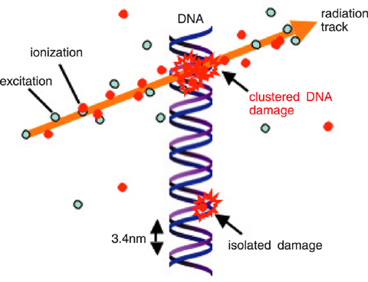
Radiotherapy
Damaging DNA of cancerous cells
Direct damage or indirect through ionization of water/oxygen forming free radicals
Cancer cells less likely to repair damage so die, in addition, higher cell turnover results in more rapid manifestation of DNA damage
Radiation sensitization with chemo/synergistic
Doses
  Radical- 1.8-3Gy/fraction, 50-70Gy, 20-30 fractions
  Palliative – 3+Gy/fraction, 20-30Gy, 1-10 fractions

Slide 7
Uses of radiotherapy
Radical
Palliative
Benign

Slide 8
Radical
Head and neck cancer
Prostate
Bladder
Cervix
Lung
Oesophagus
Skin

Slide 9
Adjuvant radiotherapy
Improves loco-regional control
Pathological features suggest benefit for adjuvant treatment
Breast, head and neck, prostate, sarcoma, endometrial
Plus chemo?
Neoadjuvant
  Rectal
  Maxillary sinus
  etc

Slide 10
Palliative
Pain relief
  bone mets, soft tissue mets
Haemostasis
  cervix, bladder, haemoptysis
Spinal cord compression
Brain mets

Slide 11
Palliative radiotherapy
Symptomatic relief from bone pain in approx 70% with 2-3 weeks
8Gy/1# or 20Gy/5#
Side-effects depending on site of treatment
May mean can reduce/withdraw opioids

Slide 12
Benign
Pituitary adenomas
Dupuytren’s contractures
Hypersalivation
Thyroid eye disease
Keloid scars

Slide 13
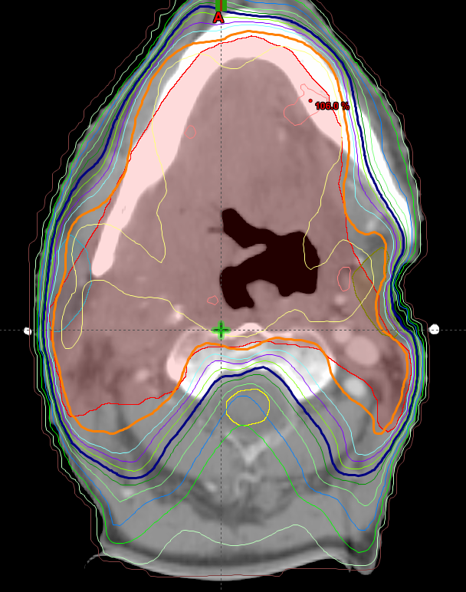
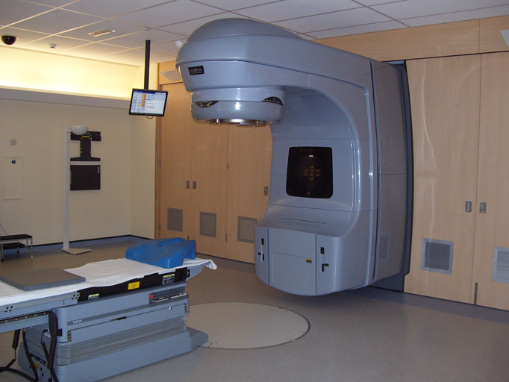
Radiotherapy
Mucositis
Dysphagia
Swelling
Diarrhoea
Nausea
Cystitis
Pneumonitis
oesphagitis

Slide 14
Side-effects
Acute
  During or within a few weeks of finishing, high cell turnover
  Supportive treatment
  Site dependent
  Dose dependent
  Mucosal toxicity typically occurs 2 weeks in to a course, and begins to resolve 2 weeks after completion
  When adjacent to critical structures beware of effects of pressure
  Erythema, pain, mucositis, desquamation, diarrhoea, nausea

Slide 15
Side-effects
Late
  months to years after therapy, slow cell turnover
  more difficult to manage and understand
  Site dependent
  Volume of tissue irradiated
  Fraction size dependent 1.8Gy vs 3Gy
  Fibrosis, functional, anatomical
  Nerve damage – brachial plexus, optic nerve, spinal cord
  Xerostomia, endocrinopathies
  Lethargy
  Carcinogenesis

Slide 16
Dose distributions
Single field
Parallel pair
Conformal plan
Intensity modulated radiotherapy (IMRT)
Rapidarc
Cyberknife

Slide 17
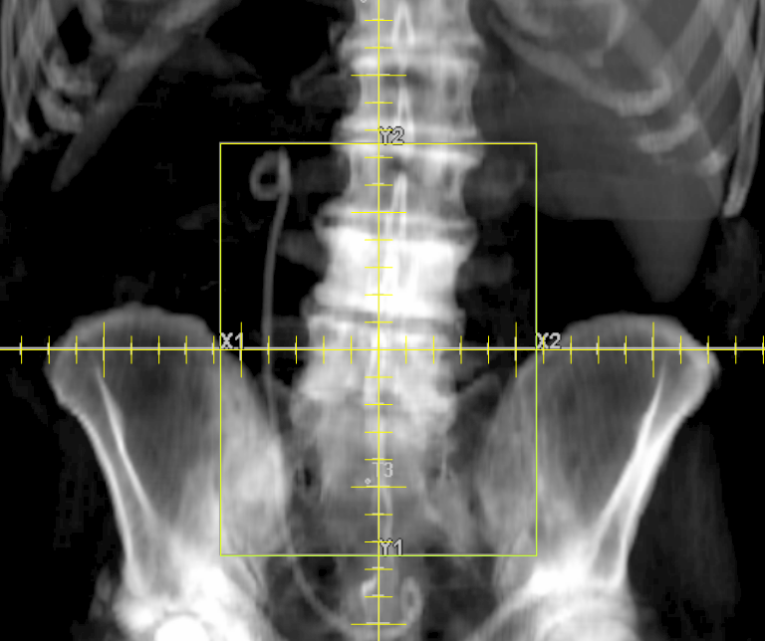
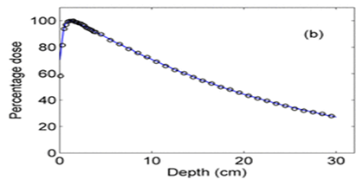

Slide 18
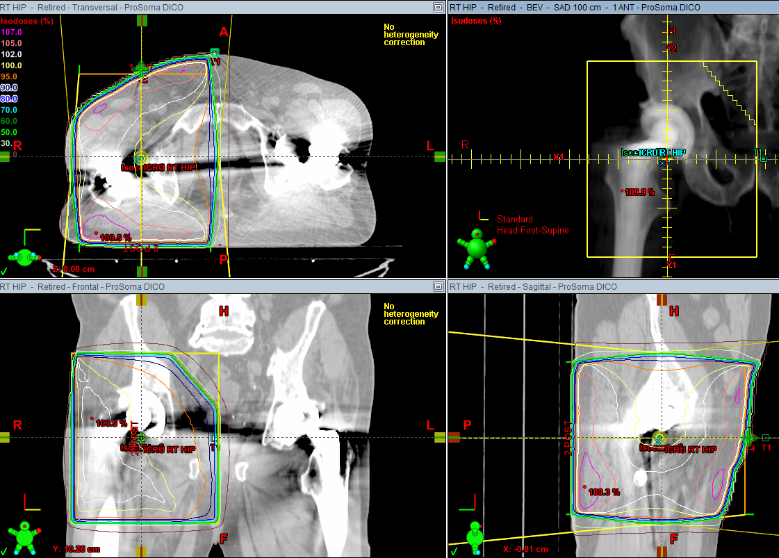
Parallel pair

Slide 19
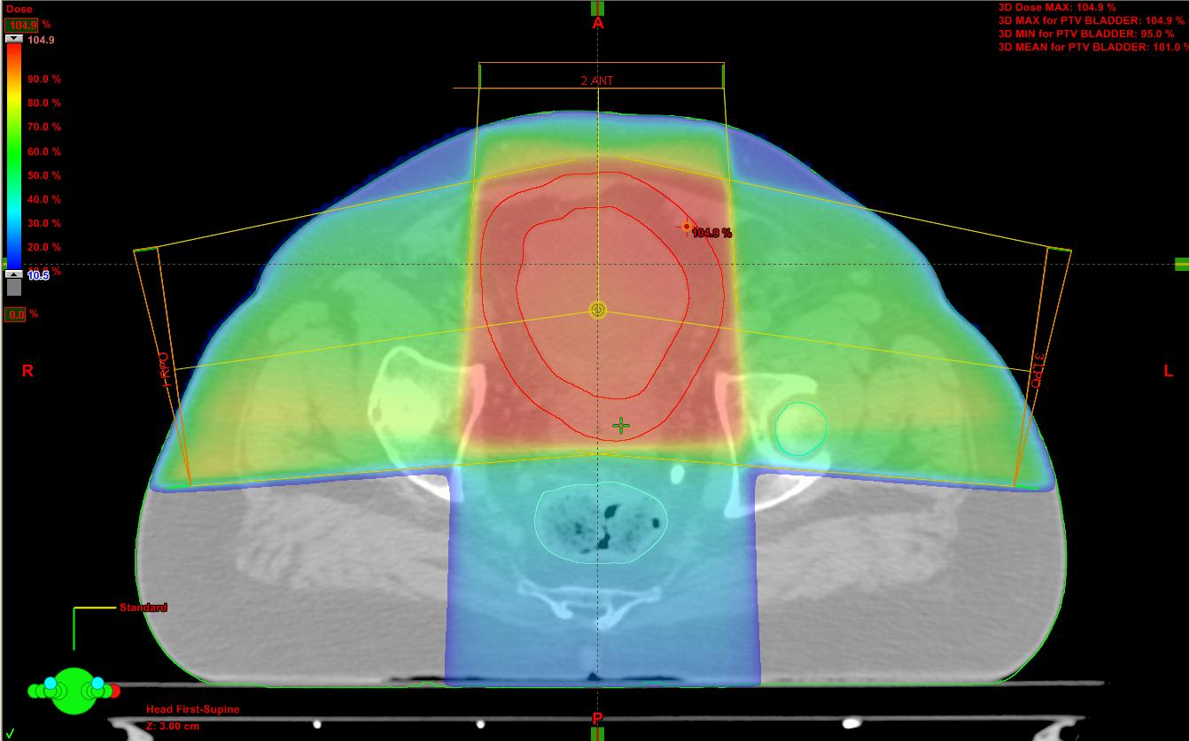
Three-field plan

Slide 20
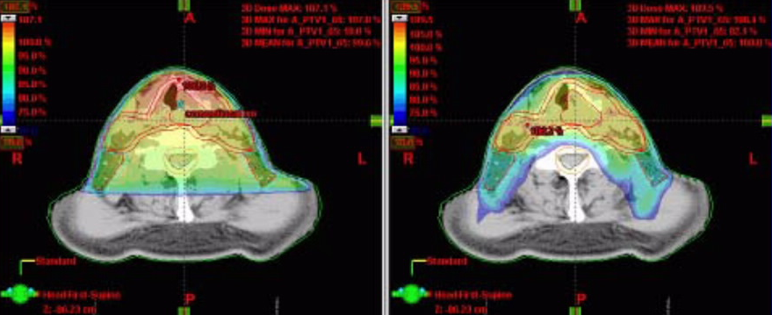
IMRT produces curved radiation doses that conform to tumour vs. conventional radiotherapy
Conventional radiotherapy
IMRT

Slide 21


Slide 22
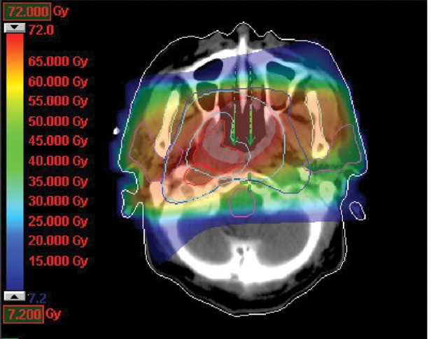
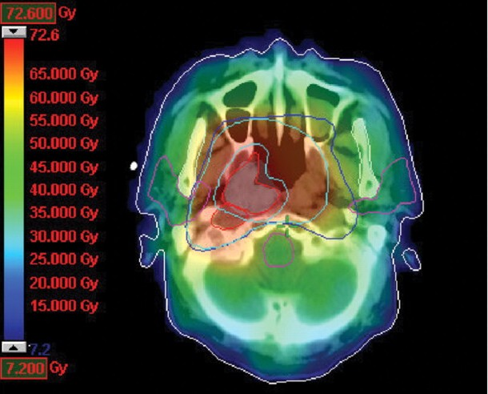
IMRT

Slide 23
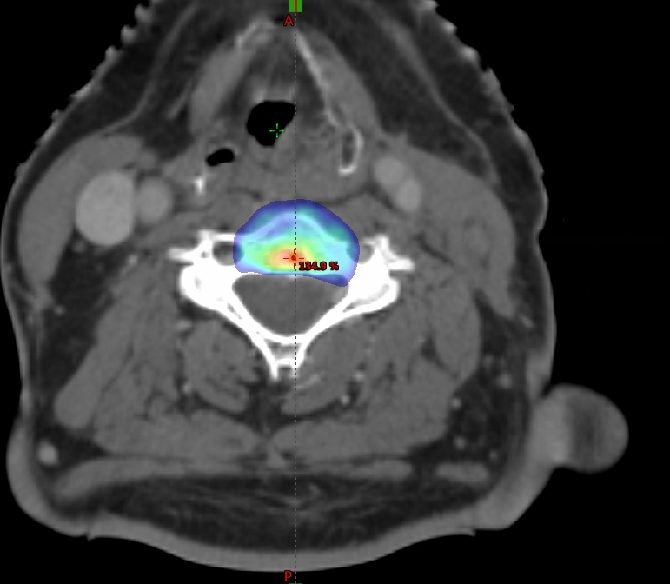
Stereotactic body radiotherapy (SABR)
Radiation delivery to a defined tumour target ;
To treat smaller tumours
Fewer treatments
Larger dose per treatment
Steep dose gradient

Slide 24
SABR
Lung Cancer T1/2a – unfit for surgery or refuse
  Meta-analysis
    Median OS 38 months
    3 year local control 87%
    2 year OS 82%
Oligometastases
  Lymph nodes, bone, lung, adrenal, liver

Slide 25
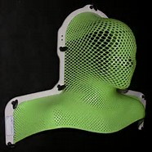
Process of planning radiotherapy
Dental extractions- if >2, allow 7 days for recovery
Dietition, enteral feeding
Immobilisation with head shell (if required) or breast board, and CT, with markers for localisation
Volumes outlined, high/intermediate/low risk
Treatment starts, set up checked daily
Plan generated by physicist

Slide 26
Chemotherapy
Neoadjuvant : before radical treatment
Concomitant: with radical treatment
Adjuvant: after radical treatment

Slide 27
Neoadjuvant chemotherapy
Purpose
  Reduction of primary tumour volume (prognostic)
  Treatment micrometastatic disease
  Head and neck, bladder, lung, breast (for breast conservation)
Advantage
  More likely to tolerate before radical treatment than after
  Downstages tumour leading to increased likelihood of complete resection
Disadvantage
  delay to primary curative procedure in patients who don’t respond
  Risk of more complications from surgery after chemotherapy

Slide 28
Concomitant treatment
Sensitise cancer to radiotherapy enhancing tumour cell kill
  Chemotherapy
  Hormones
Chemoradiation
  Head and neck
  Bladder
  Lung
  Colorectal
Hormones
  Prostate

Slide 29
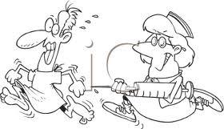
Adjuvant chemotherapy
Adding chemotherapy after surgery or radiotherapy
Advantages:
    Knowledge of pathological stage
    Primary treatment not compromised by toxicity or delay in non-responders
Disadvantages;
    Delay in treatment for micrometastatic disease
    Less tolerable after ie radical pelvic surgery
Breast, bladder, colorectal, lung

Slide 30
Chemotherapy toxicity
Neutropenic sepsis
Nausea
Renal failure – prerenal/dehydration, intrinsic
Liver toxicity
Neuropathy
Specific drug reaction

Slide 31
Specific side-effects
Cetuximab – acneiform rash, potentiates skin reaction
Bleomycin – pneumonitis
Cisplatin – renal failure, peripheral neuropathy, loss of hearing
5FU- diarrhoea, mucositits, coronary artery vasospasm
Gemcitabine – rash
Anthracyclines – cardiac toxicity
Taxanes – allergy
GCSF – pneumonitis, bone pain

Slide 32
Palliative treatment
Surgical
  Urinary diversions, defunctioning colostomy, clearance of a fungating lesion, gastrostomy
Radiotherapy
  Pain
  Haemostasis
  Fungation
  Obstructive lesions (plus dexamethasone and PPI)
Chemotherapy
  May prolong life
  Improve quality of life
  Improve symptoms
Symptom control
  Palliative care team/ GP
  Pain/nausea/constipation
  Holistic

Slide 33
New systemic treatments
Biological therapy
  Growth factor blockers
    Block the growth factor receptor on the cancer cell
    Block the signals inside the cell that start up when the growth factor triggers the receptor
    Tyrosine kinase inhibitors, mTOR inhibitors, MAP Kinase inhibitors
  Monoclonal antibodies
    Block growth factor receptors on cell surface – cetuximab, bevacizumab
    Block signals that block immune system -‘Checkpoint inhibitors’ – nivolumab, ipilumimab, pembrolizumab
Immunotherapy
  Checkpoint inhibitors

Slide 34
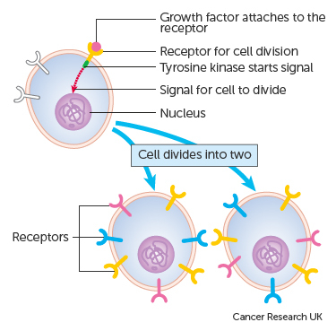
Growth factor blockers- cell surface receptors
Block receptors on cell surface – EGFR, VEGFR, etc
Epidermal growth factor receptor (EGFR) overexpressed or aberrantly activated in many solid tumours –Lung, breast, prostate, colon
Activation drives tumour growth and malignant progression
Antibodies against EGFR/VEGFR demonstrate anti-tumour activity
Downstream inhibition of signal transduction pathways

Slide 35
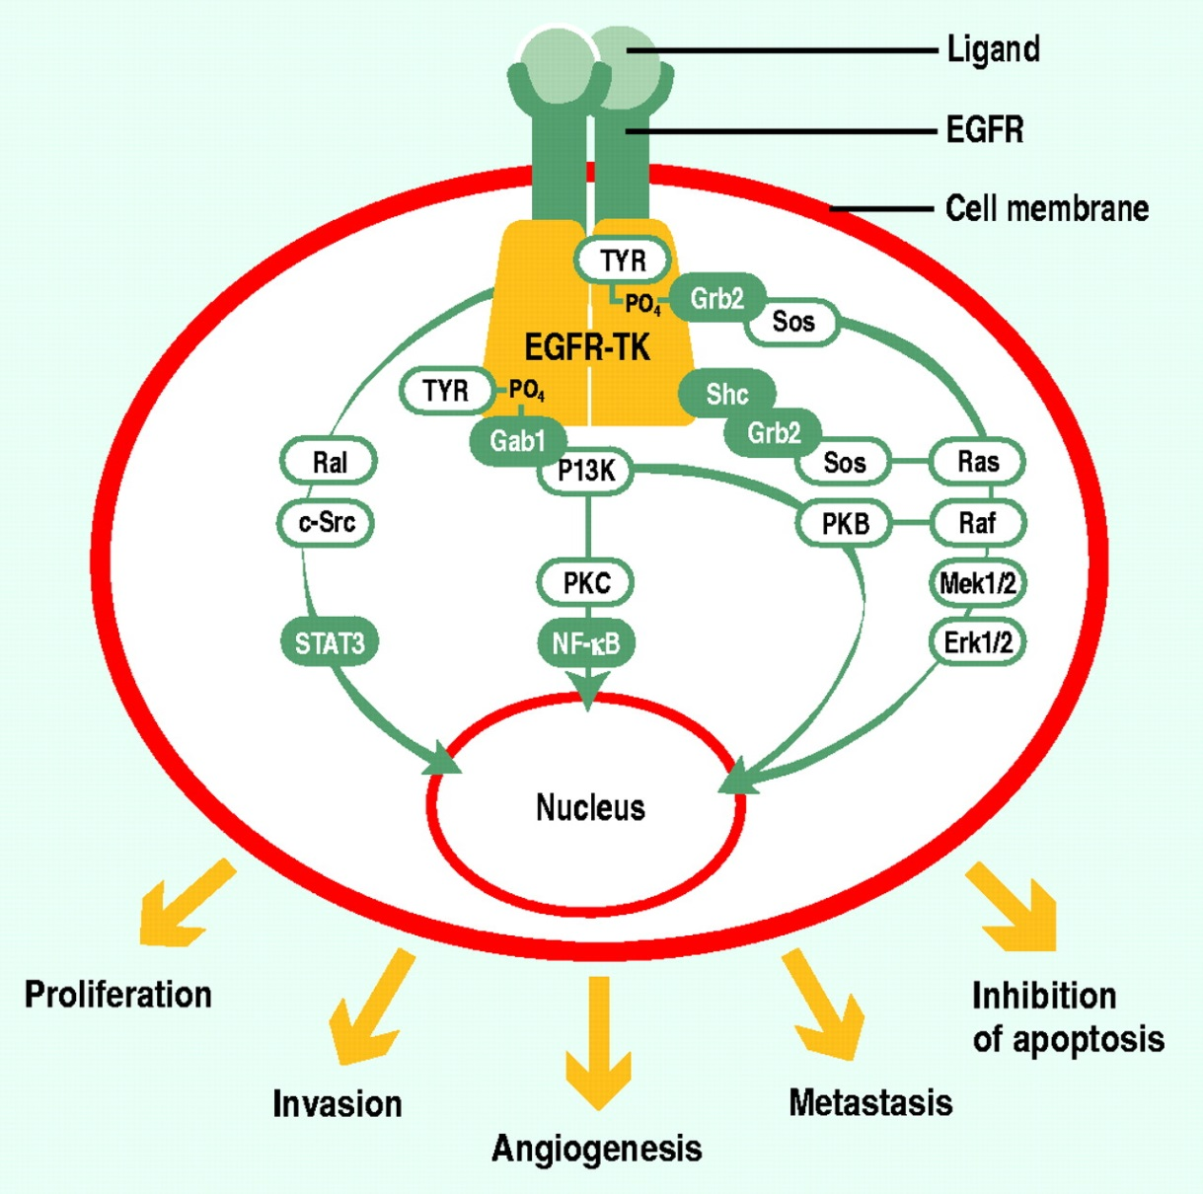
Growth factor blockers
Epidermal growth factor receptors
  Monoclonal antibodies
  Cetuximab- head and neck cancer
  Herceptin- breast cancer
Tyrosine kinase inhibitors
  Sorafenib- thyroid cancer
  Sunitinib- kidney cancer
  Erlotinib- non-small-cell lung cancer

Slide 36
Side-effects
Epidermal growth factor receptor inhibitors
    Allergic reaction, sickness, diarrhoea, flu-like illness
    Cetuximab (acne like rash)
    Herceptin (cardio-toxicity)
Tyrosine kinase inhibitors
    Fatigue, skin reaction, low blood count
    Sorafenib (cardiac ischaemia, hypertension, thromboembolism)
    Sunitinib (pulmonary haemorrhage)
    Erlotinib (DVT, arrhythmia, CVAs, myocardial ischaemia, pulmonary toxicity)

Slide 37
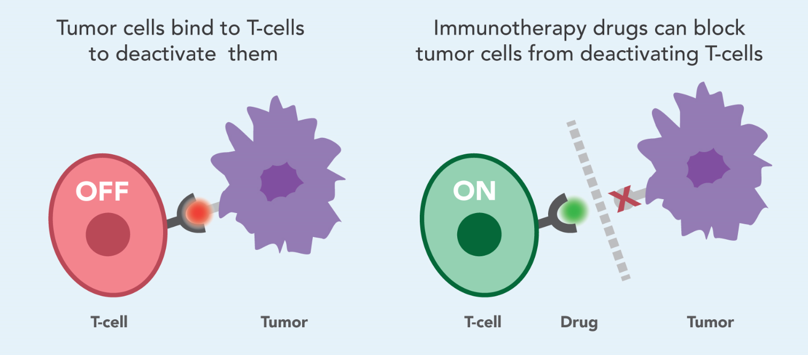
Immunotherapy
Enhances immune system to fight cancer
Targeted therapies that block specific ‘immune checkpoints’

Slide 38
The history of cancer immunotherapy: from empirical approaches to rational, science-based therapies
Treatment of cancer with bacterial products (“Coley’s toxin”)
Treatment of bladder cancer with BCG
FDA approval of sipuleucel-T (DC vaccine) in prostate cancer
Adoptive cell therapy
Adoptive T cell therapy
FDA approval of anti-PD1 for melanoma
1863
1898
1957
1976
1983
1985
1991, 4
2002
2009
2010
2011
2014
2016/17
Description of immune infiltrates in tumors by Virchow
Cancer immuno-surveillance hypothesis (Burnet, Thomas)
IL-2 therapy for cancer
Discovery of human tumor antigens (Boon, others)
HPV vaccination in VIN
FDA approval of anti-CTLA4 (ipilumimab) for melanoma
FDA approval
Anti-PD1 and anti PDL1
Bladder, Lung, Kidney

Slide 39
Current immunotherapies
BCG Unique to bladder cancer
Cytokines interferon, interleukin- rarely used now, toxic and low efficacy
Antibodies Herceptin, Cetuximab (in combination with chemo, selected cancers) low efficacy
Checkpoint inhibitor
Antibodies Nivolumab, ipilimumab, pembrolizumab powerful, long lasting, selective patients, new toxicities

Slide 40
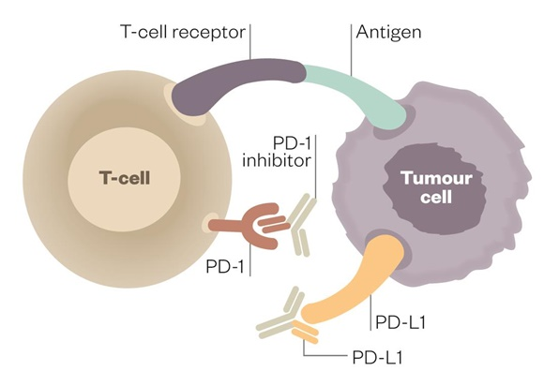
Checkpoint inhibitor antibodies
Cancers infiltrated by T cells at onset
Immune response generated in tumour, but tumour is able to suppress this
Antibodies block suppression and release immune response
Allows a very powerful anti-cancer immune response
Moving to first line treatment of renal, bladder, melanoma, lung and others

Slide 41
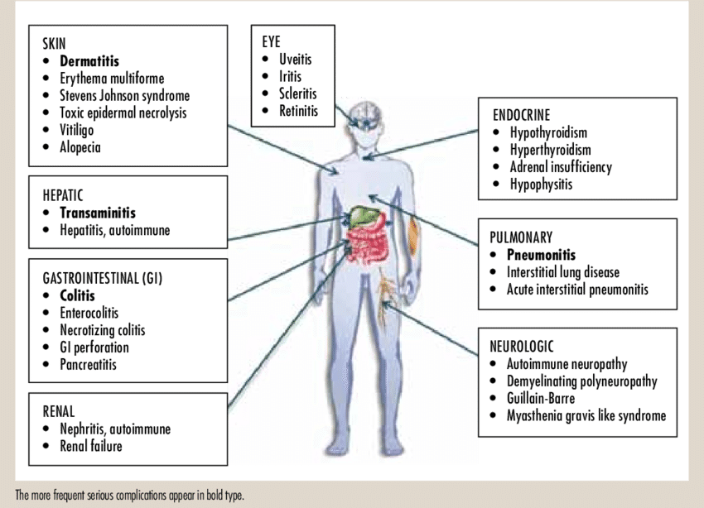
New immunotherapy toxicities
‘Overdriven’ immunity…
….autoimmunity
Reversible by high dose steroids

Slide 42
Long term sequelae and Survivorship
Living beyond cancer treatment …….
Impact;
  Social
  Physical
  Psychological
  Occupation
  Fertility
  Relationships
  Body image
  Spiritual

Slide 43
Summary
MDT work together for best therapeutic solution
Radiotherapy techniques more versatile/sophisticated
Systemic anti-cancer treatments increasingly wide and varied
Better outcomes
Focus on survivorship

Slide 44
Any questions….?

