Slide 1
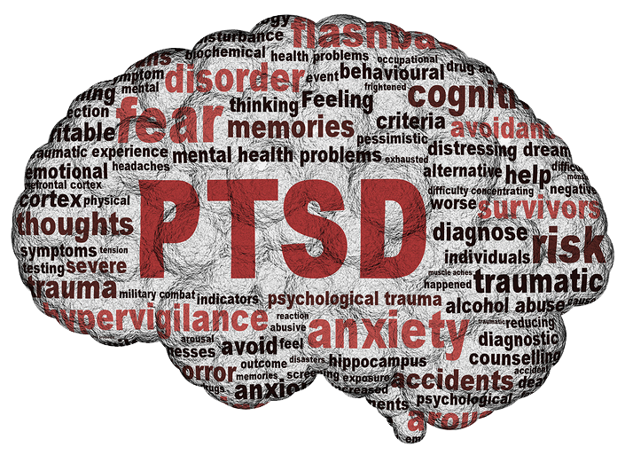
Dr David Triska
Witley and Milford Surgeries

Slide 2
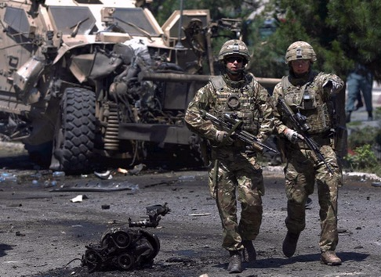
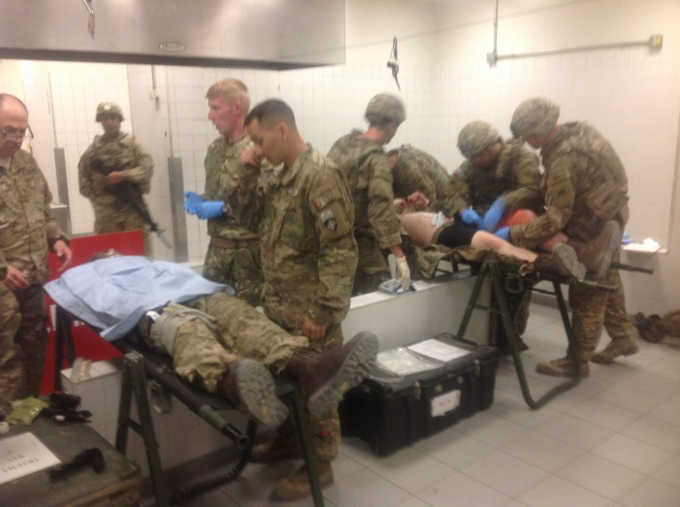
Why is this guy talking?
Notes:
My qualifications to talk to you

Slide 3
Notes:
PTSD is an anxiety disorder that a person may develop after experiencing or witnessing an extreme, overwhelming traumatic event during which they felt intense fear, helplessness, or horror. It may not be single event.
The horror of the event causes a dissociative reaction where a person is ‘stuck’ in the event and doesn’t process memories correctly

Slide 4
Depression
and
Anxiety
Acute Stress Reaction
Sleep Disorders
Substance Abuse
Adjustment Disorders
PTSD
Dissociative Disorders
Somatisation
Notes:
Adjustment disorder is a group of symptoms, such as stress, feeling sad or hopeless, and physical symptoms that can occur after you go through a stressful life event. The symptoms occur because you are having a hard time coping. Your reaction is stronger than expected for the type of event that occurred
Acute stress reaction (also called acute stress disorder, psychological shock, mental shock, or simply shock) is a psychological condition arising in response to a terrifying or traumatic event, or witnessing a traumatic event that arises a strong emotional response within the indivdual.
Dissociative disorders (DD) are conditions that involve disruptions or breakdowns of memory, awareness, identity, or perception. People with dissociative disordersuse dissociation, a defense mechanism, pathologically and involuntarily.

Slide 5
Prevalance
Notes:
Prevalence varies widely depending on which population and incident.
Generally man made incidents have a higher incidence.
It is believed to present in around 3-5% people following a traumatic incident but can be much higher (e.g. 70% following Piper Alpha)
Most go into remission after 6 months, symptoms longer than that have a poorer outlook due to their chronic nature.

Slide 6
Predictive Factors
Notes:
Prevalence varies widely depending on which population, and which incident you are looking at. Generally man-made traumatic incidents have a larger incidence of PTSD than natural disasters. There appears to be a link between the severity of the stressor and the incidence, but the absoluteness of this link is now questionable, as PTSD can develop after “minor” stressors. Generally the incidence is believed to be around 3-5 % of people who experience a traumatic incident, but in some cases it is much higher (70% of survivors of the Piper-Alpha explosion). Also, once symptoms start they can persevere for many years. Most people go into remission in 6 months, but if symptoms are still present after 6 months, then the course is likely to be chronic. War veterans after most of the “modern” wars reported symptoms for decades after the war finished.
There is no single theory on the aetiology of PTSD that is conclusive. It is sufficient for students to know that there are biological, psychological and social theories on the pathopsychology of PTSD, and that they all have at their heart a failure of the individual to adaptively process the traumatic event. It is, however, worth knowing that there are some vulnerability factors that renders individual more susceptible to developing PTSD;
life.

Slide 7
Hx Anxiety and Depression
Female
Previous trauma
Dissociation around the event#
Poor support
Man- made events
Hx of adustment disorder
Adverse Early life

Slide 8
Clinical Presenation
Notes:
Frequently it is the individual’s friends and family that first raise concerns. Be vigilant when they tell you that someone has changed from what they used to be like before the event, particularly if they now abuse alcohol, isolate themselves and have become aggressive (verbal and physical).
A - The Stressor (one required)
B - Intrusion Symptoms (1 required)
C - Avoidance (1 required)
D - Negative alterations in cognitions and mood that began or worsened after the event (2 required)
E - Alterations in arousal and reactivity (2 required)
F - Duration
Persistence of symptoms (in Criteria B, C, D, and E) for more than one month.
G - Functional significance
H - Exclusion

Slide 9
Insomnia
“I wake up drenched in sweat. I can’t remember why but my heart’s racing. Now I can’t face sleep. It’s better to be exhausted.”

Slide 10
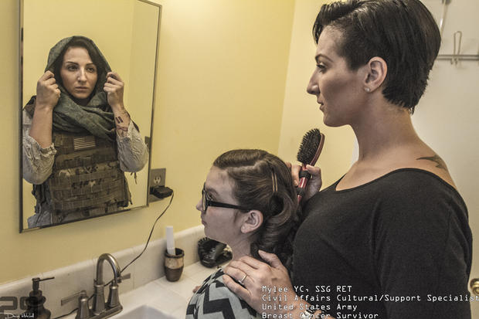
Flashbacks
“I feel like I’m straddling a timeline where the past is pulling me in one direction and the present another. I see flashes of images and noises burst through, fear comes out of nowhere… my heart races and my breathing is loud and I no longer know where I am.”

Slide 11
Irritability
“I snap at my partner. I don’t know why. Everything should be fine but it leaps out of me and I feel so ashamed afterwards. I don’t know why she stays.”

Slide 12
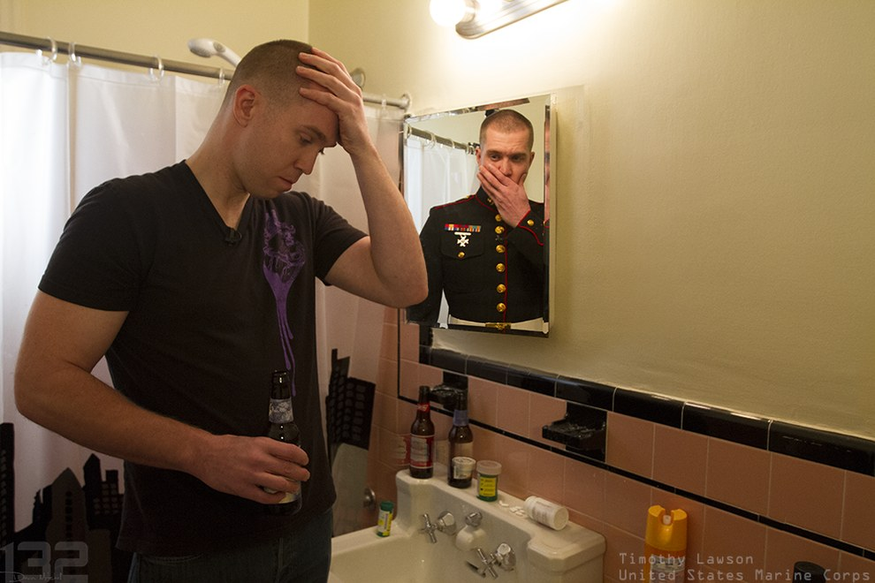
Substance abuse
“It’s the only thing that makes the world quiet again.”

Slide 13
Avoidance
“Every time the news showed a hospital I was there, giving birth. Bleeding again. Dying.”

Slide 14
Social Withdrawal
“I can’t face my family any more, even being in the house with them. No-one can help me.”

Slide 15
Personality Change
“That man I was…. He’s dead now. I don’t know who x is anymore. Maybe no-one.”

Slide 16
Self Harm
“It was the only path that made sense to me. The only way to make it stop.”

Slide 17
Dissociation
“I’m utterly alone. I don’t feel like I belong in the world any more – I’m a passenger.”

Slide 18
EMDR
Notes:
At first glance, Eye movement desensitisation reprocessing (EMDR) appears to approach psychological issues in an unusual way. It does not rely on talk therapy or medications. Instead, EMDR uses a natural function of the body, Rapid Eye Movement (REM), as its basis and Dr. Francine Shapiro, the founder of EMDR, found that just 3 90 minute sessions could alleviate symptoms of PTSD in more than 77% of the patients she treated.
We uses REM during sleep time to help it process daily emotional experiences and when trauma is extreme, this process breaks down and REM sleep doesn’t bring the usual relief from distress. The EMDR process is thought to produce an advanced stage of the REM processing. As the brain, via the eye-movement, processes troubling images and feelings, resolution of the issue can be achieved by dampening the power of emotionally charged memories.
EMDR therapy is not limited to simply taking symptoms away. It addresses the past, present and future. The goal is to allow the person to achieve a complete state of emotional health. It has also been used to help athletes, performers and executives to achieve a state of “peak performance.”

Slide 19
Trauma Focussed CBT
Notes:
Trauma-Focused Cognitive Behavioral Therapy (TF-CBT) is a components-based psychosocial treatment model that incorporates elements of cognitive-behavioral, attachment, humanistic, empowerment, and family therapy models. \
It is designed to be provided in a flexible manner to address the unique needs of each patient
This model was initially developed to address trauma associated with child sexual abuse and has more recently been adapted for use with children and adults who have experienced a wide array of traumatic experiences, including multiple traumas.

Slide 20
Pharmaceuticals

Slide 21
Notes:
The prognosis in PTSD can be varied. However as a rule of thumb 50-65% will go into remission in 6 months. If symptoms persist after 6 months, then remission without treatment is unlikely and the course will be chronic over months or years, perhaps relapsing and remitting. If symptoms are still present at two years after the incident, the prognosis is poor, and there are likely to be many determinants of ongoing symptoms, many not related to the original incident.

Slide 22
Further Reading
Nice guidance CG26 – PTSD
www.ptsduk.org
www.mind.org.uk/PTSD

