Slide 1
GP Education Half Day CCG Update
19 October 2017
Shaping healthcare for you … and your family

Slide 2
Advice & Guidance Update
Shaping healthcare for you … and your family

Slide 3
Advice & Guidance Attachment Issue Resolved
Previously, attachments had to be exported and reattached into EMIS
Now, all clinical content can be attached as per the patient referral process (by clicking on the tabs under clinical content).
Shaping healthcare for you … and your family

Slide 4
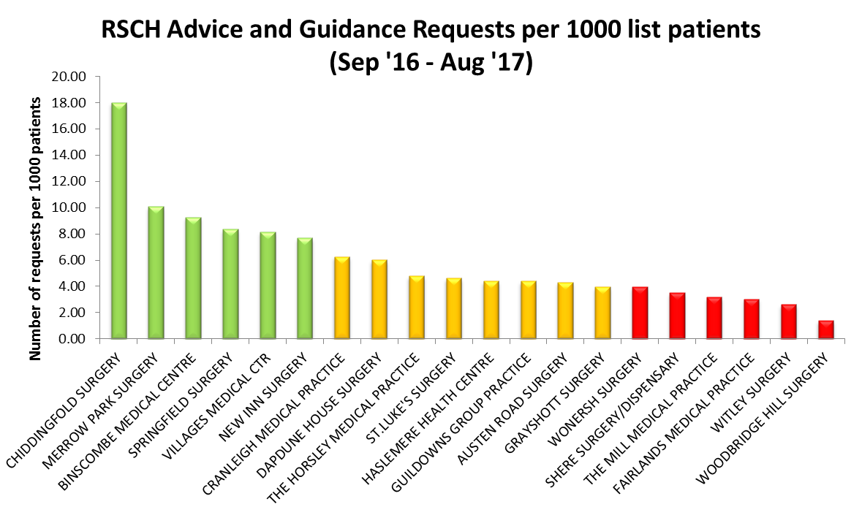
Think #A&G b4 F2F

Slide 5
Conversion rate from A&G to OPD
Data from Apr ‘17 – Jun ‘17
408 A&G sent to RSCH
33 patients, or 8% converted to an appointment
Estimated saving of 375 first appointments
Estimated cost saving of £52k
Only 8% of A&G requests converted to an outpatient appointment
Think #A&G b4 F2F

Slide 6
Advice and Guidance Specialties | Status at ASPH | Status at RSCH | Other
ALLERGY | N/A | LIVE
AUDIOLOGY | LIVE | N/A
BREAST SURGERY (Breast Surgery - [Non-Urgent, Non-Cosmetic] at RSCH) | LIVE | LIVE
CARDIOLOGY | LIVE | LIVE
CLINICAL HAEMATOLOGY (Haematology at RSCH) | SUSPENDED | LIVE
DERMATOLOGY | LIVE | N/A | ‘Guildford & Waverley Dermatology’ on e-RS, or guildford.derm@nhs.net
DIABETIC MEDICINE | LIVE | LIVE
DIETETICS | LIVE | N/A
ENDOCRINOLOGY (Endocrinology & Metabolic Medicine at RSCH) | LIVE | LIVE
ENT | LIVE | LIVE
GASTROENTEROLOGY | N/A | LIVE
GENERAL SURGERY (Sits under Surgery – Not Otherwise Specified) | LIVE | LIVE
GERIATRIC MEDICINE | LIVE | LIVE
GI and Liver (Medicine and Surgery) (please specify Gastroenterology, Upper GI Surgery or Colorectal Surgery at ASPH or find under General Surgery for RSCH) | LIVE | LIVE
GYNAECOLOGY | LIVE | LIVE
MENTAL HEALTH | N/A | N/A | Being investigated
NEUROLOGY | LIVE | LIVE
OPHTHALMOLOGY | LIVE | LIVE
ORAL & MAXILLOFACIAL SURGERY (Maxillo-Facial Surgery at RSCH) | LIVE | LIVE
PAEDIATRICS (Sits under Children’s & Adolescent Services at RSCH) | LIVE | LIVE
PAIN MANAGEMENT | LIVE | LIVE
PHYSIOTHERAPY | N/A | LIVE
RADIOLOGY |  | Being investigated
RESPIRATORY MEDICINE | LIVE | LIVE
RHEUMATOLOGY | LIVE | LIVE
TRAUMA AND ORTHOPAEDICS (Sits under Orthopaedics at RSCH) | LIVE | LIVE
UROLOGY | LIVE | LIVE
VASCULAR SURGERY | LIVE | N/A
PLASTICS | N/A | N/A
RENAL/NEPHROLOGY | N/A | N/A | Being investigated
Notes:
Table shows the specialties that are available at ASPH, RSCH or at other providers

Slide 7
Advice & Guidance for Mental Health
Initial meeting with Surrey and Borders Partnership Trust was held on 17th October
CCG will issue out communications to practices once a go live date has been agreed
Shaping healthcare for you … and your family

Slide 8
National Diabetes Prevention Programme (NDPP) Update
Shaping healthcare for you … and your family

Slide 9
NDPP Update
All 21 practices have signed up to the National Diabetes Prevention Programme (NDPP) ‘Healthier You’
764 patient referrals since launch in May 2017
Courses already running in Haslemere, Guildford and Godalming
Courses due to start in Cranleigh and Grayshott
Reports of high patient satisfaction and course retention rates
Shaping healthcare for you … and your family

Slide 10
Social Prescribing Update
Shaping healthcare for you … and your family

Slide 11
Social Prescribing - Definition
Social prescribing is a way of linking patients in primary care with sources of support within the community
It provides GPs with a non-medical referral option that can operate alongside existing treatments to improve health and well-being
While there is no widely agreed definition of social prescribing, or ‘community referrals’, reports on social prescribing include an extensive range of prescribed interventions and activities
Shaping healthcare for you … and your family
Notes:
National policies emphasise the need to embed prevention though deeper integration of primary care and community services
Social prescribing is one approach which has been widely cited as a care model to contribute towards this agenda.
Social prescribing is one of the 10 High Impact Actions to release time for care (established as part of the GP Forward View)

Slide 12
Benefits of Social Prescribing
Reduces pressure on General Practice and A&E
Improves support for people with wider ‘social’ needs
Reduces health inequalities –for those who use the NHS the most, complex needs
Shaping healthcare for you … and your family
Notes:
Giving people time -what matters to you?
Power shift –people in control of their own health and wellbeing
Move towards community support, away from traditional services
Helps patient to set their own goals, builds resilience –co-produced support plans
Enables people to ‘give back’ for the support they’ve received

Slide 13
Social Prescribing in Guildford & Waverley
Existing elements of social prescribing within local area supported by the voluntary sector and the Diocese
Possibility to apply for a VCSE bid (up to £300k) to enable a more structured approach to benefits and links to primary care
CCG and Local Authority have already met with representatives of voluntary sector and Diocese to scope the potential bid
Restrictions about funding (Local Authority and/or CCG have to commit to a proportion of funding in year 2, 3 and 4
Applicants need to demonstrate links with a wide range of local services and how the service will reduce health inequalities
Applications need to be submitted by 21st November 2017
Shaping healthcare for you … and your family

Slide 14
GP Referrals into the Service (Examples)
Mrs Bloggs - she lives alone and comes to see her GP twice a week (for different reasons, but not medical all the time). She may need befriending
Mr Smith – he comes to see his GP more frequently than before and he’s lost weight (no medical issues here); - he might have money issues
Mrs A – she’s over 65 years old and all of a sudden she visits her GP more frequently than before because she likes to complain about her weight and back pains (she can be referred to this service and this service can refer her to exercise classes)
Mrs C – she may have mild learning disability issues and she may need additional support re services to access – she needs signposting
Mrs D – recently lost her husband and requires additional support – she can be referred for bereavement support
Mrs E – she’s over 85 and cannot drive anymore due to her poor eyesight - she can be referred to this service for additional support and advice
Shaping healthcare for you … and your family

