Slide 1
Trajectories in Non-malignant Disease and New Collaborative Care Models For Advanced Disease
Debbie Hindson Nurse Consultant (non cancer)

Slide 2
Aim
Explore the transition into Specialist Palliative Care for people with non-malignant conditions
- Disease trajectory
Review the challenges for different non malignant disease groups
- Prognostic indicators
- Multi-morbidities
Proposed model for proactive collaborative care

Slide 3
WHO definition Palliative Care (accessed 2018)
Palliative care is an approach that improves the quality of life of patients and their families facing the problem associated with life-threatening illness, through the prevention and relief of suffering by means of early identification and impeccable assessment and treatment of pain and other problems, physical, psychosocial and spiritual.

Slide 4
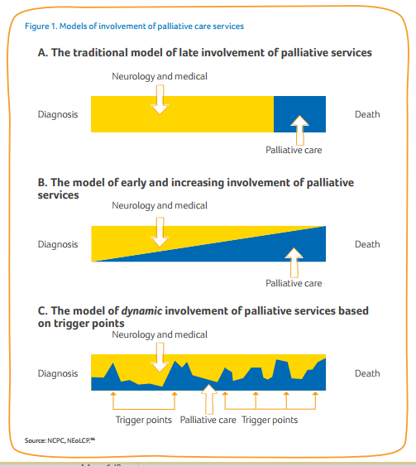
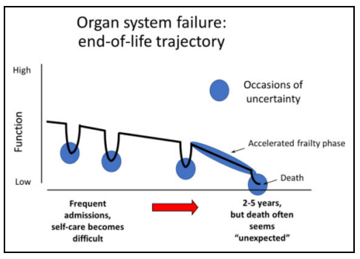
Disease Trajectory

Slide 5
National Drivers for Palliative Care for Non-Malignant Conditions
Access Inequalities
Accessible palliative care from diagnosis to death collaboration with active treatments and palliative support
Proactive early referral to improve quality if life

Slide 6
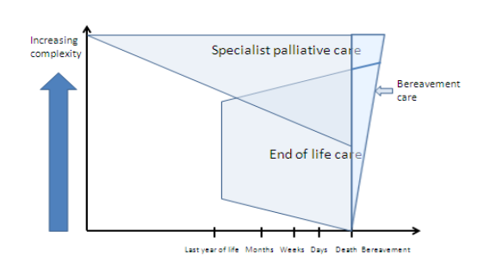
Specialist Palliative Care
Living Well Day Services | Community Support | In-Patient | Post bereavement
Specialist palliative care is the active, total care of patients with progressive, advanced disease and their families. Care is provided by a multi-professional team who have undergone recognised specialist palliative care training. The aim of the care is to provide physical, psychological, social and spiritual support
http://www.ncpc.org.uk/sites/default/files/CommissioningGuidanceforSpecialistPalliativeCare.pdf

Slide 7
Benefits of proactive palliative care involvement
Allows for broader integration of care across services (Bakitas, 2013)
Palliative care delivered in parallel with disease focussed treatment (Boyd,2012)
Supports timely advanced planning (Charnock, 2014)
Reduced burden on caregivers (Higginson, 2011)
Lower symptom distress (Schroedl et al 2014)
Patients and family may be better prepared for death
Proactive bereavement support

Slide 8
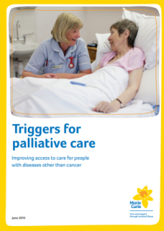
Challenges to transitions for palliative care
Prognostic uncertainty – variation to predict disease trajectory
High levels of hospital use
No clear terminal phase
Emerging limited evidence base for non malignant palliative care to establish patient outcomes
Perception of HCPs - time, timing and confidence
Perception of patients around palliative care
Cancer trajectory still predominant
Under developed links between condition specialist and palliative care specialists

Slide 9
Triggers – Prognostic Indicators

Slide 10
Proposed Non Malignant Collaborative Model
Acute Trust
Palliative Consultant attendance at MDT
Identify end-stage using GSF indicators
Joint clinic:
LIVING WELL WITH ADVANCED ILLNESS
Community based
Patients well enough to attend as out-patient
Specialist consultant/CNS & palliative care consultant/CNS
Optimising medical management
Rationalising medication
Holistic assessment
Advance Care Planning
Identification of palliative needs
Patients with no palliative needs
OT
Specialist community CNS
Physio
SALT
Community matron
Direct referral via ART for patients too unwell to attend joint clinic
Patients with palliative needs referred by joint clinic to PTHC via ART
Services available across all areas:
Patient & Family Services
Physio
OT
PTHC Services
Via
Advice & Referral Team
Community Specialist Team remain involved in care
Blocks of care
MDT discussion at end of each block
Retention on non-malignant service caseload with Open Door Policy for further episodes of care
Living Well Services
Tailored programmes of care to encourage self-management and patient/carer empowerment.
Inpatient Unit
Community & Out-patient Service
draft 1 29/11/2017

Slide 11
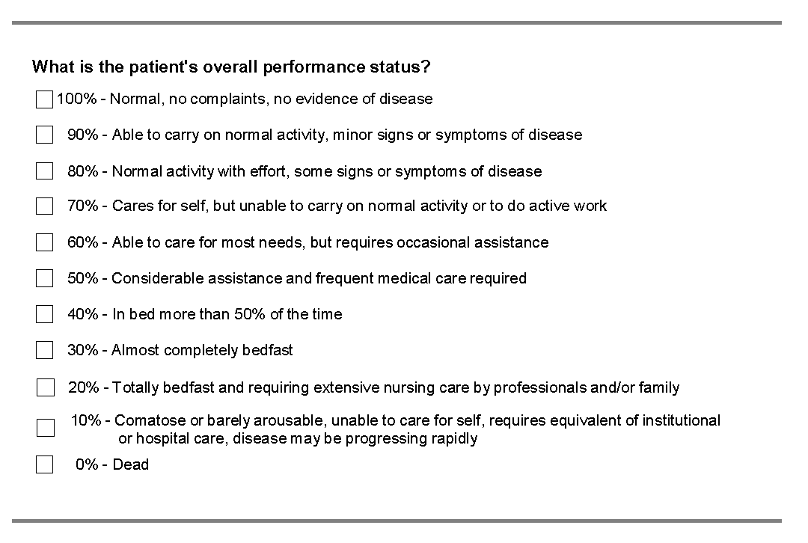
Monitoring and Evaluation tools – impact on models of care

Slide 12
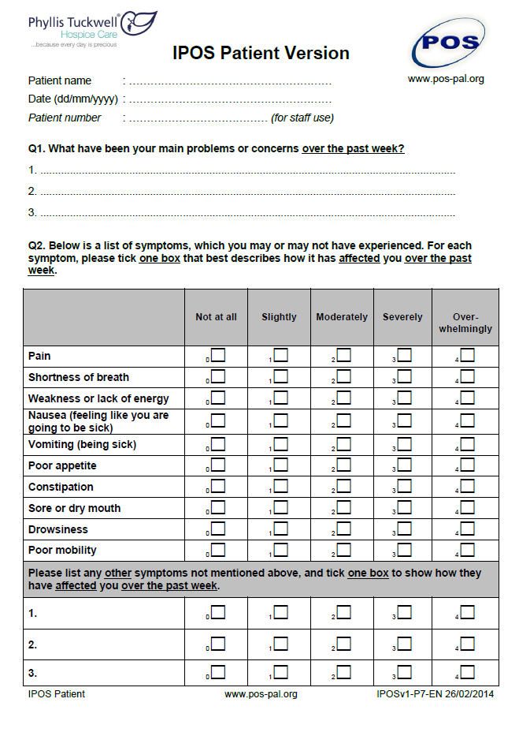
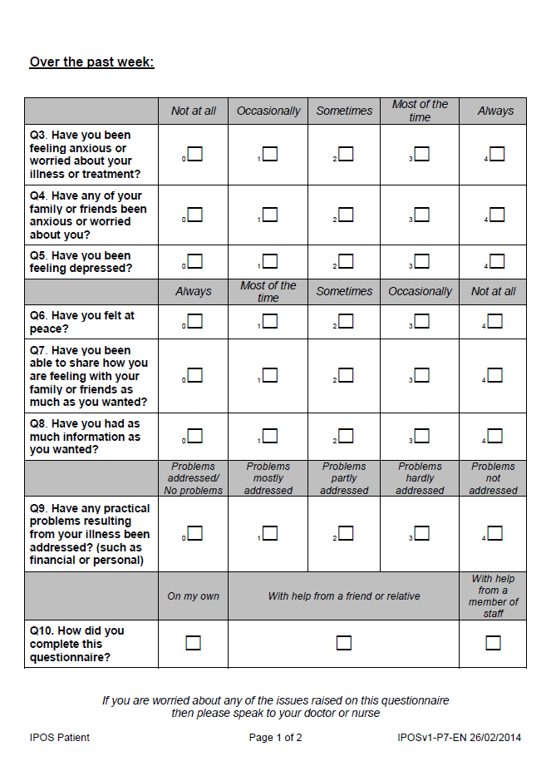
i-POS - Evaluation

Slide 13
Outputs
A clear referral pathway for patients with non-malignant condition
Advance Care Planning in place for patients
With patients’ consent, care plans and resuscitation status communicated to South East Ambulance Service securely via their own IBIS database, thereby reducing hospital admissions
Improved service utilisation
Reciprocal education programme between PTHC and local health providers
Submission of service evaluation and achievements for publication in journals such as the British Medical Journal and European Journal of Palliative Care

Slide 14
Summary
National drive for palliative care equitable access for people non malignant conditions
PTH has started to develop models of care – still remains a large cohort of people who would benefit to access to specialist palliative care
As part of the models – recognition of Collaborative approach across boundaries to supporting the proactive management of advanced disease in the non malignant population

Slide 15
Thank You

