Slide 1
Benzodiazepine and Antidepressant Prescribing Amy Scott, Medicines Optimisation Pharmacist Guildford & Waverley CCG
Shaping healthcare for you … and your family

Slide 2
NHS England- Key Messages Benzodiazepines and suicide
Need for regular and close monitoring of patients who are withdrawing from benzodiazepines
Need to consider the particular risks associated with shorter acting benzodiazepines
Existence and continued relevance of guidance from NICE and BAP on prescribing/withdrawal of benzodiazpeines. https://www.bap.org.uk/docdetails.php?docID=77
https://cks.nice.org.uk/benzodiazepine-and-z-drug-withdrawal#!scenario (managing benzo withdrawal)

Slide 5
Antidepressants
Note - The Mood Hive and associated local depression and anxiety treatment guidelines have been removed from PAD. Updated guidelines and resources for treating and managing depression in adults are being developed by Surrey & Borders Partnership. For current advice, in line with NICE guidance, please see the Clinical Knowledge Summaries

Slide 7
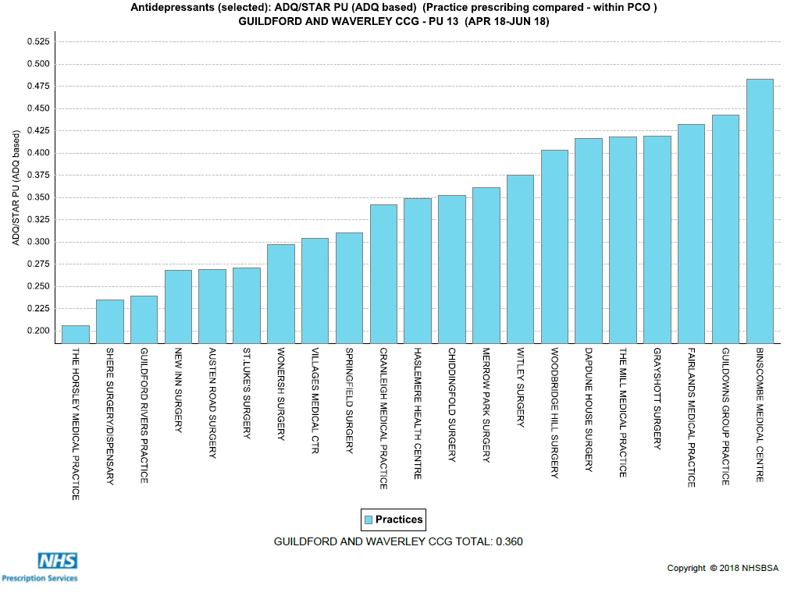

Slide 8
