Slide 1
Alzheimers disease
111 years on from Auguste D

Slide 2
Dementia update
Historical context
Early diagnosis
MCI
Medication issues, current and future
Driving
Any questions?

Slide 3
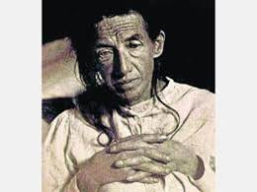
Auguste Deter

Slide 4
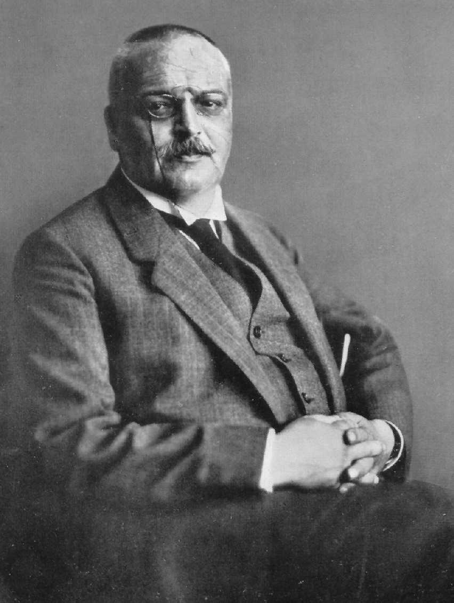
Dr Alzheimer

Slide 5
Auguste D 1901
Paper 1907
Alzheimers disease Kraplein 1910 (rare presenile dementia)
Alzheimers Disease 1977, amyloid plaques
NFT 1984
1993 Choline esterase inhibitors
2000 memantine

Slide 6
MCI
Transition healthy ageing to clinical dementia
Driven by need for early recognition
Broadening of initial construct away from prodromal AD

Slide 7
Mild Cognitive Impairment
Concept developed in late 1980s
2003 symposium
DSM V

Slide 8
MCI criteria
Subjective concerns from patient, informant or clinician
Evidence of impairment in one or more domains
Preservation of function

Slide 9
MCI sub types
aMCI (single)
aMCI (multiple)
naMCI (single)
naMCI (multiple)

Slide 10
MCI as a prodrome of AD……
Uncertain: clinical MCI, no biomarkers
Intermediate: MCI plus evidence of increased amyloid or neurodegeneration
High Probability: MCI plus amyloid plus neurodegeneration

Slide 11
Biomarkers (Increased Beta-amyloid burden)
PET studies (Pittsburgh compound)
CSF AB42 levels

Slide 12
Biomarkers (neurodegeneration)
CSF Tau
Hippocampal/ medial temporal lobe volume MRI
FDG-PET (hypoperfusion)
SPECT perfusion

Slide 13
Clinically useful?
Prevalence rates ( >65) ~ 20%
Conversion to clinical dementia ~ 10% (20% in Memory Clinic) per year
No evidence of benefit from treatment with Cognitive Enhancers, no alteration of conversion rate

Slide 14
Identification of presymptomatic AD
Not possible currently
Peripheral biomarkers
Pathology developing for 10 – 20 yrs before symptoms

Slide 15
So………
MCI useful in identifying those at higher risk of subsequently developing AD
Use of biomarkers limited to research
Important group to monitor

Slide 16
Screening tools
Over estimation of value
Must always be seen in context of underlying prevalence

Slide 17
medication
Choline esterase Inhibitors
Memantine
Anti depressants
Mood stabilisers
Anti psychotics
benzodiazepines

Slide 18
Choline Esterase Inhibitors
Donepezil, Galantamine, Rivastigmine
No difference in efficacy
Donepezil easy to use, cheap
Transdermal Rivastigmine, PD dementia

Slide 19
Choline Esterase Inhibitors
Mild – moderate AD
Modest effect on cognition, care giver burden, delay need for institutional care
Can be helpful in non cognitive symptoms, particularly agitation and psychosis

Slide 20
Memantine
Mod- severe AD
Intolerant of AchEI’s
Modest effect on cognitive symptoms/function
Helpful with non cognitive symptoms, particularly those with a significant affective component

Slide 21
Memantine & AchEI’s in combination
Complimentary actions
Good evidence base
SABP reviewing guidance
Cognitive & non cognitive symptoms

Slide 22
Anti depressants
Generally safe
Conflicting evidence from studies
Useful in affective lability, irritability, emotional incontinence
Best evidence for Sertraline & citalopram, increasing for Mirtazepine

Slide 23
Anti psychotics
Have been over used
Not the work of Satan
But increase all cause mortality, increase incidence of cerebrovascular events, impair cognition
Helpful in florid psychotic symptoms, aggression & agitation
Best evidence for risperidone, then Olanzapine

Slide 24
Mood stabilisers
Carbemazepine & gabapentin can be helpful in challenging behaviours
Poorly tolerated
Significant side effects
Valproate not helpful

Slide 25
Benzodiazepines
NO

Slide 26
The future…………
No drugs since memantine
From 2002 to 2014:
244 compounds
413 clinical trials
99.6% failure rate

Slide 27
bapineuzumab
Amyloid antibody
Pfizer, J&J, Elan
+ve mouse studies
Reduces amyloid burden on PET
Doesn’t work
X2 phase 3 trials
“Hundreds of Millions of dollars”

Slide 28
2017 - SABP
CREAD crenezumab, amyloid AB, phase 3
SYMBAD, BPSD, mirtazepine & carbemazepine
Masitinib tyrosine kinase inhibitor, phase 3 , AD and ALS
ELAN liraglutide, long acting glucagon like agonist, phase 3

Slide 29
driving

Slide 30
Driving
Individuals must inform DVLA
Decision made on individual basis
May issue driving licence for 12 months
DVLA approved assessment centres

Slide 31
driving
X 3 – 8 risk of RTA
Risk linked to duration of symptoms and disease severity
3 years symptoms = 16 – 24 yr old male

Slide 32
Driving - factors to consider
Subj reports unhelpful
Poor correlation between informant & risk
MMSE
Tests of visuospatial function +/- executive function better predictive value

Slide 33
driving
Moderate – severe : stop
Mild: consider referral to driving centre if any concerns

