Slide 1
Psychological therapies in primary care (IAPT)
IAPT services provide evidence based treatments for people with anxiety and depression (implementing NICE guidelines).
IAPT in Guildford and Waverley is an ‘Any Qualified Provider service’ which means there are multiple IAPT providers offering choice of intervention and location e.g. online, face to face, group…
Notes:
Aims of presentation.

Slide 2
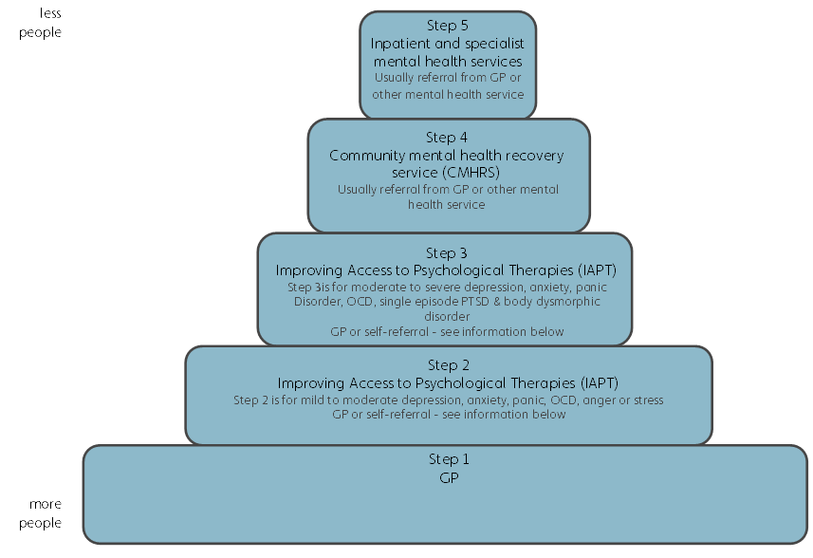
The Stepped Care Approach
Community connections
Services offering emotional and wellbeing support including support groups, drop in services, social events, activities such as art and walking groups, and confidence building courses

Slide 3
IAPT (Improving Access to Psychological Therapies)
Depression (including antenatal and postnatal); Anxiety panic disorder, phobias, OCD and PTSD
Aimed at primary care including early intervention
Timely access to brief intervention
Contact within 3 days of referral
assess within 10 days
start treatment within 28 days
Easy access including self-referral

Slide 4
Access to suit everyone
Range of providers: Centre for Psychology; DHC Talking Therapies; IESO Digital Health; Mind Matters; ThinkAction
Providing different, NHS, services
Face to face
Online
Computerised packages (e.g. skype)
Groups
Individual

Slide 5
Interventions / treatment
CBT (Cognitive Behavioural Therapy) based Guided Self-help
CBT
Counselling for depression,
Interpersonal Psychotherapy (IPT)
EMDR (single episode trauma)

Slide 6
IAPT cards – help yourself!

Slide 8
Date For Your Diary
The next Clinical Mental Health Forum:
Wednesday 6th December 1-2pm
The Mill Medical Practice, Godalming
The agenda will include presentations from Community Connections and the Guildford safe haven

