Slide 1
TIHM for dementia
Using technology to improve the quality of life for people with dementia
Notes:
Extend warm welcome to everyone and thank them for inviting you
Introduce self
Most of you should, hopefully, be aware of the TIHM for dementia study by now. I am going to briefly just go over the basics of the study, then update you on the feedback we have had about the study from our Trusted Users and tell you about how you can apply for funding to take part in the study.

Slide 2
TIHM for dementia: what is it?
One of seven test beds funded by the Department of Health and one of two IoT test beds focusing on new ways of working to support people with long term and complex health conditions.
TIHM is a randomised control trial that aims to support people with dementia who live at home and their carers.
Uses new technologies allowing clinicians to remotely monitor people’s health and safety round the clock and in real time
Partners from the NHS, academia, industry and the voluntary sector
Notes:
TIHM for dementia is part of an initiative funded by the Department of Health and overseen by NHS England and Innovate UK to accelerate development of innovative new ways of working to support people with long term conditions more effectively and efficiently
The statistics around dementia are startling with nearly 19,000 people in Surrey and HE Hants estimated to have dementia
Of those registered with dementia, over half will be admitted to hospital each year and 20% are frequent users of emergency services
Our TIHM for dementia trial aims to address some of these issues
Partners in the study are: Alzheimer’s Society, University of Surrey 5G Innovation Centre, Royal Holloway University of London, six CCG’s for Surrey and North East Hampshire and eight technology companies

Slide 3
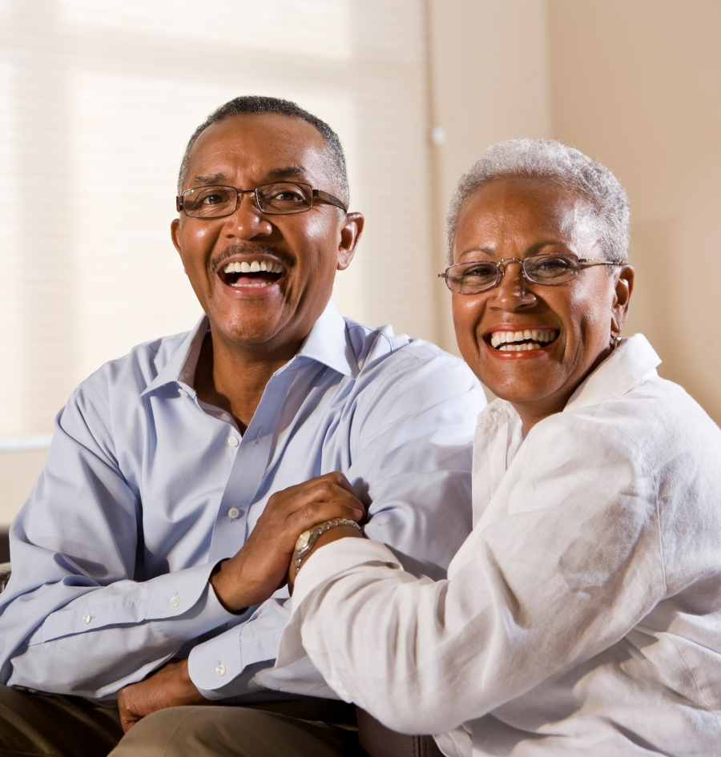
TIHM for dementia: key aims
Help people stay safe and well in their homes
Identify health and safety problems early on to reduce people’s need to go into hospital and care homes
Reduce pressure on carers
Improved targetting of NHS resources
Notes:
Improving the lives of people with dementia and their carers to enable them to live independently and take more control over their health and wellbeing
Enable people with dementia to live well in their own homes for longer, reducing hospital bed stays and care home admissions
Reducing the burden on carers to improve the quality of their life
Collaboration with academia, technology partners and voluntary sector to create manageable solutions to address the demand on health and social care services
Need led solutions so resources can be targeted to people who need them, when they need them most
Creating scalable solutions that can be quickly deployed for other long term health conditions

Slide 4
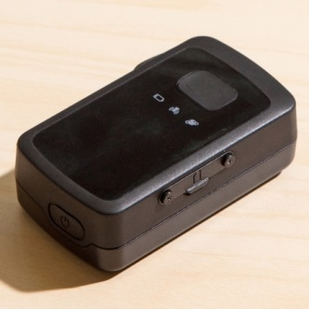
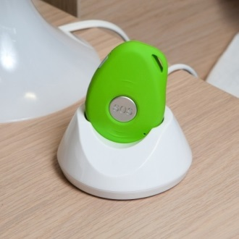
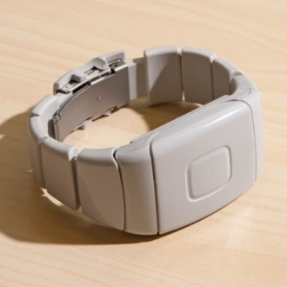
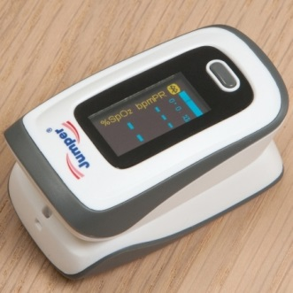
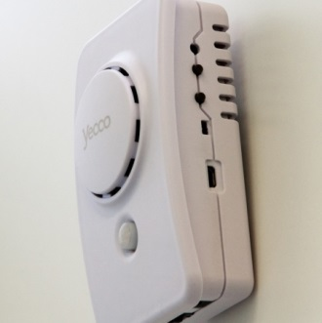
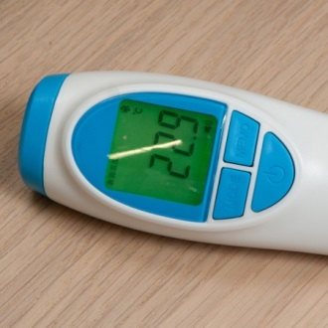
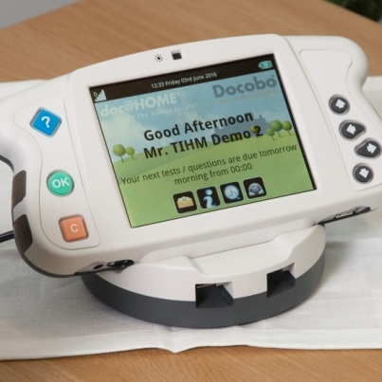
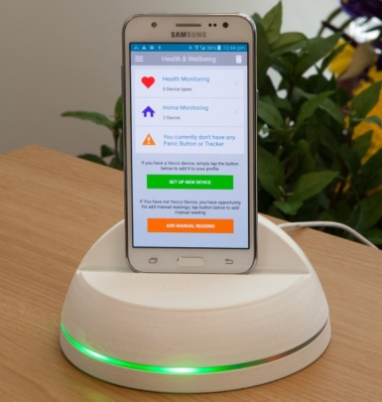
How does the technology work?
Devices installed in the home collect information about a person’s health and safety using the Internet of Things
Data is analysed using machine learning algorithms to identify deviations in behaviour
Problems are flagged up to clinicians at SABP’s Clinical Monitoring Unit who can step into offer support
Notes:
Two-year clinical trial involving the testing of devices such as sensors, apps and trackers installed in the homes of people with dementia in Surrey and NE Hants
The devices themselves are established products, what’s new is using data from combinations of devices to monitor people’s wellbeing via the internet of things to a monitoring centre where any change in wellbeing will be flagged to clinical staff and action can be taken
The trial will run alongside any existing health and social care support participants are receiving
At the end of the trial we will be making proposals on how the technology can be more widely applied to benefit other long term physical and mental health conditions

Slide 5
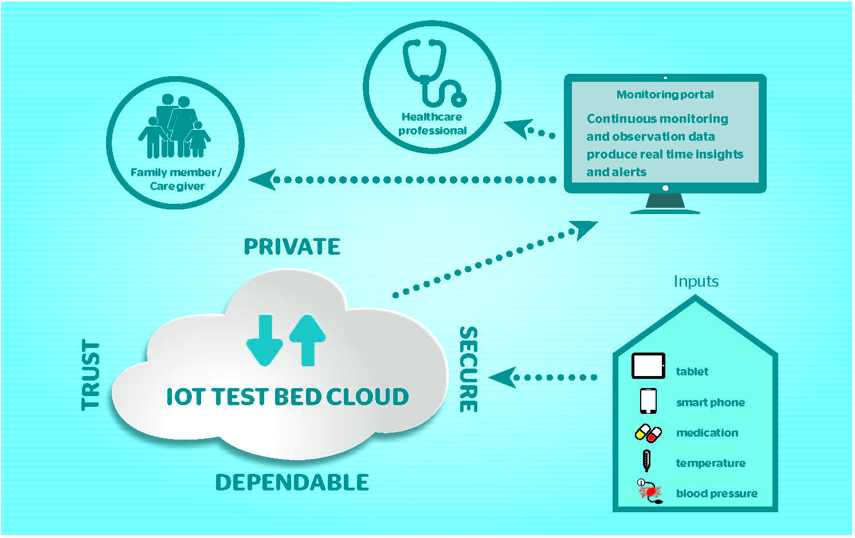
TIHM for dementia architecture

Slide 6
TIHM Integrated View (iView)
Notes:
This is the data that appears on the Integrated View at the Clinical Monitoring Unit where clinicians will follow up on alerts. This may involve them calling a carer to check that the person with dementia is okay, or organising for a Dementia Navigator from the Alzheimer’s Society to visit or if necessary, the emergency services may be contacted.

Slide 7
TIHM Integrated View (iView)

Slide 8
TIHM Integrated View (iView)
The technology being used in the TIHM study allows a persons location to be tracked
This information is available via the Integrated View and helps the clinical monitoring team to know if someone has wandered away from home and may need help

Slide 9
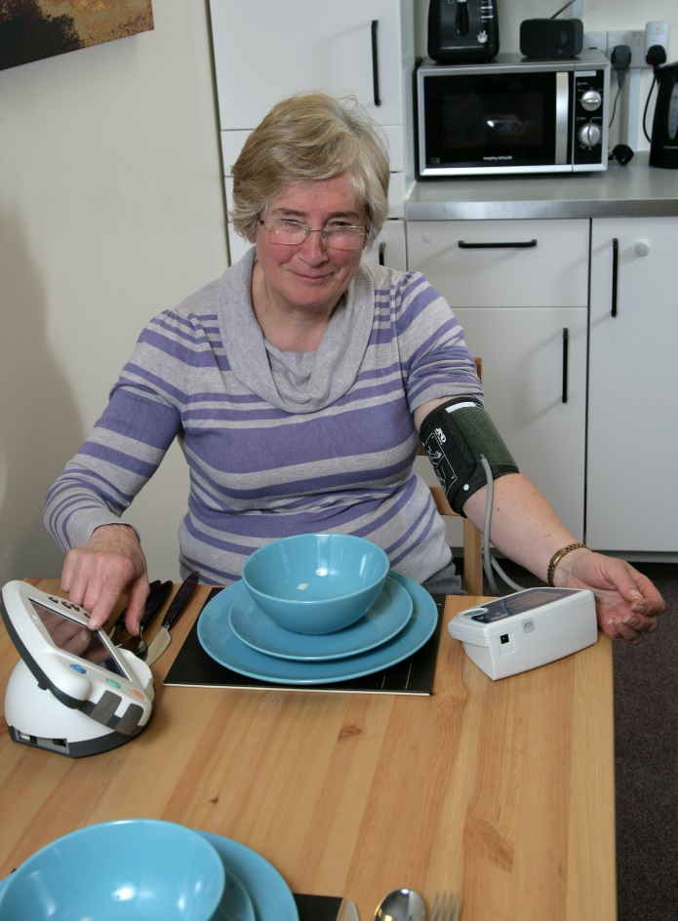
Feedback from Trusted Users
People feel safer/more supported
Less likely to go to A&E and the GP, unless advised to do this
Problems identified early on and treated, such as anxiety, high blood pressure and low pulse
Carers more confident to leave the person with dementia alone
Listen to the people trialling the technology. Go to: https://youtu.be/jxyyoFa31E0
https://youtu.be/fK8RtCiZpKs
Notes:
There are seven Trusted Users who have been trialling the TIHM for dementia technology for nearly six months now. They have been very positive about their involvement in the study and all say they are benefitting from the technology in their homes.
When they visit their GPs they can share recent data about blood pressure, weight, hydration, temperature, pulse and blood oxygen saving GPs time and helping them to make informed decisions earlier on.

Slide 10
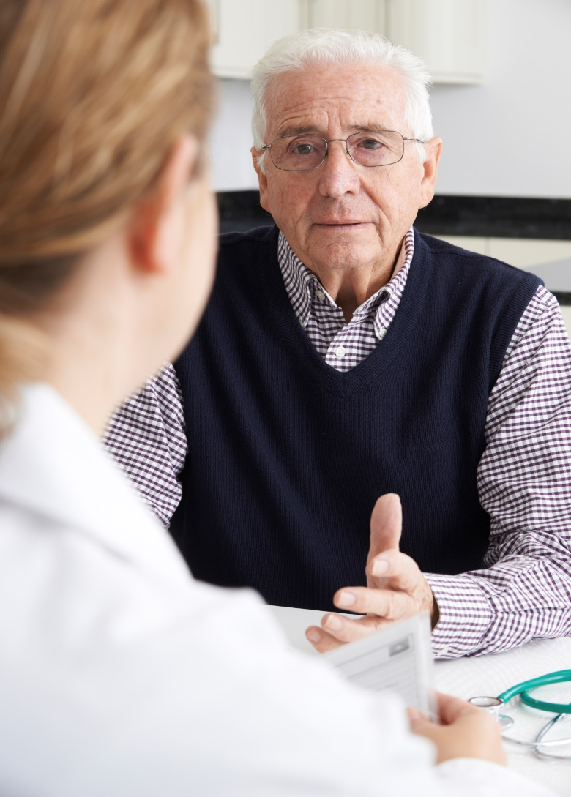
TIHM for dementia: why should GPs get involved?
Patients involved in the technology arm of the study receive extra support
Supports GPs by removing some of the routine monitoring, such as blood pressure tests etc.
Provides GPs with a historic and holistic account of someone’s health and wellbeing to help provide informed care and treatment
Notes:
Improving the lives of people with dementia and their carers to enable them to live independently and take more control over their health and wellbeing
Enable people with dementia to live well in their own homes for longer, reducing hospital bed stays and care home admissions
Reducing the burden on carers to improve the quality of their life
Collaboration with academia, technology partners and voluntary sector to create manageable solutions to address the demand on health and social care services
Need led solutions so resources can be targeted to people who need them, when they need them most
Creating scalable solutions that can be quickly deployed for other long term health conditions

Slide 11
Recruitment
400 people recruited onto the study so far
More volunteers needed
Recruitment will continue until end October
To be eligible a person must:
have mild to moderate dementia
live in Surrey or NE Hampshire
be living independently in the community and have a carer who is willing to get involved. The carer can be a partner, relative, friend or a paid carer

Slide 12
Funding for GPs who identify possible recruits
GP Practices can earn more than £350: So far 32 have written to their patients.
Identify people on their registers who have a diagnosis of dementia and who are not living in a care home
Print and sign approved TIHM for dementia letter, provided by Surrey and Borders Partnership, for people identified in the search
Send out the above letter with a TIHM for dementia leaflet to the identified people. Practices will already have been provided with the envelope containing the TIHM leaflet
To get involved in this activity and apply for funding, email:Helen Woronowski helen.woronowski@nihr.ac.uk
Notes:
We only expect practices to search for someone who has a diagnosis of dementia. The Research and Development Team at Surrey and Borders Partnership will decide, once they have received an expression of interest from someone who wants to get involved in TIHM, whether they eligible to get involved. They will do this by visiting the person and getting them to do a simple memory test
The TIHM for dementia leaflet that practices will be asked to send out with the letter contains a free reply slip so that practice does not have to get involved in replying to people or dealing with responses
The letter has been approved by the Health Research Authority and the Ethics Committee

Slide 13
GP feedback
GP from North East Hants and Farnham CCG:
“Our practice signed up for this as it involved no GP time, only some admin support to send out the patient letters. It potentially benefits our patients with dementia and financially rewards us to the tune of just over £350. It seems a no brainer!”
So far 23 practices have written to hundreds of people on their registers about the study

Slide 14
Find out more
tihm@sabp.nhs.uk
www.sabp.nhs.uk/tihm
@TIHM_dementia

Slide 15
With thanks to…

