Slide 1
Guildford Primary Care Education Lung Cancer Update Thursday 3 May 2018
Debbie Bell
Cancer Research UK Facilitator
Surrey
Debbie.bell@cancer.org.uk
Alessandra Dale
Macmillan GP
Guildford and Waverley CCG
alessandra.dale@nhs.net

Slide 2
What we will cover
Smoking cessation - GP role
E cigarettes
Early diagnosis
Local support from CRUK and Macmillan
Case studies
Top 10 tips
Resources and CPD

Slide 3
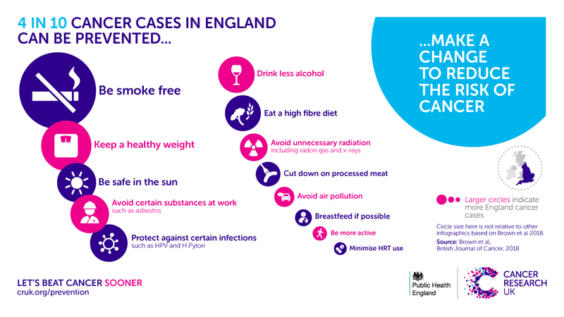

Slide 4
What can GPs do?
Notes:
Intended audience:
Aim of slide:
Adaptation:
Key Points:

Slide 5
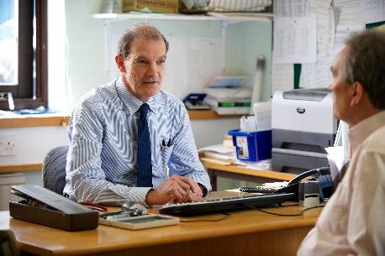
WHAT YOU CAN DO AS A HEALTHCARE PROFESSIONAL?
Refer patients to Stop Smoking Services.
Quit 51 in Surrey
Send personalised letters.
There is evidence that brief intervention (a tailored conversation around current behavior and opportunities to make changes) from GPs can encourage smoking cessation.
elearning.rcgp.org.uk/course 30 mins
Notes:
Aim of slide: To outline what HCP can do to support their patients to quit smoking.
Key points:
A large study across England found smokers were almost twice as likely to try to stop if they had been offered help by a GP, than if they had only been advised to stop.
It is also important to refer patients to Stop Smoking Services if available for support in their cessation attempt.
There is some evidence that interrogating patient records and sending personalised letters to smokers registered with the practice may also encourage more people to quit with services.
There is also evidence for the impact of brief interventions - a tailored conversation around current behavior and opportunities to make changes - in encouraging smoking cessation.
The CRUK/RCGP Behaviour Change and Cancer Prevention e-learning module outlines the current evidence for brief interventions in relation to smoking (as well brief intervention for alcohol and VBA for weight).
It includes information on how to approach conversations about prevention with patients.
You can access it at elearning.rcgp.org.uk/course.
Discussion prompts:
As practice do you know who your smokers are?
Do you ask about smoking status at every opportunity?
Can your practice staff support smokers to give up? Are staff trained?
Do you know your local stop smoking services and how to refer?
Extra information:
A recent evidence review by the Health Information team has found there is limited evidence for VBA impacting smoking cessation, however there is evidence around brief interventions (longer HCP intervention, different from VBA) having an effect. It is a good idea to talk more broadly about brief interventions and highlighting that they can be effective in encouraging cessation.
References:
West R, Fidler J 2011 Smoking and Smoking Cessation in England 2010. London: Vasco- Graphics. www.smokinginengland.info
Stead LF et al Physician advice for smoking cessation. Cochrane Database of Systematic Reviews 2013, Issue 5. Art. No.: CD000165. DOI: 10.1002/14651858.CD000165.pub4
Brief interventions & referral for Smoking Cessation in Primary Care & other settings
Avayard et al. 2011 Brief opportunistic smoking cessation interventions:. doi:10.1111/j.1360-0443.2011.03770.x
NICE Smoking Cessation: PH10
Smoking Cessation services G10
Lancet: https://www.cancerresearchuk.org/about-us/cancer-news/news-report/2017-01-25-personalised-invite-can-encourage-more-people-to-quit-smoking-through-stop-smoking-services

Slide 6
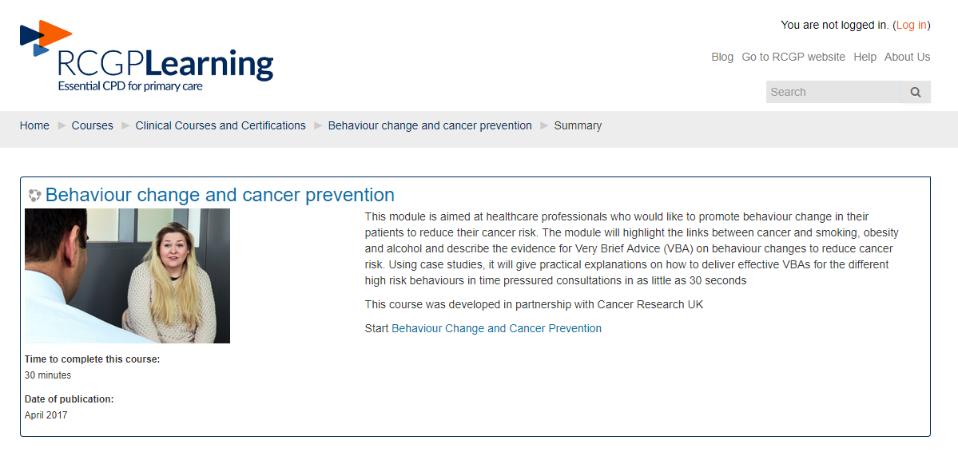
VBA e learning module
http://elearning.rcgp.org.uk/course/info.php?id=211 (last accessed 7.4.18)

Slide 7
VALUE OF THE MODULE
Value of module
4.5 /5
Provides motivation to give advice (esp. smoking).
evidenced based / numbers needed to treat (NNT).
Quick to implement.
Reinforcement & / or increased depth of knowledge about risk factors link to cancer.
Practical support (language) in delivering VBA.
‘The value of it is its brevity and the fact that it’s got some evidence behind it, so you know you’re not wasting your time by being so brief.’ GP
‘Smokers … before the training I felt very unconfident to challenge the subject, to talk about it as a lifelong non-smoker. I almost felt I didn’t have the credentials to talk to people about it. After the training… I really felt I had the confidence to talk to smokers and link it to cancer and other health issues.’ Community Health Trainer
‘It’s refreshing, it’s memorable, it’s immediately applicable. It’s within everyone’s ability to do it.’ Nurse Practitioner
1= not at all confident, 2 = not too confident, 3 = neither confident nor underconfident, 4 = somewhat confident, 5 very confident
Those in non-specialised roles– Value of module (4.2)

Slide 8
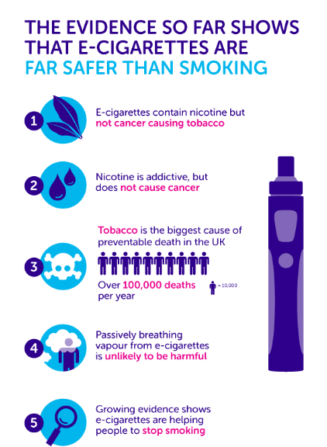
E-CIGARETTES
All evidence so far suggest they are safer than tobacco cigarettes, although long term effects are not known
RCGP recommends GPs:
Provide advice on relative risk of smoking and e-cigarette use
Actively engage with smokers who want to quit with the help of e-cigarettes
Encourage smokers who want to use e-cigarettes as an aid to quit smoking to seek the support of local stop smoking services
Taken from http://www.rcgp.org.uk/clinical-and-research/clinical-news/to-vape-or-not-to-vape-the-rcgp-position-on-ecigarettes.aspx
Notes:
Aim of slide: To highlight the evidence relating to the safety of e-cigarettes and their use in smoking cessation.
Key points:
All the evidence so far suggests e-cigarettes are far safer than tobacco cigarettes.
Growing evidence shows e-cigarettes may have the potential to help smokers move away from tobacco. But it’s not yet possible to know the long-term impact of these products.
There is no convincing evidence in the UK that e-cigarettes are re-normalising smoking or acting as a gateway for children into smoking.
RCGP has produced a position on e-cigarettes, authored by Dr Richard Roope, RCGP and Cancer Research UK Clinical Champion for Cancer.
It recommends:
GPs provide advice on the relative risks of smoking and e-cigarette use, and provide effective referral routes into stop smoking services.
GPs engage actively with smokers who want to quit with the help of e-cigarettes.
Where a patient wants to quit smoking, and has not succeeded with other options, GPs should recommend and support the use of ENDs battery-powered devices that allow the inhalation, or “vaping” of an aerosol containing nicotine, with the option of flavouring.
GPs recognise ENDS offer a wide reaching, low-cost intervention to reduce smoking (especially deprived groups in society and those with poor mental health, both having elevated rates of smoking).
All GPs encourage smokers who want to use e-cigarettes as an aid to quit smoking to seek the support of local stop smoking services.
References:
Burstyn I. Peering through the mist: systematic review of what the chemistry of contaminants in electronic cigarettes tells us about health risks. BMC Public Health. 2014;14(1):18. doi:10.1186/1471-2458-14-18
http://scienceblog.cancerresearchuk.org/2017/02/06/new-study-comes-the-closest-yet-to-proving-that-e-cigarettes-arent-as-dangerous-as-smoking/
McNeill A, Brose L, Calder R, Hitchman S, Hajek P, McRobbie H. E-Cigarettes : An Evidence Update. Commissioned by Public Health England.; 2015. https://www.gov.uk/government/publications/e-cigarettes-an-evidence-update.
Goniewicz M, Knysak J, Gawron M, et al. Levels of selected carcinogens and toxicants in vapour from electronic cigarettes. Tob Control. 2013
http://scienceblog.cancerresearchuk.org/2017/02/06/new-study-comes-the-closest-yet-to-proving-that-e-cigarettes-arent-as-dangerous-as-smoking/
Tobacco: Harm reduction approaches to smoking
http://www.rcgp.org.uk/clinical-and-research/clinical-news/to-vape-or-not-to-vape-the-rcgp-position-on-ecigarettes.aspx

Slide 9
Value of early diagnosis
Notes:
Intended audience:
Aim of slide:
Adaptation:
Key Points:

Slide 10
UK GPs are facing a 2.5% annual growth in their 400 million consultations
An average GP will see 8000 patients a year . . .
But will only have 7 cases of cancer
There are 50000 GPs in 9,000 independent practices in the UK
100
Notes:
Intended Audience: Internal staff (non-P&I) and external non-NHS staff.
Key Points
However, although cancer is a priority for GPs because of its seriousness, it’s a very small part of a far greater workload
Each GP has 8000 people coming in their door for consultation each year, but only 7 people on their list of patients will get cancer. It’s therefore very unlikely that someone who turns up to see them will have cancer
The task of identifying those at risk in a typical 10 minute consultation means that patient-doctor communication, the GP’s consequent decision-making and action, and the practice systems available to support them are critical
At the same time, getting GPs’ attention to think about their cancer referrals can be hard. GP workload is high and increasing. Also there are 50,000 GPs in the UK working in 9,000 independent practices. To change behaviour is a BIG COMMS CHALLENGE
Additional info:
GPs also see a great number of patients whose symptoms may be an indication of cancer: the average GP makes around 39 urgent referrals for tests for suspected cancer per year (but guidelines would like to see more patients
referred for tests)

Slide 11
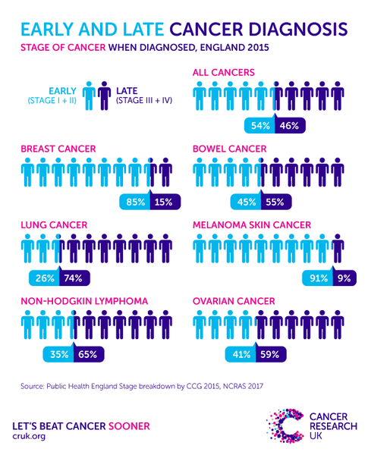

Slide 12
1 year+ survival

Slide 13
5 year survival

Slide 14
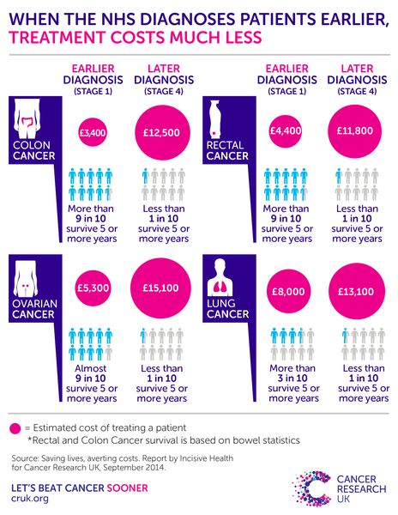

Slide 15
Local data on lung cancerTwo Week Wait referrals for suspected lung cancer per 100,000

Slide 16
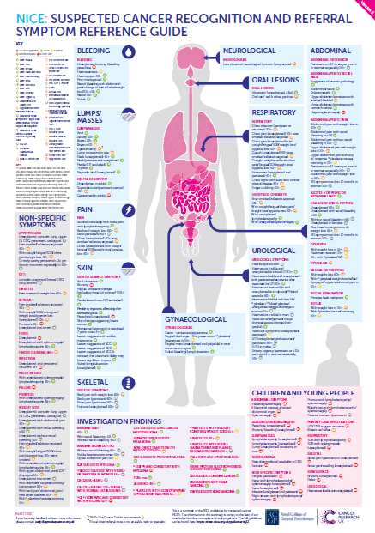

Slide 17
Local support
Notes:
Intended audience:
Aim of slide:
Adaptation:
Key Points:

Slide 18
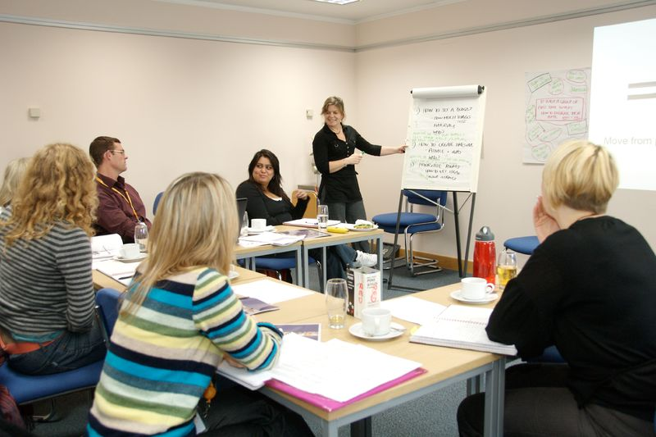
Our practice visits are at the core of what we do
Interactive discussion about cancer, their data and ideas for improvement
Follow up with training, advice, and resources
Meet the whole team
Notes:
Key points:
Our practice visits are at the heart of our offer
A facilitator approaches a practice and arranges to meet the whole team – GPs, administrators, practice nurses. We believe that
This is usually over lunch or when the practice is closed
ENGLAND ONLY: The facilitators bring data on how the practice is performing on cancer – including information on how many of its patients are taking part in screening programmes, or the level of its referrals for suspected cancer
DEVOLVED: The facilitators discuss with the practice how they are doing on various aspects of cancer – for example the systems they have got in place to follow-up on patients who haven’t taken part in bowel screening
The approach is very tailored – we ask the practice what they would like to work on and bring ideas for improvement
We follow up, by providing training, advice and resources to the practice

Slide 19
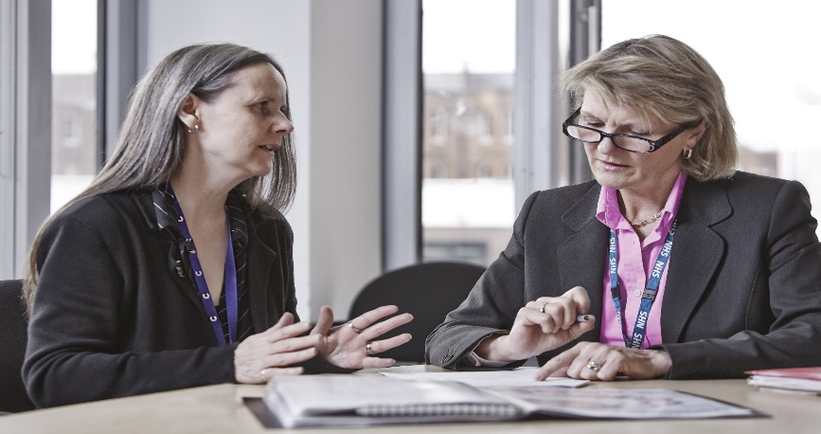
. . . and they are exceptionally effective
99% of attendees would recommend them to
colleagues
91% rated the visit as ‘Very useful’
96% of attendees plan to take action to improve their practice as a result
Notes:
Key points:
Practice visits are exceptionally effective… Feedback tells us that 96% of them result in the practice taking action; 91% of attendees find them VERY useful and the rest find them useful
And practice teams really like our approach – 99% of attendees would recommend them to a colleague

Slide 20
Case histories

Slide 21
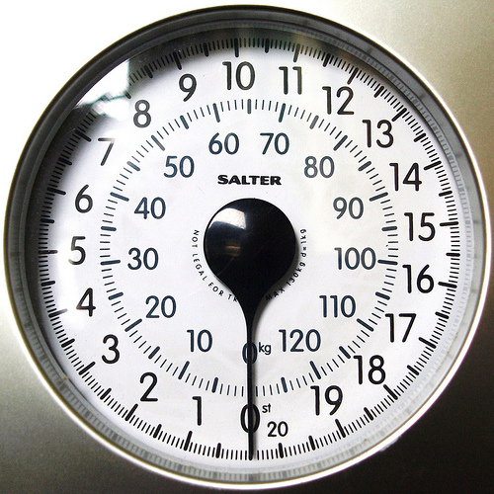
Case 1
56 year old woman
6 months of unintended weight loss - 5kg. Appetite unchanged
Fatigue - attributes this to stress at work
No cough/dyspnoea
Ex-smoker - stopped 10 years ago
Normal chest/abdo exam
Weight 74kg, BMI 28.5. No other recent record of weight
What would you do?
This Photo by Unknown Author is licensed under CC BY-NC-SA

Slide 22
Case 1
FBC shows mild leucocytosis = 12
All other blood tests normal
What now?

Slide 23
Case 1
She returns 3 weeks later
She has lost more weight (now 72kg) and has lost her appetite. No other new symptoms
Examination reveals a mass ?lymphadenopathy in the left supraclavicular fossa and some obvious enlarged nodes in left side of the neck
What next?

Slide 24
Nice Urgent Suspected Lung Cancer Guidance
Urgent suspected cancer referral if
40+ with unexplained haemoptysis
CXR suggestive of lung cancer
Urgent x-ray in people 40+ if 2 unexplained symptoms (never smokers) or 1 unexplained symptom (current/ex smokers)
cough
sob
fatigue
chest pains
weight loss
appetite loss
Consider urgent x-ray in people 40+ if
Persistent/recurrent chest infection
finger clubbing
supraclavicular lymphadenopathy or persistent cervical lymphadenopathy
thrombocytosis

Slide 25
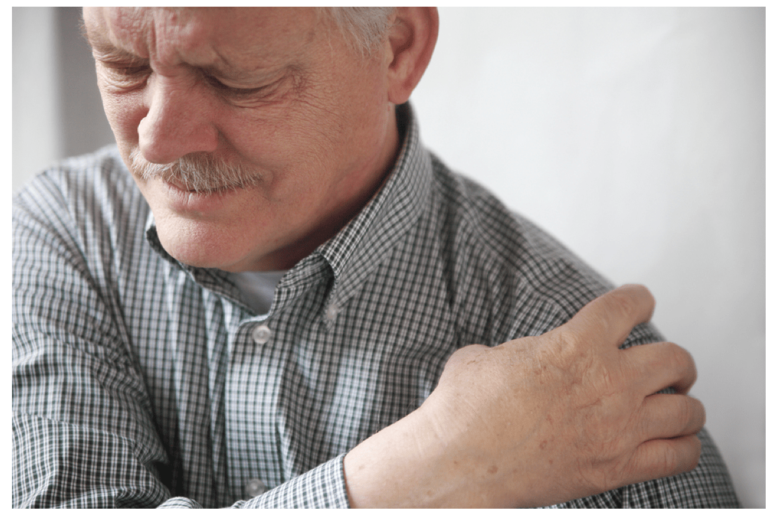
Case 2
71 year old man
8 weeks constant, severe pain in the right shoulder radiating beneath scapula and into axilla
Exacerbated by walking, sitting, turning in bed.
Grip weakness and loss of dexterity but no arm pain/ paraesthesia.
Chest tightness
Reduced appetite and sleep disturbance
Heavy smoker. Aortic valve replacement. Asthma

Slide 26
Case 2
Normal shoulder exam
No neurological deficit in the upper limbs
Cervical/thoracic spine movements restricted and painful
Pain when palpating upper thoracic spinous processes and the facet/rib joints
Chest auscultation normal. RR30. Sats 95%

Slide 27
Case 2
Booked in for asthma review
Referred to community MSK clinic
Isotope bone scan
Large soft tissue mass posteriorly in the apex of the right lung with chest wall extension and destruction of adjacent ribs
No increased uptake anywhere else to suggest metastases
Pancoast tumour

Slide 28
Horner’s syndrome

Slide 29
Why was this unusual?
No mechanical pain pattern. Pain reported on resting and walking
Normal shoulder examination
Severe/prolonged pain
Constitutional/non MSK symptoms

Slide 30
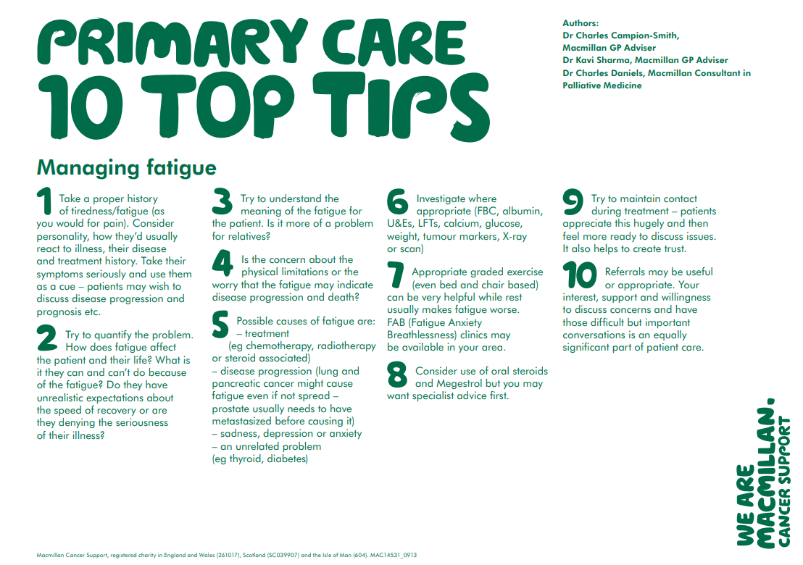

Slide 31
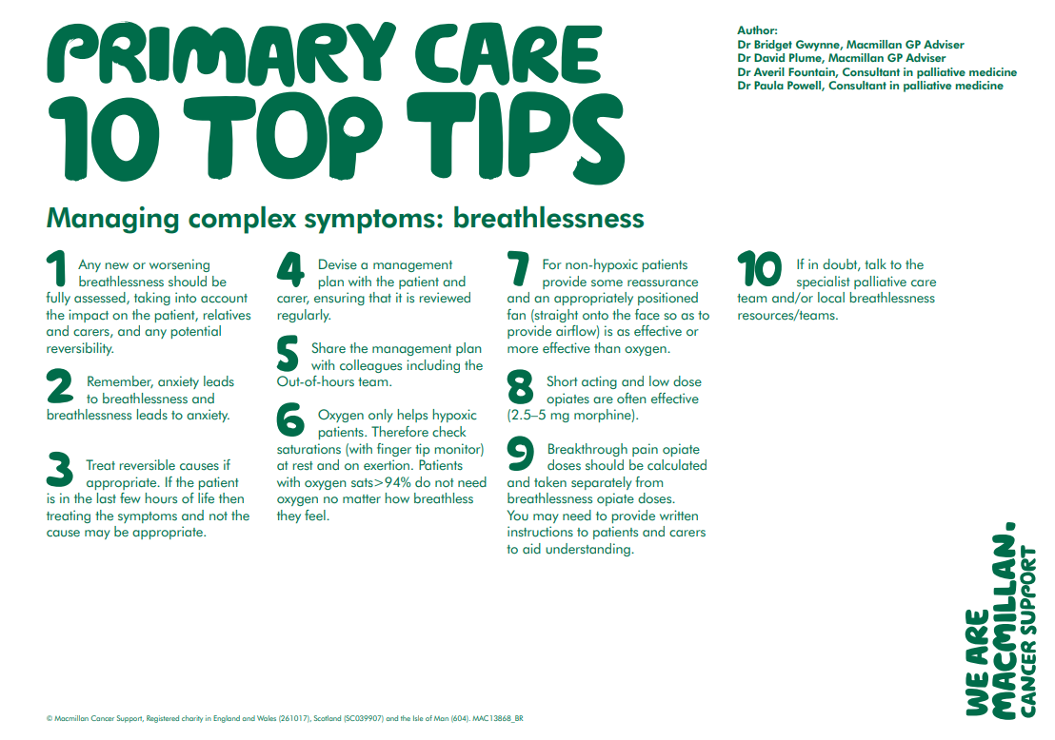

Slide 32
CPD & resources
National General Practice Profiles
https://fingertips.phe.org.uk/profile/general-practice/data#page/3/gid/1938133086/pat/152/par/E38000214/ati/7/are/H81006/iid/91350/age/1/sex/4
NICE suspected cancer referral guidance 2015 – lung
https://www.nice.org.uk/guidance/ng12/chapter/1-recommendations-organised-by-site-of-cancer#lung-and-pleural-cancers
Cancer Research UK – Health Professionals
http://www.cancerresearchuk.org/health-professional
CPD and courses
http://www.cancerresearchuk.org/health-professional/learning-and-ways-we-can-support-you

Slide 33
CPD & resources cntd
Behaviour change and cancer prevention RCGP/CRUK
http://elearning.rcgp.org.uk/course/search.php?search=behaviour+change
Lung cancer and immunotherapy
http://scienceblog.cancerresearchuk.org/2017/06/27/lung-cancer-discovery-points-to-a-better-way-to-personalise-immunotherapy/
Lung cancer information for patients
http://about-cancer.cancerresearchuk.org/about-cancer/lung-cancer

Slide 34
CPD & resources
RCGP/Macmillan consequences of cancer toolkit (helping you to help your patients living with and beyond cancer)
http://www.rcgp.org.uk/clinical-and-research/toolkits/consequences-of-cancer-toolkit.aspx
Macmillan revalidation toolkit (learning modules to improve quality of cancer care in primary care)
https://www.macmillan.org.uk/_images/revalidation-toolkit_tcm9-291970.pdf
Macmillan Learn Zone (e-learning and some free to attend courses relevant to cancer and end of life care)
http://learnzone.org.uk/professionals/

Slide 35
Thank you for listening Debbie and Alex
Debbie Bell
Cancer Research UK Facilitator
Surrey
Debbie.bell@cancer.org.uk
Alessandra Dale
Macmillan GP
Guildford and Waverley CCG
alessandra.dale@nhs.net

